Slide 1





Implementing the Strategic Action Programme for the South China Sea and Gulf of Thailand (SCS SAP) Project
Second Meeting of the Regional Working Group on Land-Based Pollution (RWG-LBP)
11-12 November 2024, Shenzhen, China
Status and Progress of the SCS SAP Project implementation
at Regional and National Level
PROJECT COORDINATION UNIT

Slide 2
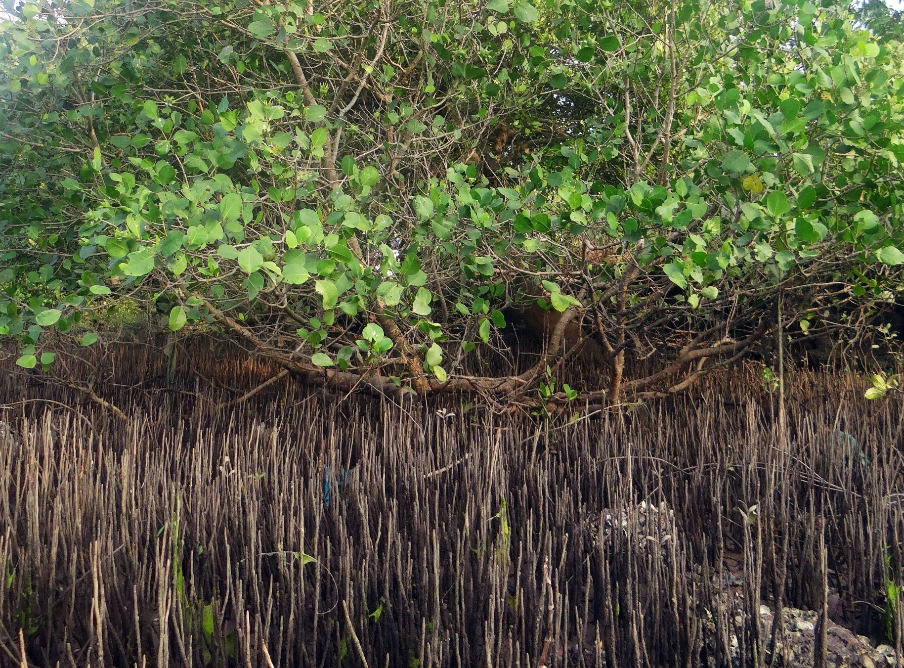
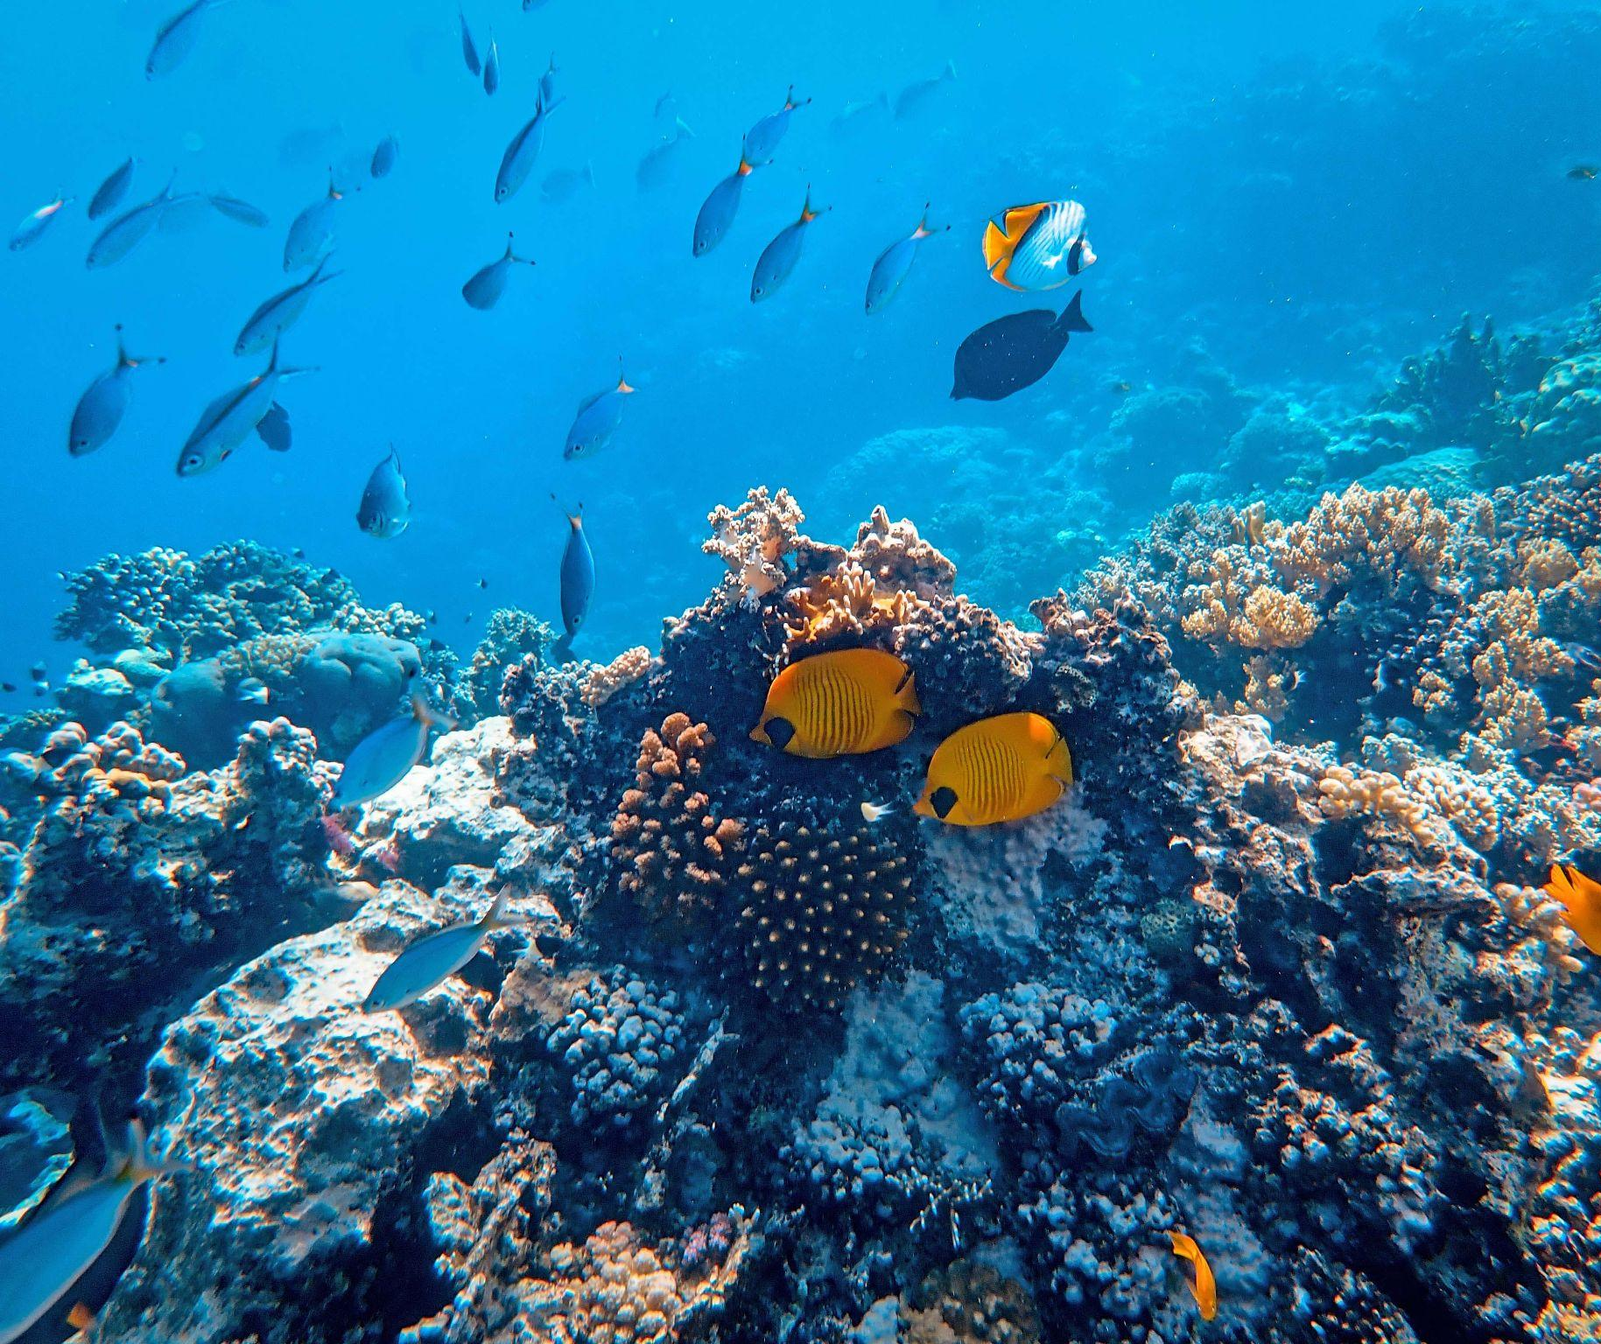
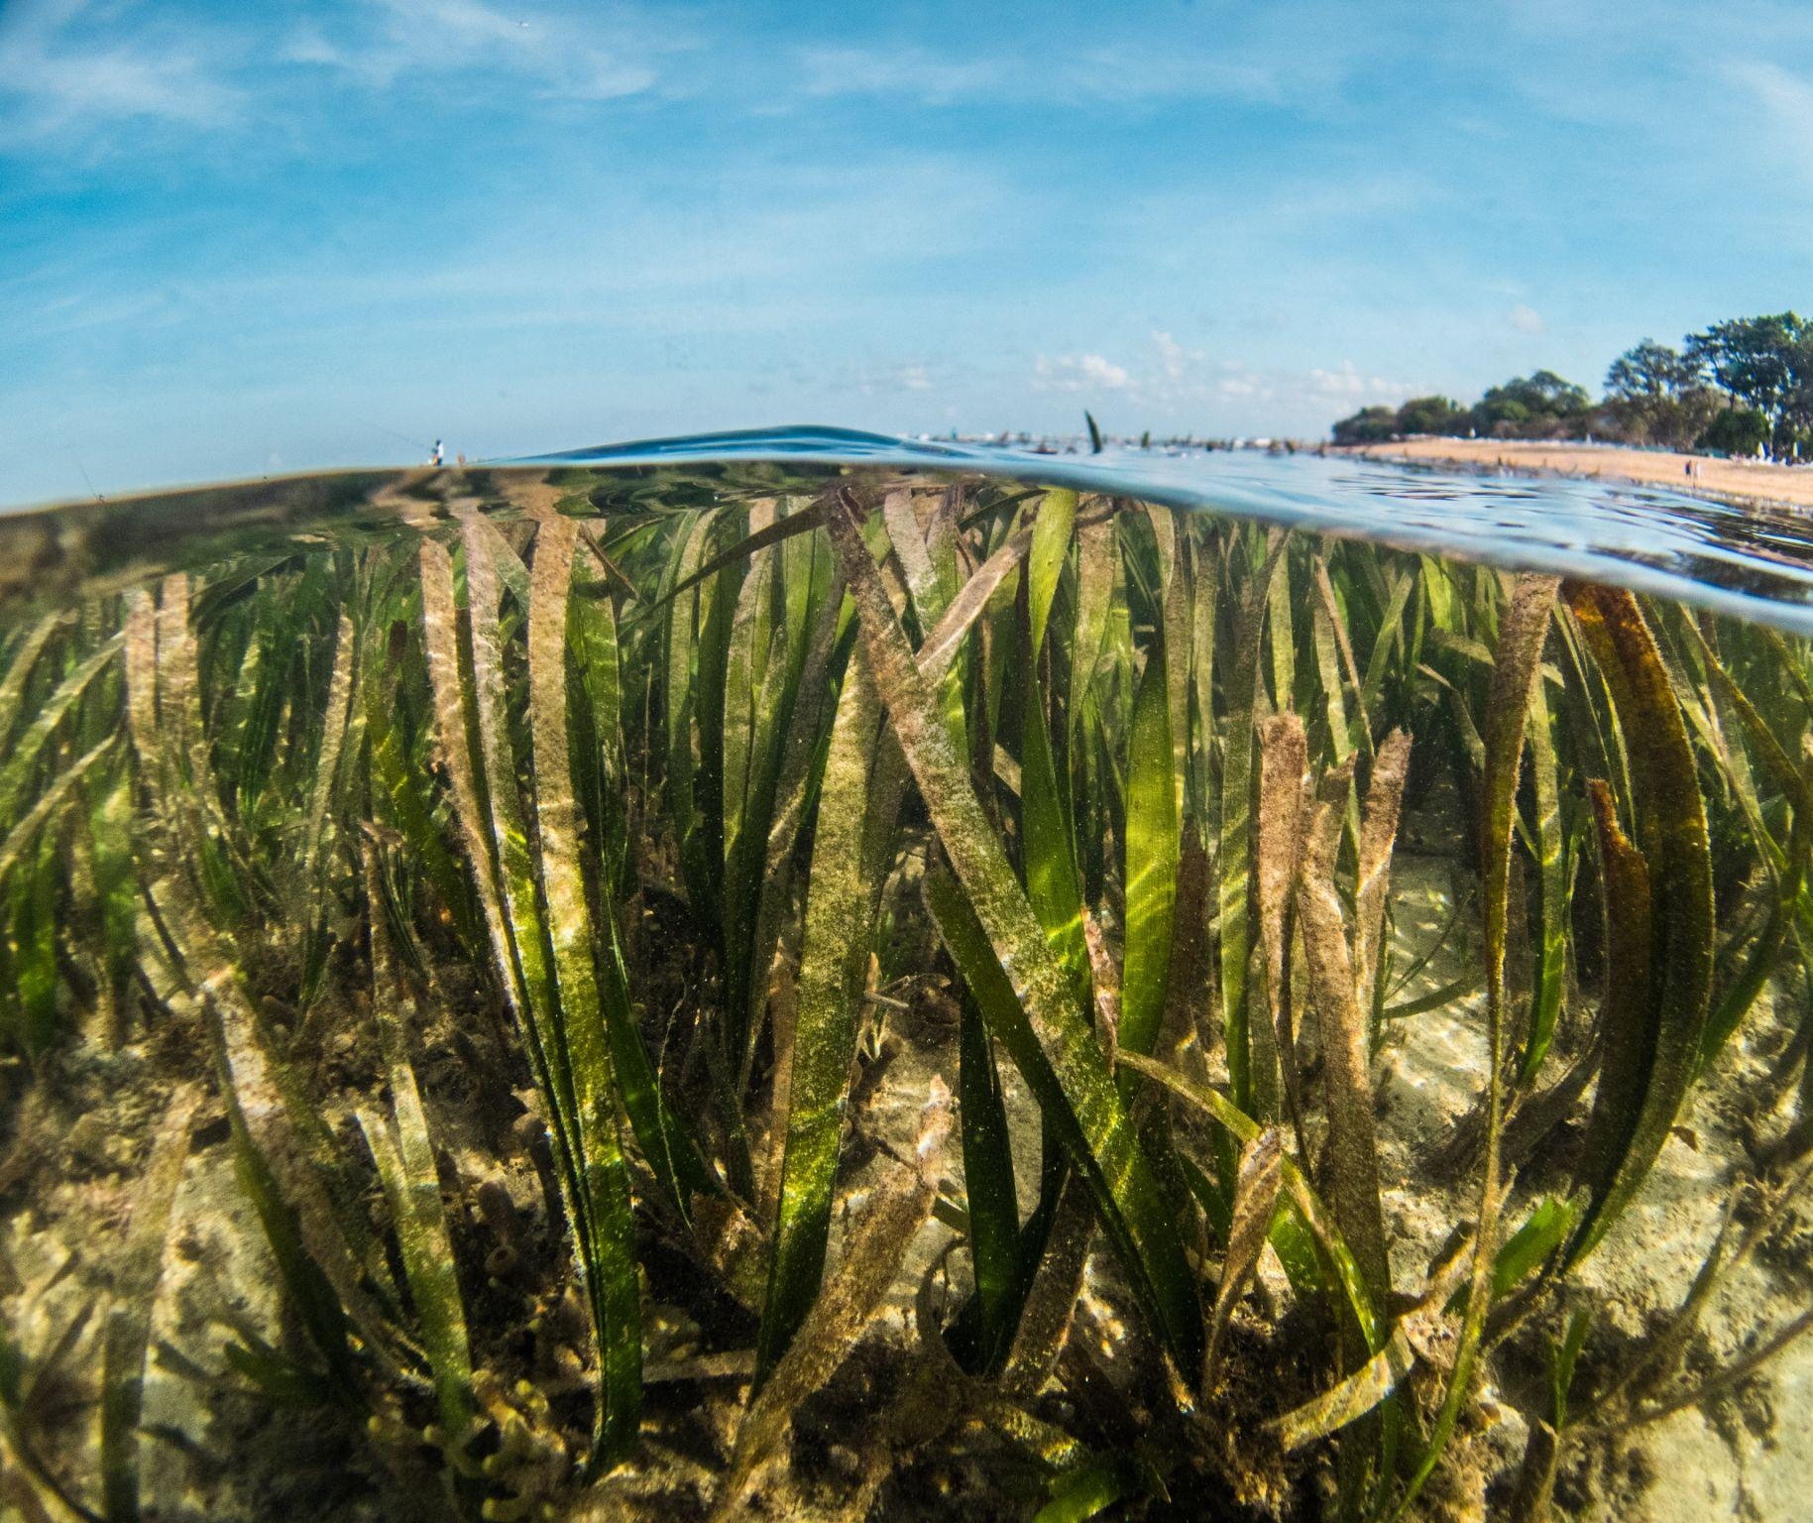
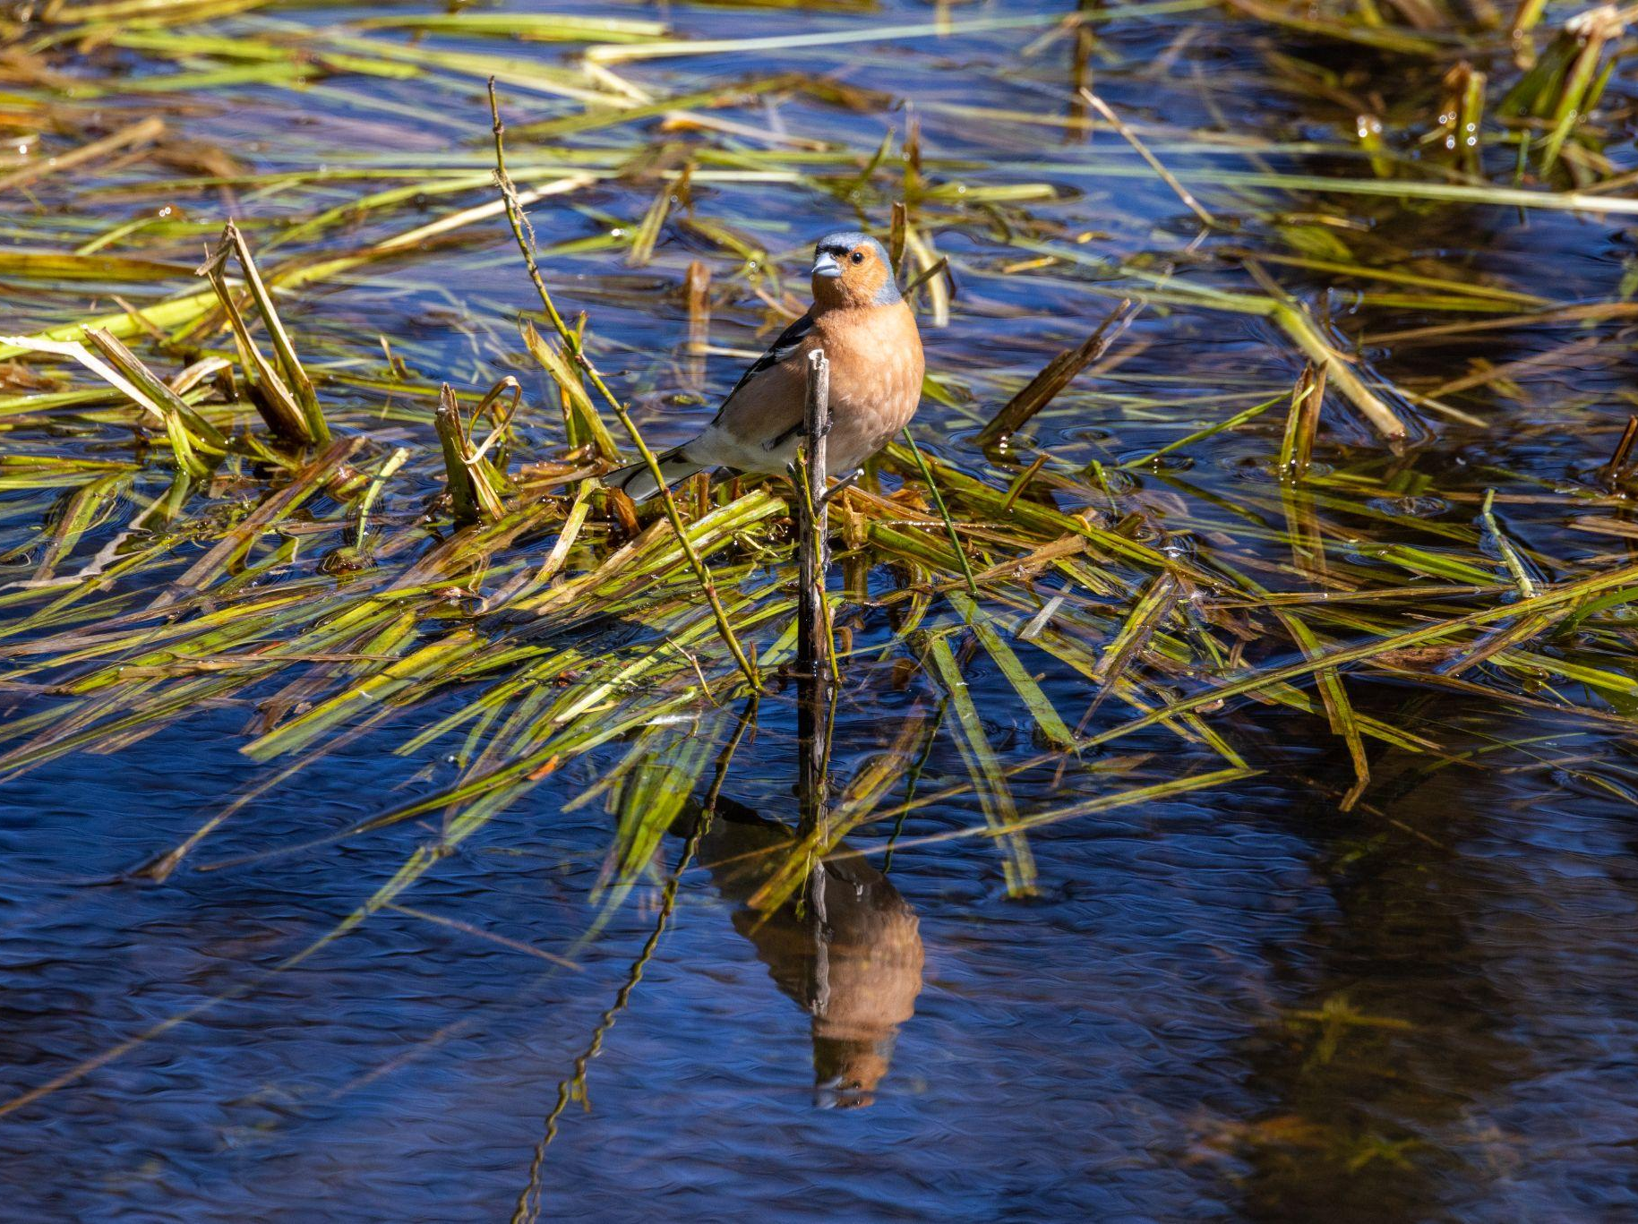
1. Project Approval and Implementation
Project endorsed by the GEF in November 2016
Project implementation began in April 2018
Executing Agencies:
United Nations Office for Project Services (UNOPS) – national activities
Southeast Asian Fisheries Development Center (SEAFDEC) - regional activities
Inception Phase implementation commenced in April 2020 with the engagement of the Project Inception Team assisted by regional and national consultants and teams

Slide 3
2. Project Inception Phase – April 2020 – July 2021
Elaborated the regional and national activities of the project, in close consultation with the implementing and executing agencies together with national and regional partners
Implementation impacted by the COVID-19 crisis – travel restrictions
Drafted the Regional Implementation Report and the National Implementation Reports
30 July 2020: First Regional Inception Phase Online Meeting

Slide 4
2. Project Inception Phase – April 2020 – July 2021
4 December 2020: Second Inception Phase Online Meeting
15 March 2021: Third Inception Phase Online Meeting
29-30 June 2021: First Project Steering Committee (PSC) Meeting – discussed and approved the Regional Implementation Report, revised work plans and budgets, no-cost project extension until 2024
1 July 2021: SCS SAP Project Inception Workshop to present and launch the project. Signals the end of the inception phase and start of the implementation phase.

Slide 5
3. Project Implementation Phase – July 2021 onwards
Despite the challenges of COVID-19, all partners and national teams were able to initiate actions:
National teams organized internal coordination and consultations with concerned agencies and institutions to discuss the project and implementation phase activities
Review and confirmation of national focal points of different project bodies including memberships
Review and confirmation of intervention sites and targets

Slide 6
3. Project Implementation Phase – July 2021 onwards
Review and updating for publication:
1) Draft National Implementation Reports,
2) Draft Report on Habitats and Land-based Pollution Achievements in Implementing the SAP at the National Level During 2008 – 2021, and
3) Good practices on habitats, fisheries and land-based pollution management
Organized bilateral meetings and calls with regional organizations, projects and initiatives on possible synergies and collaboration and participated in various regional and national meetings, conferences and events

Slide 7
3. Project Implementation Phase – July 2021 onwards
Project Cooperation Agreements (PCAs) with Cambodia, China, and Thailand for national execution of Component 1 have been signed in late 2022 and amended in June 2023 and June 2024
Cambodia - Ministry of Environment (MOE)
China - South China Institute of Environmental Sciences (SCIES)-Ministry of Ecology and Environment (MEE)
Thailand - Department of Marine and Coastal Resources (DMCR)-Ministry of Natural Resources and Environment (MONRE)

Slide 8
3. Project Implementation Phase – July 2021 onwards
Project Cooperation Agreements (PCAs) with Indonesia, Philippines and Vietnam have been delayed due to national events resulting to government restructuring, change of leaderships and mandates of agencies that would execute the project, and the internal consultation, coordination and approval process
Indonesia - Ministry of Environment and Forestry (MOEF)
Philippines - Department of Environment and Natural Resources (DENR)
Vietnam - Ministry of Natural Resources and Environment (MONRE)

Slide 9
3. Project Implementation Phase – July 2021 onwards
Indonesia
Grant Support Agreement (GSA) with the Bogor Agricultural University-Center for Coastal and Marine Resources Studies finalized and being reviewed by PCU
Memorandum of Understanding (MOU) between UNOPS and Ministry of Environment and Forestry (MOEF) finalized and signed by UNOPS and awaiting signature by MOEF
Philippines
Grant Support Agreement (GSA) with the Society for the Conservation of Philippine Wetlands (SCPW) finalized and being processed for approval by UNOPS

Slide 10
3. Project Implementation Phase – July 2021 onwards
Vietnam
Project Cooperation Agreement (PCA) with Vietnam Environment and Marine Science Institute (VEMSI), being finalized for submission to PCU. Project is awaiting approval by the government
Thailand
- Project Cooperation Agreement (PCA) with Pollution Control Department (PCD) for Components 2 and 3 implementation, being finalized for submission to PCU

Slide 11
3. Project Implementation Phase – July 2021 onwards
National Coordinators for Cambodia, China, Indonesia, Philippines, Thailand and Viet Nam were recruited and continued to provide project management and technical support to the project and national teams
First Regional Working Group (RWG) Meetings (Virtual)
1 December 2021: RWG on Mangroves
2 December 2021: RWG on Coral Reefs
3 December 2021: RWG on Seagrass
7 December 2021: RWG on Wetlands
13 December 2022: RWG on Land-Based Pollution

Slide 12
3. Project Implementation Phase – July 2021 onwards
17-19 October 2022: First Regional Scientific and Technical Committee (RSTC) Meeting in Bangkok, Thailand
16 December 2022: Withdrawal of SEAFDEC as executing agency
30-31 January 2024: Second Project Steering Committee (PSC) Meeting – discussed and approved the new execution modality with UNOPS as sole executing agency, revised overall work plans and budgets, no-cost project extension until 2026
22-24 April 2024: SCS SAP Special Forum and Roundtable Meeting in Bangkok, Thailand in collaboration with UNESCO/IOC Sub-Commission for the Western Pacific (WESTPAC)
26 June 2024: First Regional Task Force on Economic Valuation (RTF-EV) Meeting

Slide 13
3. Project Implementation Phase – July 2021 onwards
23-25 July 2024: Second Regional Scientific and Technical Committee (RSTC) Meeting in Bangkok, Thailand
21-26 September 2024: 10th GEF Biennial International Waters Conference (IWC10) in Montevideo/Punta del Este, Uruguay
4 October 2024: SCS-SAP Project Office established at the Faculty of Fisheries of Kasetsart University, Thailand
21-25 October 2024: SCS-SAP-COBSEA Integration Meetings in Siem Reap, Cambodia (2nd WGMCE, 6th WGML, 26th IGM)
6-8 November 2024: PEMSEA EAS Congress 2024 in Xiamen, China

Slide 14
Implementing the Strategic Action Programme for the South China Sea and Gulf of Thailand (SCS SAP) Project
THANK YOU!

