Slide 1
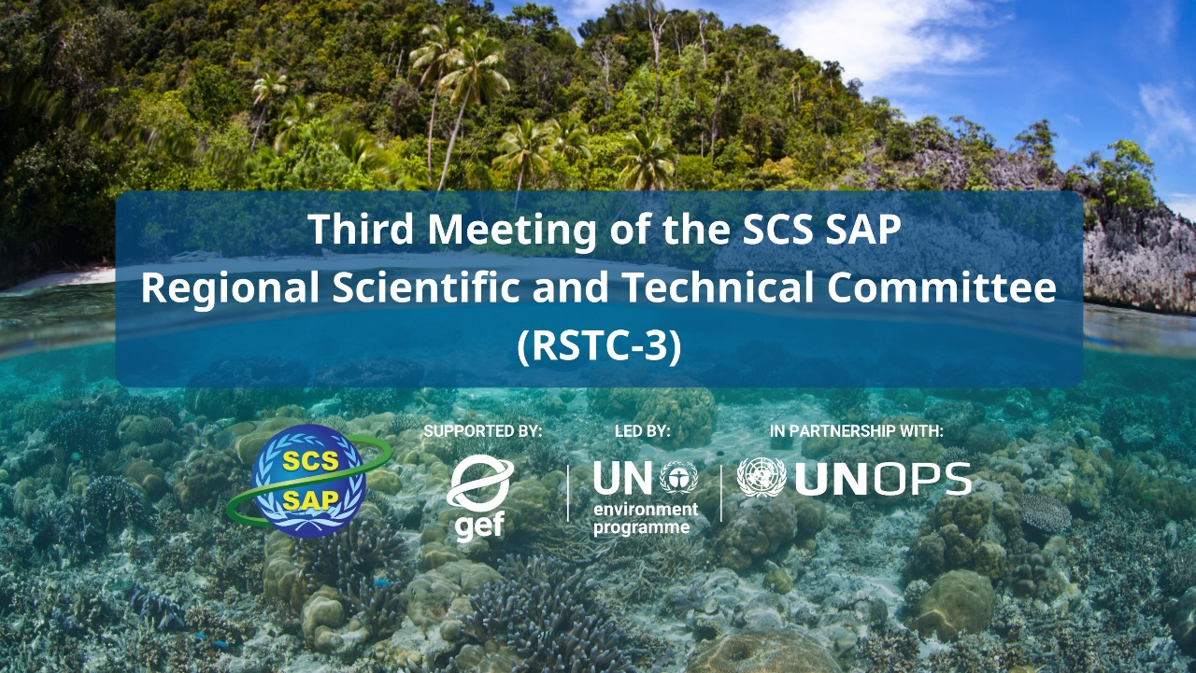
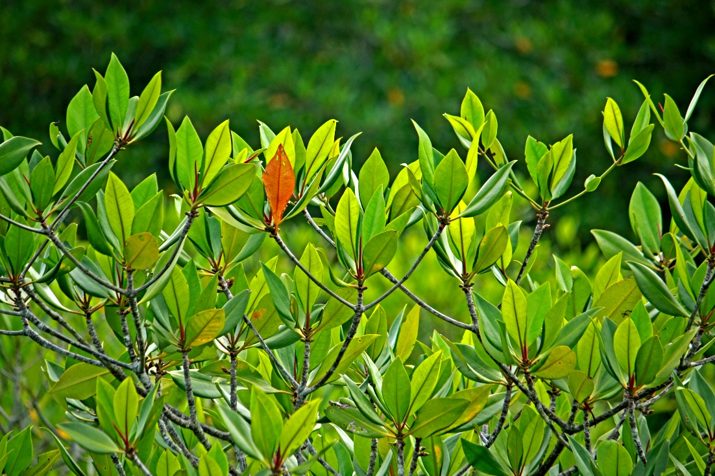
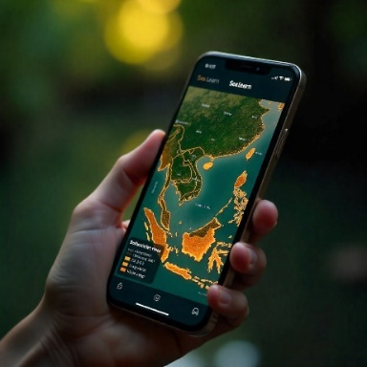
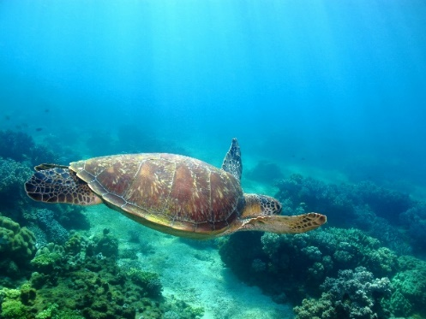
RSTC3 Meeting
26-28 Jan 2026
Phú Quốc
FINAL DRAFT
Summary of achievements in implementing the SAP for the South China Sea and Gulf of Thailand on habitat management during 2008-2021
Vo Si Tuan, Regional Science Coordinator &
[Name-TBD], National Coordinators?

Slide 2
Table 1. Mangrove SAP targets and summarized achievements in implementing the SAP until 2021
Regional targets (SAP, 2008) | Cambodia | China | Indonesia | Philippines | Thailand | Viet Nam | Total & % compared the target
Output 1.1.1 Declaration of 57,400 ha of mangrove as National Parks and Protected Areas | 9,351 | 0 | 33,235 | 0 | 0 | 0 | 42.586ha 74.2%
1.1.2 Designation and plans for the management of 166,600 ha of mangrove as non-conversion, sustainable use areas | 24,627 | N/A | 74,459 | N/A | N/A | 8,900 | 107,986ha 64.8%
1.1.3 Reform of laws and regulations for the sustainable use of 602,800 ha of mangrove forest | N/A | 5,431 | 32,328 | 6,059 | 36,027 | 93,675 | 173,520ha 28.8%
1.1.4 Replanting of 21,000 ha of deforested mangrove land | 104 | 680.8 | 5,000 | 784 | 7,009 | 1,103 | 14,680.8 69.9%
1.1.5 Biodiversity increased for 11,200 ha of mangrove forest via enrichment planting | N/A | 3,907 | N/A | N/A | N/A | N/A | 3,907ha 34.9%
1.1.6 Established mechanism for monitoring management, ecological and socio-economic indicators at 26 sites [based on SAP results framework] | N/A | 5 | 5 | 4 | N/A | N/A | 14 sites 53.8%

Slide 3
Table 2. Coral reef SAP targets and summarized achievements in implementing the SAP until 2021
Regional targets (SAP, 2008) | Cambodia | China | Indonesia | Philippines | Thailand | Viet Nam | Total & % compared with the targets
1.2. 110,430 ha of coral reef at 46 priority sites managed sustainably (ha) | 1,854 | 20,891 | 18,100 | 4,821 | 54,423 | 2,937 | 103,026ha 93.3%
1.2.1 Management capacity (number/levels human resources, facilities and equipment, and sustainable financing mechanisms) built for 46 coral reef sites | 6 | 3 | 7 | 4 | 5 | 8 | 33 sites 71.7%
1.2.2 Management approaches (integrated, community-based, multiple use) improved at 46 coral reef sites | 7 | 3 | 7 | 4 | 11 | 2 | 34 sites 73.9%
1.2.3 Management tools (licensing and permit systems, seasonal closures, zoning) developed and utilized to address key threats at priority sites | 4 | 3 | 7 | 4 | 4 | 8 | 30 sites 65.2%
1.2.4 Established mechanism for monitoring management, ecological and socio-economic indicators at 46 sites [based on SAP results framework] | 4 | 3 | 7 | 4 | 11 | 8 | 37 80.4%
Targets (ha and sites) for management of SAP (2008) | 2,260 (7) | 0 | 18,091 (7) | 12,500 (9) | 72,000 (14) | 5,570 (9) | 46 sites

Slide 4
Table 3. Seagrass SAP targets and summarized achievements in implementing the SAP until 2021
Regional targets (SAP, 2008) | Cambodia | China | Indonesia | Philippines | Thailand | Viet Nam | Total & % compared with the targets
1.3.1 Twenty seagrass areas totaling 26,036 ha under sustainable management with supporting laws and regulations | 6,793 | 1,893 | 1,775 | 2,879 | 2,534 | 9,196 | 25,070ha 96.3%
1.3.2 Amended management plans for 7 existing MPAs with significant seagrass areas, to include specific seagrass-related management actions and policy, legal and institutional reforms | 0 | 3 | 0 | 0 | 1 | 1 | 5 71.4%
1.3.3 Designation of 7 new Marine Protected Areas focusing on seagrass areas identified in the prioritized listings of the SCS Project | 2 | 0 | 1 | 1 | 2 | 2 | 8 114.3%
1.3.4 Established mechanism for monitoring seagrass habitat management for 20 sites | 2 | 3 | 1 | 2 | 3 | 2 | 14 70%
Targets (ha & site) of the SAP adopted in 2008 | 11,446 (2) | 1,960 (4) | 2,420 (7) | 6,920 (3) | 0 | 5,050 (4) | 20 sites

Slide 5
Table 4. Wetland SAP targets and summarized achievements in implementing the SAP until 2021
Regional targets (SAP, 2008) | Cambodia | China | Indonesia | Philippines | Thailand | Viet Nam | Total & % compared with the targets
1.4.1 Integrated management plans developed and under implementation for at least 2 lagoons (21,818 ha), 10 estuaries (639,418 ha), 5 tidal flats (96,903 ha), 1 peat swamp (45,700 ha) and 1 non-peat swamp (9,808 ha) (813.647ha in total) | 12,000 | 20,276 | 267, 592 | 152,506 | 161,682 | 93,645 | 564,012ha 66.9%
1.4.2 Declaration of 7 wetland areas with protection status (i.e. non-hunting area, nature reserves, protected areas, Ramsar Sites) | 0 | 4 | 1 | 2 | 1 | 2 | 10 sites 142.9%
1.4.3 Adoption of a regional monitoring scheme and its national implementation (19 sites) | 1 | 2 | 1 | 3 | N/A | N/A | 7 sites 36.8%
Targets (ha & site) of the SAP adopted in 2008 | 12,000 (1) | 20,276 (6) | 267, 592 (1) | 54,515 (3) | 55,508 (2) | 264,110 (6) | 19 sites

Slide 6
MPAs and OECMs established or upgraded during 2008-2021
4
10

Slide 7
MPAs and OECMs established or upgraded during 2008-2021
7
10

Slide 8
MPAs and OECMs established or upgraded during 2008-2021
6
9

Slide 9
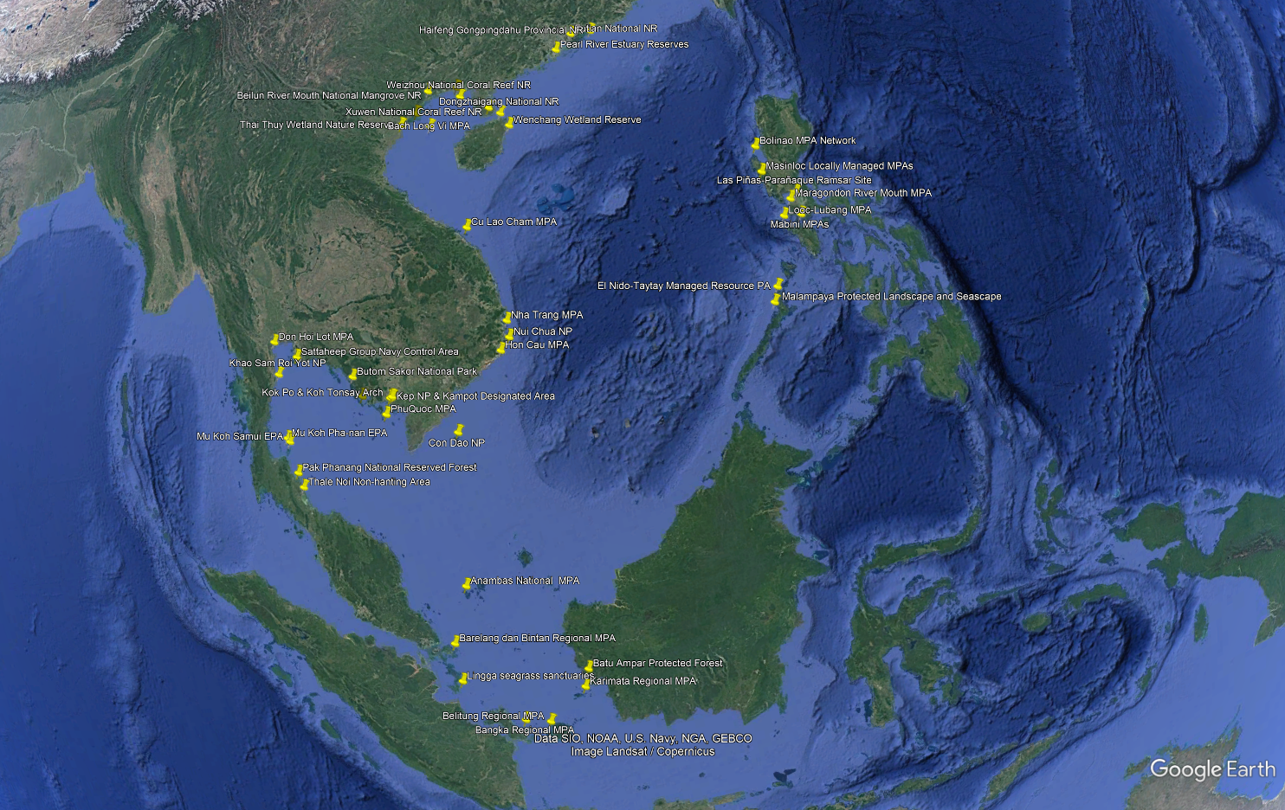
Map indicating MPAs & OECMs established or upgraded during 2008-2021

Slide 10
Cumulative achievements in implementing the SAP | MG | CR | SG | WL
Total SCS SAP sites (5 countries) | 16 | 13 | 12 | 10
SCS SAP added sites (excluding sites where the SAP implementation reported for 2008-21) & their habitat area (ha) | 10 | 2 | 1 | 3
Kep Beach and Koh Tonsay and Koh Pou archipelagos |  | 67.83
Prek Sihanouk | 6,500 |  |  | 1,800
Cambodia replanting | 420
Huidong, Guangdong | 150
Yangjiang, Guangdong | 7,200
Zhanjiang, Guangdong | 390
Dahu, Guangdong |  |  |  | 6.877.9
Maoweihai, Guangxi |  |  |  | 4,222.9
China replanting | 500
Busuanga | 1,619 | 1,920
Coron | 2,739
Bandon Bay | 8,371 |  | 6,700
Koh Mak |  | 1,400
Thailand replanting | 220
Total under added management by SCS SAP project (ha) | 26,967 | 3,387.8 | 6,700 | 12,900.8
SAP implementation during 2008-2021 (ha), 6 countries | 107,986 | 103,026 | 25,070 | 564,012
Total implementation until 2026 (ha), 6 countries | 134,953 | 106,414 | 31,770 | 576,913
Total SAP targets (ha), 6 countries | 166,600 | 110,430 | 26,036 | 813,647
% achieved compared to the 2008 targets | 81.00 | 96.36 | 122.02 | 70.90
Total mangrove planting | 1,140 + 14,680.8 (20028-21) = 75.33%
Reforms of laws & regulations for mangroves (noting that country reports mainly for SAP target sites but not the national level) | Additional 51,654ha, around 35% (per 682,899ha) in total

Slide 11
MPAs & OECMs in the participating countries
Country | No. | MG | WL | CR | SG
Cambodia | 8 | 23,210.0 | 480.0 | 1,700.0 | 13,070.0
China | 22 | 13,925.6 | 69,658.0 | 6,965.9 | 1,501.7
Indonesia | 13 | 162,091.2 | 312,052.0 | 24,651.9 | 16,529.6
Philippines | 13 | 10,248.7 | 236,912.6 | 8,882.6 | 4,729.5
Thailand | 15 | 22,720.9 | 62,308.0 | 28,340.8 | 9,234.0
Vietnam | 14 | 92,067.0 | 6,560.0 | 3,884.3 | 7,297.0
Total Existing All | 85 | 324,263.4 | 687,970.6 | 74,425.5 | 52,361.8
Newly established during 2008-2025 | 24 | 52,341 | 59,352 | 13,649 | 16,896
% |  | 16.14 | 8.63 | 18.34 | 32.27

Slide 12
RSTC members are invited to:
Review the final draft of regional summary of achievements in implementing the SAP during 2008-2021 on habitats (Meeting Document: SCSSAP RSTC 3/6)
Provide additional and/or adjusted inputs for final revision
Advise next steps for publication of the regional summary (online, technical publication…)
Advice how to finalize the achievement report on LbP, taking into account the agreement in the 3rd RWG-LbP meeting to provide additional inputs for the entire period between 2008-2026 (but not yet done)
THANK YOU

