Slide 1

Third Meeting of the Regional Scientific and Technical Committee (RSTC-3)
UNEP/GEF Implementing the Strategic Action Programme for the South China Sea and Gulf of Thailand (SCS SAP)
Synergies and Convergence
with COBSEA
26-28 January 2026
Phu Quoc, Viet Nam

Slide 2
SCS SAP: SYNERGIES AND CONVERGENCE
COBSEA
Regional Working Groups (RWGs)
Regional Scientific and Technical Committee (RSTC)
TDA and SAP processes
SEA: PUFFER
SEA: LEARN
Transboundary Project

Slide 3
SCS SAP: SYNERGIES AND CONVERGENCE
COBSEA
Regional Working Groups (RWGs)
Regional Scientific and Technical Committee (RSTC)
TDA and SAP processes
SEA: PUFFER
SEA: LEARN
Transboundary Project
Sustainability Options & COBSEA Task Force
2026
2027

Slide 4

SCS SAP: SYNERGIES AND CONVERGENCE
COBSEA
Regional Working Groups (RWGs)
Regional Scientific and Technical Committee (RSTC)
TDA and SAP processes
Working Group on Marine and Coastal Ecosystems (WGMCE)
SEA: PUFFER
SEA: LEARN
Transboundary Project
Intergovernmental Meeting (IGM)
Sustainability Options & COBSEA Task Force
2026
2027

Slide 5
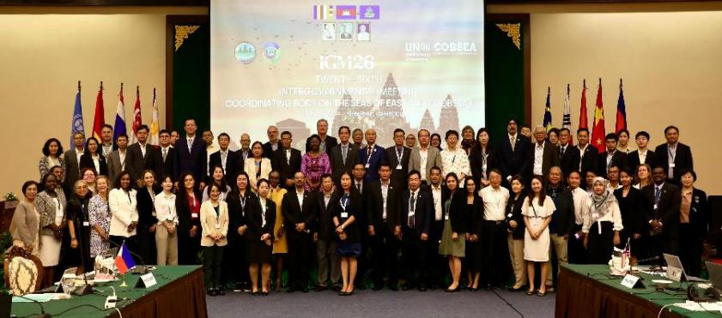
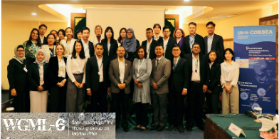
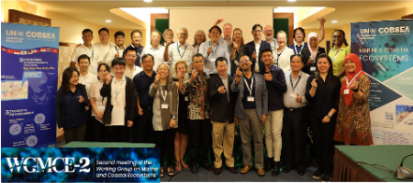
COBSEA Governance
COBSEA Intergovernmental Meetings (IGMs)
Working Group on Marine Litter (WGML) - RAP MALI (2019)
Working Group on Marine and Coastal Ecosystems (WGMCE) - MCE Framework (2023)
Notes:
As an intergovernmental body bringing nine countries together in the East Asian Seas region, COBSEA’s work is based on the approved biennial workplan by the Intergovernmental Meetings, or IGMs of COBSEA, every two years.
Besides IGMs, COBSEA has two Working Groups. Working Group on Marine Litter support achieving the COBSEA Regional Action Plan on Marine Litter, or RAP MALI. Working Group on Marine and Coastal Ecosystems supports the implementation of the COBSEA Marine and Coastal Ecosystems Framework. The Working Group meetings happen annually to exchange the progress of the biennial workplan each and to discuss the challenges and priorities.

Slide 6

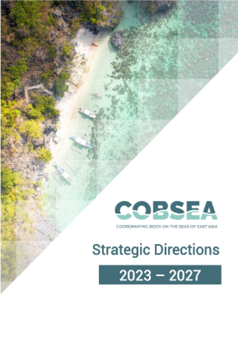
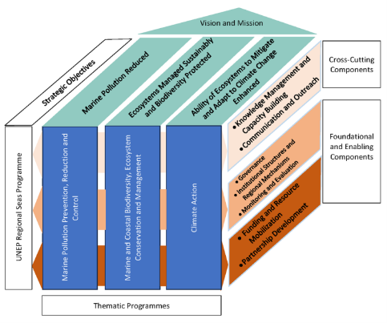



COBSEA Strategic Directions 2023-2027
Adopted in 2023, guides COBSEA initiatives across 3 thematic programmes
1 Marine Pollution Prevention, Reduction and Control
Marine litter, Plastic pollution
Nutrients, sediments
2 Marine & Coastal Biodiversity, Ecosystems Conservation and Management
Sustainable Blue Economy
MSP, MPAs, OECMs, habitats
3 Climate Action
Climate adaptation and resilience
Blue Carbon
Notes:
Under the COBSEA Strategic Directions, we work across 3 thematic areas: 1-Addressing Marine Pollution, including plastic, ghost gear, and nutrients; 2- Protecting Marine & Coastal Biodiversity, Ecosystems Conservation and Management; and 3-Climate Action; like blue carbon and coastal resilience.
For today, we’re going to focus on this second thematic area --

Slide 7


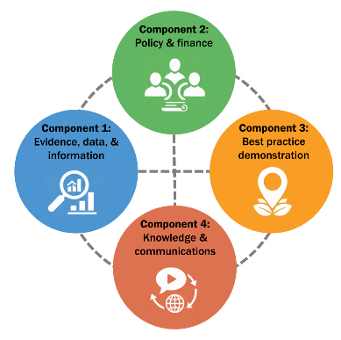
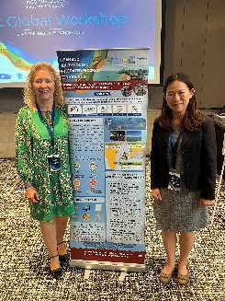
2026 Nutrients Pollution outlook
COBSEA Collaborative Action Framework on Nutrients Management
adopted during IGM26
(Oct 2024, Seam Reap, Cambodia)

Slide 8
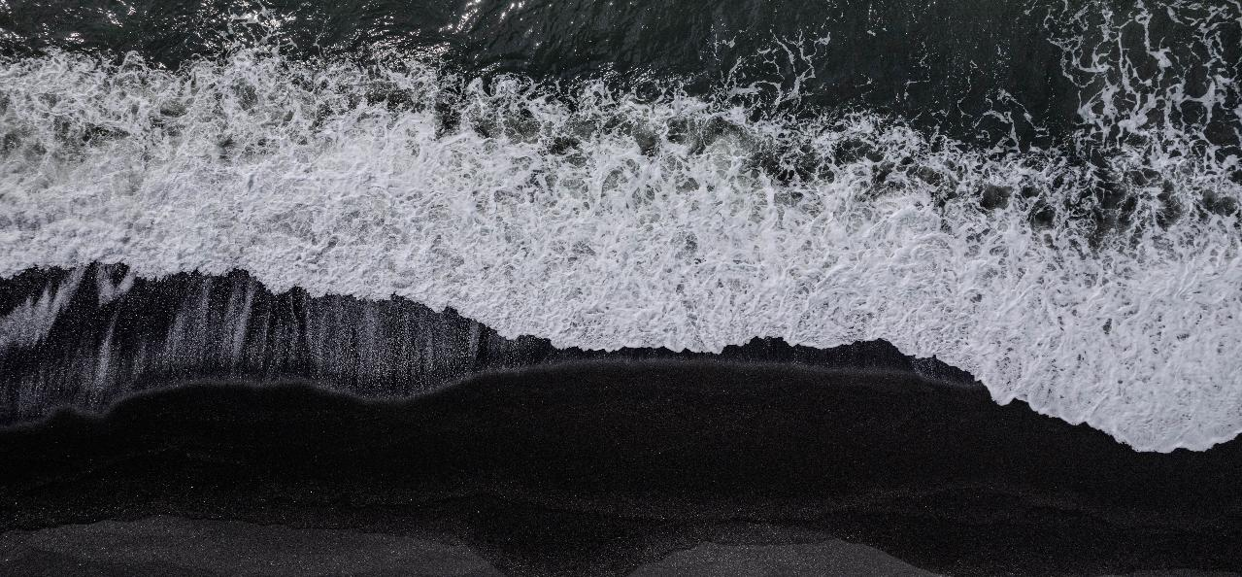





2026 Marine and Coastal Ecosystems outlook
WGMCE-4
Possible integration options from the SCS-SAP RWGs (Pros and Cons)
Reconfirm: WGMCE members and partner experts
GEF Blue SMEs PPG
Exploring linkages with UNEP FI
SOI Workshop in the Philippines
Regional MSP Workshop
SEASCAPES
KBF Inception and Implementation
Global MPA Network Fundraising
CORI / Asia MPA Congress
OECM Videos
EAS MPA Network Monthly Meetings
30x30 Reef Revival Inception (tbd)
MERMAID Discovery Webinar
GCRMN Validation Workshop
Country review for GCRMN report (tbd)

Slide 9

























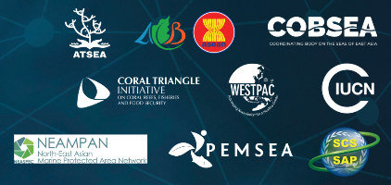








Strategic Partnerships
Overall:
Marine Litter:
Nutrients:
Ocean-based climate action:
Marine and Coastal Ecosystems:

Slide 10
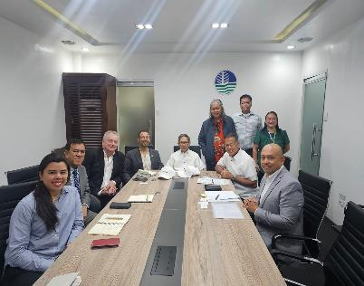


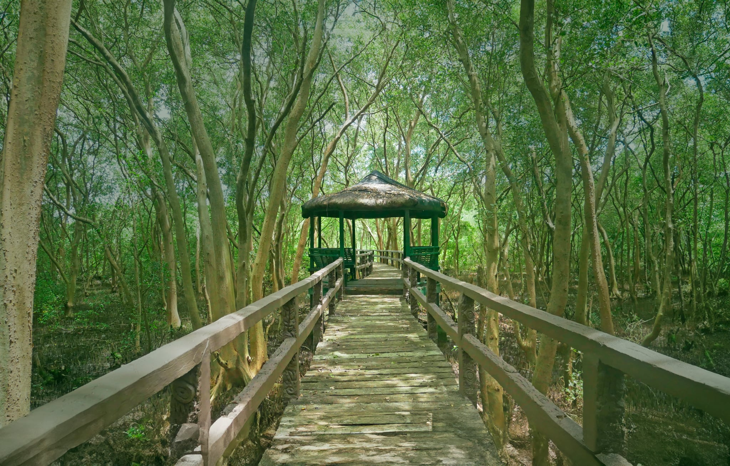
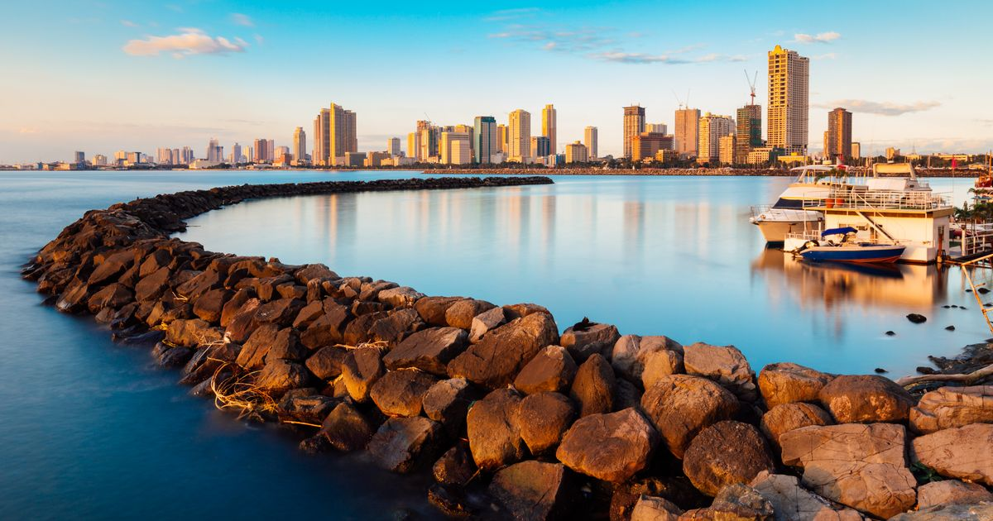
Towards IGM 27...
25-27 Nov (tbc), Manila, Philippines
24 Nov (tbc) Field trip: Las Pinas Paranaque Wetland Park
23-24 Nov (tbc): WGML8 COBSEA RAP MALI - on Marine Litter
23-24 Nov (tbc): WGMCE4 COBSEA Marine and Coastal Ecosystems
Task Force Recommendations on Strengthening of COBSEA
COBSEA PoW and Budget 2027-28
COBSEA Strategic Directions 2028-32 (New!)
Nutrients Collaboration Framework
Blue Climate Action Policy Paper
BBNJ support
SCS SAP Convergence/Synergies – TDA/SAP
SEA:Puffer, SEA:Grants; SEA:Learn

Slide 11
Thank you!
Cảm ơn!!

