Slide 1



From strategy to action: Charting the course
for enduring impact and a resilient future for the SEAs
Third Meeting of the Regional Scientific and Technical Committee (PSC)
of the SCS SAP Project
26-28 January 2026, Phu Quoc Island, Vietnam
Project Coordination Unit (PCU)
Anders Poulsen, Senior Project Manager

Slide 2
Key Project Events since last RSTC Meeting, July 2024:
2nd Regional Scientific and Technical Committee (RSTC) Meeting, July 2024, Bangkok, Thailand
Project Retreat, October 2024, Siem Reap, Cambodia
Mid-term Evaluation, February-March 2025
Project Steering Committee Meeting, May 2025, Manila, Philippines
Regional Working Group Meetings, Habitats, August 2025
Land-based Pollution, November 2024 & November 2025
3rd Regional Scientific and Technical Committee (RSTC) Meeting, January 2024, Phu Quoc Island, Vietnam

Slide 3
Revised Focus of Project
Key Project Deliverables:
SAP Implementation
Knowledge Management Platform – SEA:LEARN
Integrated and Participatory TDA SAP Process – SEA:STAR
Grants Mechanism – SEA:PUFFER
Regional Integration – SCS SAP COBSEA
Completed by Q3 2026
Start Q1 2026 – End Q3 2027
Completed by Q2 2026
Start: Q3 2025 – End Q3 2027
Completed by Q4 2027

Slide 4
Connected Deliverables:
SAP Implementation
Regional Governance
COBSEA
SEA:LEARN
SEA:PUFFER
TDA/SAP SEA:STAR

Slide 5
Focus of This RSTC Meeting
Key Project Deliverables:
SAP Implementation
Knowledge Management Platform – SEA:LEARN
Integrated and Participatory TDA SAP Process – SEA:STAR
Grants Mechanism – SEA:PUFFER
Regional Integration – SCS SAP COBSEA

Slide 6

Economic Valuation

Slide 7
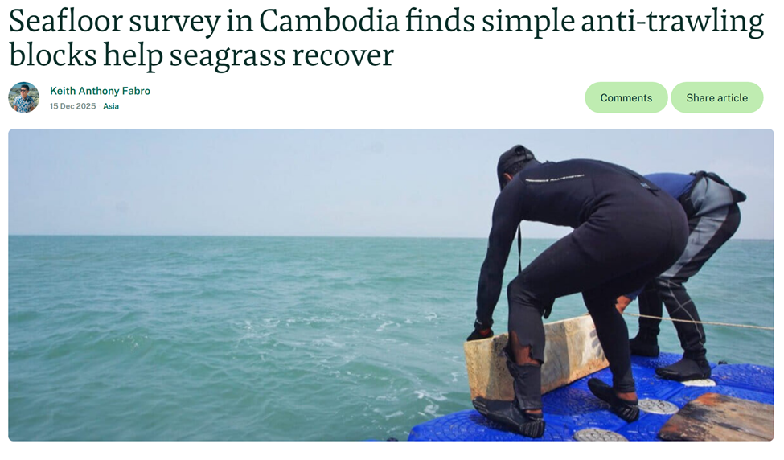
Thank You

