Slide 1
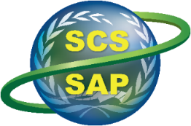

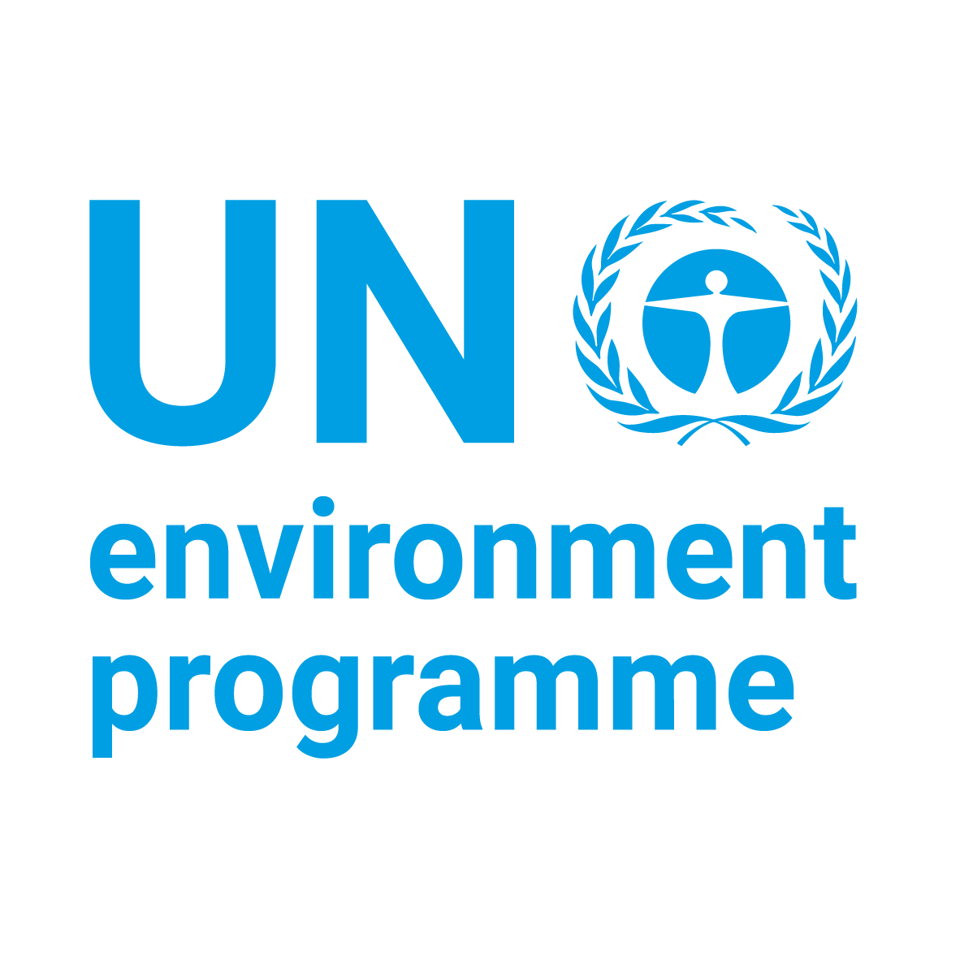


Implementing the Strategic Action Programme for the South China Sea and Gulf of Thailand (SCS SAP) Project
Third Meeting of the Regional Scientific and Technical Committee (RSTC)
26-28 January 2026, Phu Quoc, Vietnam
Good practices on habitat and land-based pollution management in the participating countries of the UNEP/GEF SCS SAP Project
Vo Si Tuan, Regional Science Coordinator
[Name] National Coordinators

Slide 2
RECENT GOOD PRACTICES ON HABITAT AND LAND-BASED POLUTION MANAGEMENT IN THE PARTICIPATING COUNTRIES OF THE UNEP/GEF SCS SAP PROJECT
Number of recent good practices submitted by participating countries in advance of the meeting
Country | Reformed policies, law & financial mechanism at national & provincial level | Management measures and technologies for sustainable use at local level
Cambodia | 1 | 3
China | 2 | 11
Indonesia | 1 | 3
Philippines | 6 | 6
Thailand* | 2 | 3
Vietnam |  | 3
Total | 12 | 29
*Thailand submitted 4 good practices on LbP, recently, but not following the agreed template

Slide 3
Reforms at the national & provincial levels
Thailand 1. Integrated Marine Spatial Planning for the Chonburi Island Cluster (Koh Lan, Koh Krok, Koh Sak & Koh Sichang), Thailand
Thailand 2: Scaling-Up Locally Managed Marine Areas (LMMAs) in Thailand: National Policy Framework and Community Empowerment
China 1: Established a multi-stakeholder marine litter governance system that involves fishing vessels into litter collection efforts in Hainan Province, China
China 2: The provincial regulation concerning the prohibition of single use plastic products in Hannan Province, China
Cambodia 1. Establishment of Marine Fisheries Refugia in Cambodia
Philippines 1. National Coral Reef Policy Reforms and Ecosystem-Based Management in the Philippines
Philippines 2. Wetland (Estuaries) Conservation in the Philippines
Philippines 3. Monitoring Mangrove Forests in the Philippines using Remote Sensing
Philippines 4. Integrated Coastal Management in Northwestern Philippines
Philippines 5. Strategic Environmental Plan (SEP) and ECAN in Palawan, Philippines
Philippines 6. Policy reforms for land-based pollution management in the Philippines
Indonesia 1. Policy reforms and technique innovation for restoring Indonesia’s coral reefs: 30 Years of Restoration Projects (1990–2020)

Slide 4
Management measures and technologies for sustainable use at the local level
MSP, PAs, ICM (10)
China 2: Effective management of ecological conservation and sustainable development using innovative and integrated approach at Dapeng Bay, China
China 5.: Watershed Treatment and Coastal Wetland Restoration at Maoweihai, Guangxi, China
China 6: Coastal eco-restoration and comprehensive watershed improvement in Beihai, Guangxi, China
Thailans 1. Management Measures for Conservation and Sustainable Use in the Ban Don Mangrove Forests, Surat Thani Province, Thailand
Thailand 2. Ban Don-Seagrass Meadows: A Model for Sustainable Coastal Habitat Management
Thailand 3: Integrated Policy Harmonization and Sustainable Management for the Don Hoi Lot Ramsar Site
Vietnam 1. Marine protected areas contribute to sustainable socio-economic development in Cu Lao Cham islands, Vietnam
Philippines 3. Bay-Wide Coastal Governance in Lanuza Bay, Surigao del Sur, Philippines
Philippines 6: Establishment of an additional management zone in the Malampaya Sound Protected Landscape and Seascape, Palawan Province, Philippines
Cambodia 3: Strengthened Policies and Local Financing for Pollution and Habitat Management in Peam Krashop Wildlife Sanctuary, Koh Kong Province, Cambodia
Protecting and restoring coral reefs in Natuna and Anambas, Indonesia

Slide 5
Management measures and technologies for sustainable use at the local level (cont.)
Community based restoration & management (6)
Philippines 1. Scaling up sea cucumber stock restoration through community-based culture production and reserve management
Philippines 2. A Model of Community-Based No-Take Marine Reserve (NTMR) in Apo Island, Negros Oriental, Philippines
Philippines 4. Participatory MPA Networks in Calamianes Islands, Palawan, Philippines
Philippines 5. Coral Restoration through Filipinnovation in Marinduque
Cambodia 1. Gender in Community-Based Natural Resources Management: A Case at Beoung Kachhang Community Protected Area in Cambodia
Cambodia 2. Community-Led Habitat Protection and Waste Reduction in Koh Kapik Community Protected Area, Peam Krashop Wildlife Sanctuary, Koh Kong Province, Cambodia
Protection, Restoration and Community Engagement for Coral Reef Conservation in Bangka Belitung, Indonesia
LbP management (5)
China 7: Integrated management of water quality of Qianshan River in Zhuhai, Guangdong, China
China 8: Comprehensive watershed improvement of Maozhou River in Shenzhen, Guangdong, China
China 9: Whole chain control of plastic pollution in the Pearl River Estuary, China
Vietnam 3. Co To district: A Plastic Waste-Free Zone
Indonesia 1. Preventing marine pollution from land-based sources through waste banks in Bank Sampah Bersinar, Indonesia

Slide 6
Management measures and technologies for sustainable use at the local level (cont.)
Restoration with nature-based solution (3)
China 1: The Shenzhen Bay Mangrove Wetland Restoration Project in Shenzhen city, China
China 3: Rehabilitation of Yintan beach by Nature-based solutions and supporting artificial measures and regulation reform in Beihai, China
China 4: Restoring the Haikou Bay with Nature-based Solutions and Watershed Approaches in Haikou city, China
Blue economy & blue carbon (3)
China 10. Blue Carbon trading for the Futian Mangrove Forest in Shenzhen, Guangdong Province, China
China 11: High-quality Development of the Blue Economy in Shenzhen Daya Bay, China
Vietnam 2. Circular economy demonstration model at Quy Nhon coastal fishing port
The RSTC members are invited to:
review contents of the submitted good practices (Meeting Document: SCSSAP RSTC 3/7)
suggest adjustments, revisions, specially for those not narrative writing
advise the plan for publication and dissemination (online, technical publication)

