Slide 1


Cost-Benefit Analysis South China Seas TDA/SAP – A General Framework and Guidelines
Luky Adrianto
RTF-EV, CCMRS-IPB University, Indonesia
RSTC-3, Phu Quoc, Vietnam
26 January 2026

Slide 2
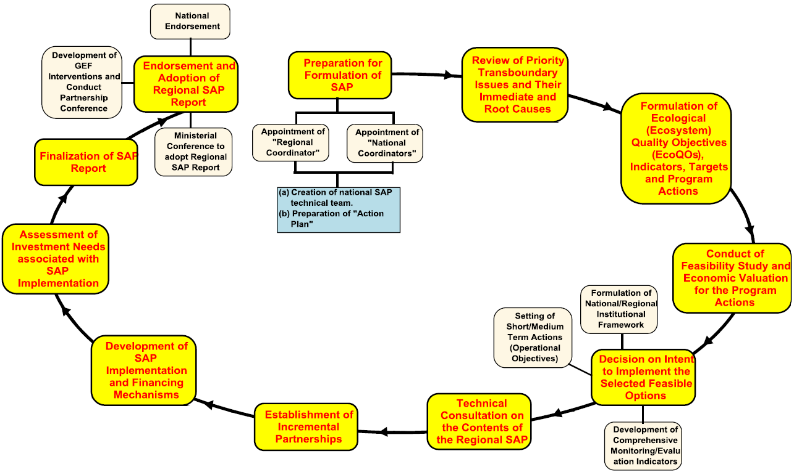
Position of CBA in the TDA/SAP Framework
TDA
Results
RSTC3 Meeting
26-28 Jan 2026
Phú Quốc
Cost-Benefits Analysis
TDA/SAP Guidelines (2020)

Slide 3
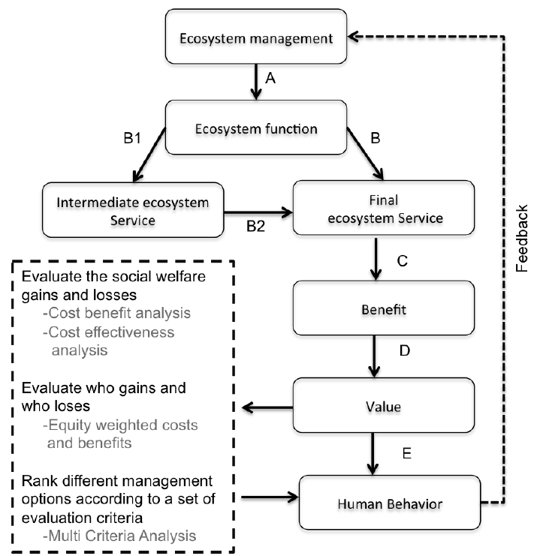
General Framework of Ecosystem Services Valuation and CBA
RSTC3 Meeting
26-28 Jan 2026
Phú Quốc
Hanley et al (2015)

Slide 4
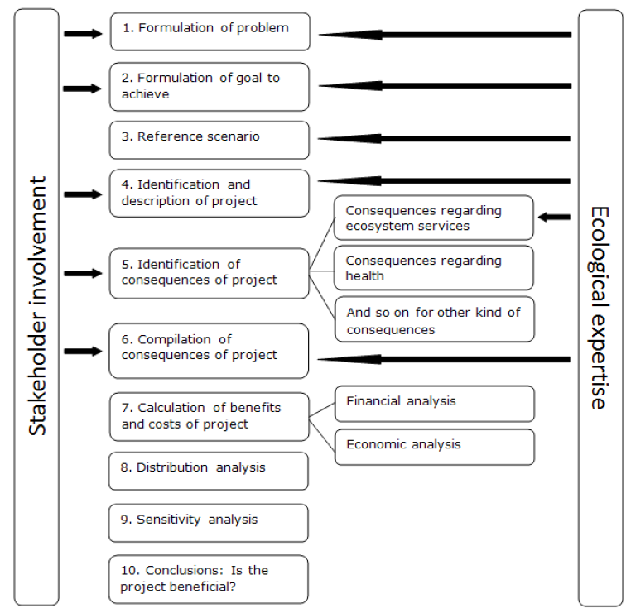
10 Steps of CBA in the TDA/SAP Framework
RSTC3 Meeting
26-28 Jan 2026
Phú Quốc
TDA
Process
TDA-SAP
Bridging
Process
Final SAP
Modified from Kinnel et al (2012)

Slide 5
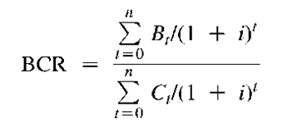
CBA Algorithm in the TDA/SAP Framework
RSTC3 Meeting
26-28 Jan 2026
Phú Quốc
Cost Identification and Valuation: Collect data on all costs associated with recommended priorities.
Benefits Identification and Valuation: Identify and quantify the benefits resulting from recommended priorities in terms of for example increased biodiversity, ecosystem services, and socio-economic benefits to local communities.
Measuring Cost-Benefit Ratio: Use the cost-benefit analysis methodology to assess the total economic value of the management of recommended priorities.
Sensitivity and Scenario Analysis: Develop a sustainability model that takes into account economic, environmental, and social aspects to support decision-making related to overall recommended priorities (e.g. EcQOs)
Adrianto et al (2024)

Slide 6
A Simple MCA for Setting the Final Priority Actions
RSTC3 Meeting
26-28 Jan 2026
Phú Quốc
TDA-SAP Bridging Process
SAP Process
Regional Priority Actions
Risk Assessment
Cost Benefit Analysis
TDA Results
Implementable Priority Actions
National Priority Actions
National Development Plan

Slide 7
RSTC3 Meeting
26-28 Jan 2026
Phú Quốc
“Individually, we are only a drop.
Together, we are an ocean..”
Ryunosuke Satoro

