Slide 1
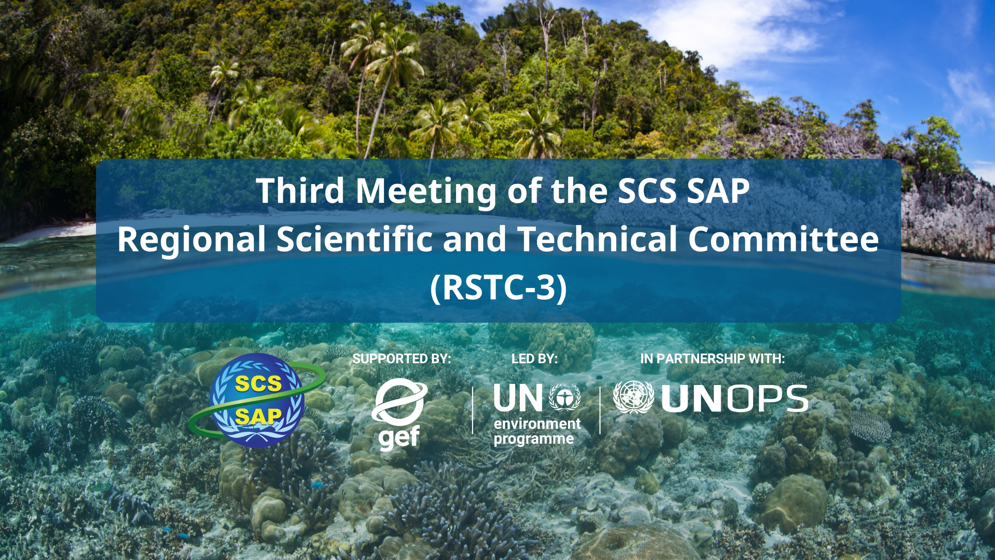
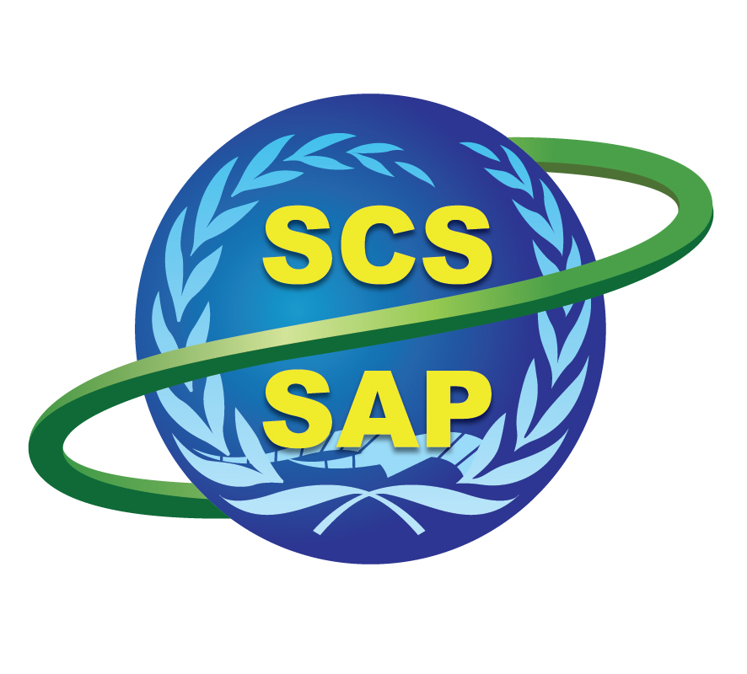



SUPPORTED BY LED BY IN PARTNERSHIP WITH

Slide 2

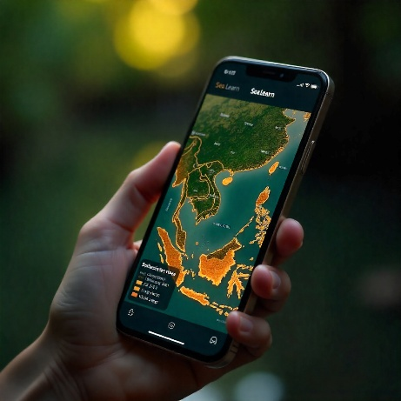
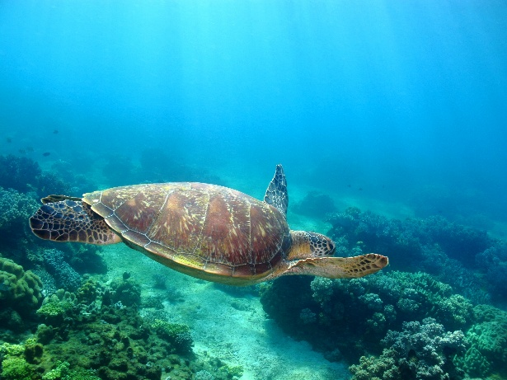
The Indonesia’s South China Sea :
National and Regional Priority Actions
Ministry of Environment of Indonesia
Center for Coastal and Marine Resources
Studies (CCMRS) IPB University
RSTC3 Meeting
26-28 Jan 2026
Phú Quốc

Slide 3
Ministry of Environment of Indonesia
Ms. Irene Aditya Yuniarti
Ms. Nur Isna Khairunnisa
Center for Coastal and Marine Resources
Studies (CCMRS) IPB University
Prof. Dr. Yonvitner (Team Leader & Ecosystem)
Prof. Dr. Luky Adrianto (Socio Economics)
Prof. Dr. Ario Damar (Pollution)
Prof. Dr. M. Riyanto (Fisheries)
Dr. Taryono (Governance)
Ms. Isdahartati
Project National Coordinator
Mr. Heru Waluyo Kesowo
RSTC3 Meeting
26-28 Jan 2026
Phú Quốc

Slide 4
5. What are strategic recommendations to improve governance of transboundary environmental problems and closing gaps in Item 4.
Strategic Recommendation for Ecosystems
National | Priority Regional
Harmonizing legal entity, mandate, align with restoration targets, spatial planning, and enforcement, and monitoring system. | Harmonizing legal entity, mandate, align with restoration targets, spatial planning, and enforcement, and monitoring system.
Rehabilitation and restoration of ecosystem mangrove, seagrass, and coral to maintain ecosystem support for ecology and social function. | Science and knowledge improvement regional capacity building, embed community-based knowledge in wetland management, and integrate mangrove, coral, seagrass, and wetlands.
Science and knowledge improvement, local capacity building, embed community-based knowledge in wetland management, and integrate mangrove, coral, seagrass, and wetlands into Indonesia’s NDC systems. | Regional cooperation on mangrove, coral, seagrass, and wetland local capacity building, embed community-based knowledge in wetland management, and integrate wetlands into global target including NDC, APEC, and WEF and ASEAN regional.
Inter-provincial cooperation on mangrove, coral, seagrass, and wetland local capacity building, embed community-based knowledge in wetland management, and integrate wetlands into Indonesia’s and global targets.

Slide 5
5. What are strategic recommendations to improve governance of transboundary environmental problems and closing gaps in Item 4.
Strategic Recommendation for Pollutions
National priority | Regional priority
Enhancing coordination among government institutions in implementing various National Strategic Action Plans for pollution management, including domestic wastewater, solid waste, industrial waste, hazardous waste, and marine plastic. | Regional coordination on marine oil pollution, marine plastic, and marine debris.
Improvement of the infrastructure of domestic wastewater pollution management.
Improving river, coastal and marine pollution monitoring program.
Inter-provincial coordination on marine oil pollution, especially in the marine-transport shipping route.

Slide 6
5. What are strategic recommendations to improve governance of transboundary environmental problems and closing gaps in Item 4.
Strategic Recommendation for Socio-Economics
National priority | Regional priority
Community-oriented Nature-based Solutions, e.g., fisheries-tourism, blue carbon free islands, etc. | Climate-adaptive coastal and marine economic regional cooperation.
Diversify coastal livelihood (multi livelihood strategies).

Slide 7
5. What are strategic recommendations to improve governance of transboundary environmental problems and closing gaps in Item 4.
Strategic Recommendation for Fisheries
National priority | Regional priority
Enhancing Fisheries Monitoring and Enforcement: Strengthen surveillance and law enforcement systems by using technology, good governance, and community involvement to fight illegal fishing effectively. | Improving Fisheries Governance and Resolving Fishing Ground Conflicts: Set up co-management zones, mediation processes, and livelihood diversification programs to reduce conflicts and create fair, inclusive governance among fishing communities.
Implementing Sustainable Fisheries Management in WPP 711: Use science-based catch limits, manage fishing efforts, and encourage responsible practices to ensure the long-term sustainability of fish stocks in Fisheries Management Area 711. | Managing Abandoned, Lost, or Discarded Fishing Gear (ALDFG): Introduce gear registration, retrieval programs, biodegradable materials, and mandatory reporting to reduce the impact of ghost gear on marine ecosystems.
Improving Fisheries Governance and Resolving Fishing Ground Conflicts: Set up co-management zones, mediation processes, and livelihood diversification programs to reduce conflicts and create fair, inclusive governance among fishing communities. | Reducing Bycatch and Protecting Endangered, Threatened, and Protected (ETP) Species: Use bycatch reduction technologies, enforce temporary closures, train crews in safe release practices, and expand electronic monitoring to protect vulnerable marine species.
Managing Abandoned, Lost, or Discarded Fishing Gear (ALDFG): Introduce gear registration, retrieval programs, biodegradable materials, and mandatory reporting to reduce the impact of ghost gear on marine ecosystems.
Reducing Bycatch and Protecting Endangered, Threatened, and Protected (ETP) Species: Use bycatch reduction technologies, enforce temporary closures, train crews in safe release practices, and expand electronic monitoring to protect vulnerable marine species.

Slide 8
5. What are strategic recommendations to improve governance of transboundary environmental problems and closing gaps in Item 4.
Strategic Recommendation for Governance
National priority | Regional priority
Establish a multi-level governance framework (central-provincial-regency) for integrated blue economy development, pollution control, and coastal ecosystem conservation. | Establish a regional governance framework for integrated blue economy development, pollution control, and coastal ecosystem conservation.
Strengthening illegal fishing eradication through enhanced monitoring, enforcement, and regional cooperation. | Strengthening the regional governance framework for illegal fishing eradication through enhanced monitoring, enforcement, and regional cooperation.
Revitalize inter-provincial working groups via diplomatic channels to address transboundary sludge pollution affecting especially Batam and Bintan. | Revitalize regional working groups via diplomatic channels to address transboundary sludge pollution.
 | Enhance the effectiveness of SCS working groups focused on coastal ecosystem conservation (mangroves, seagrass, coral reefs).

Slide 9


THANK YOU
pkspl.ipb.ac.id
PKSPL IPB
@pkspl-ipb-university

