Slide 1
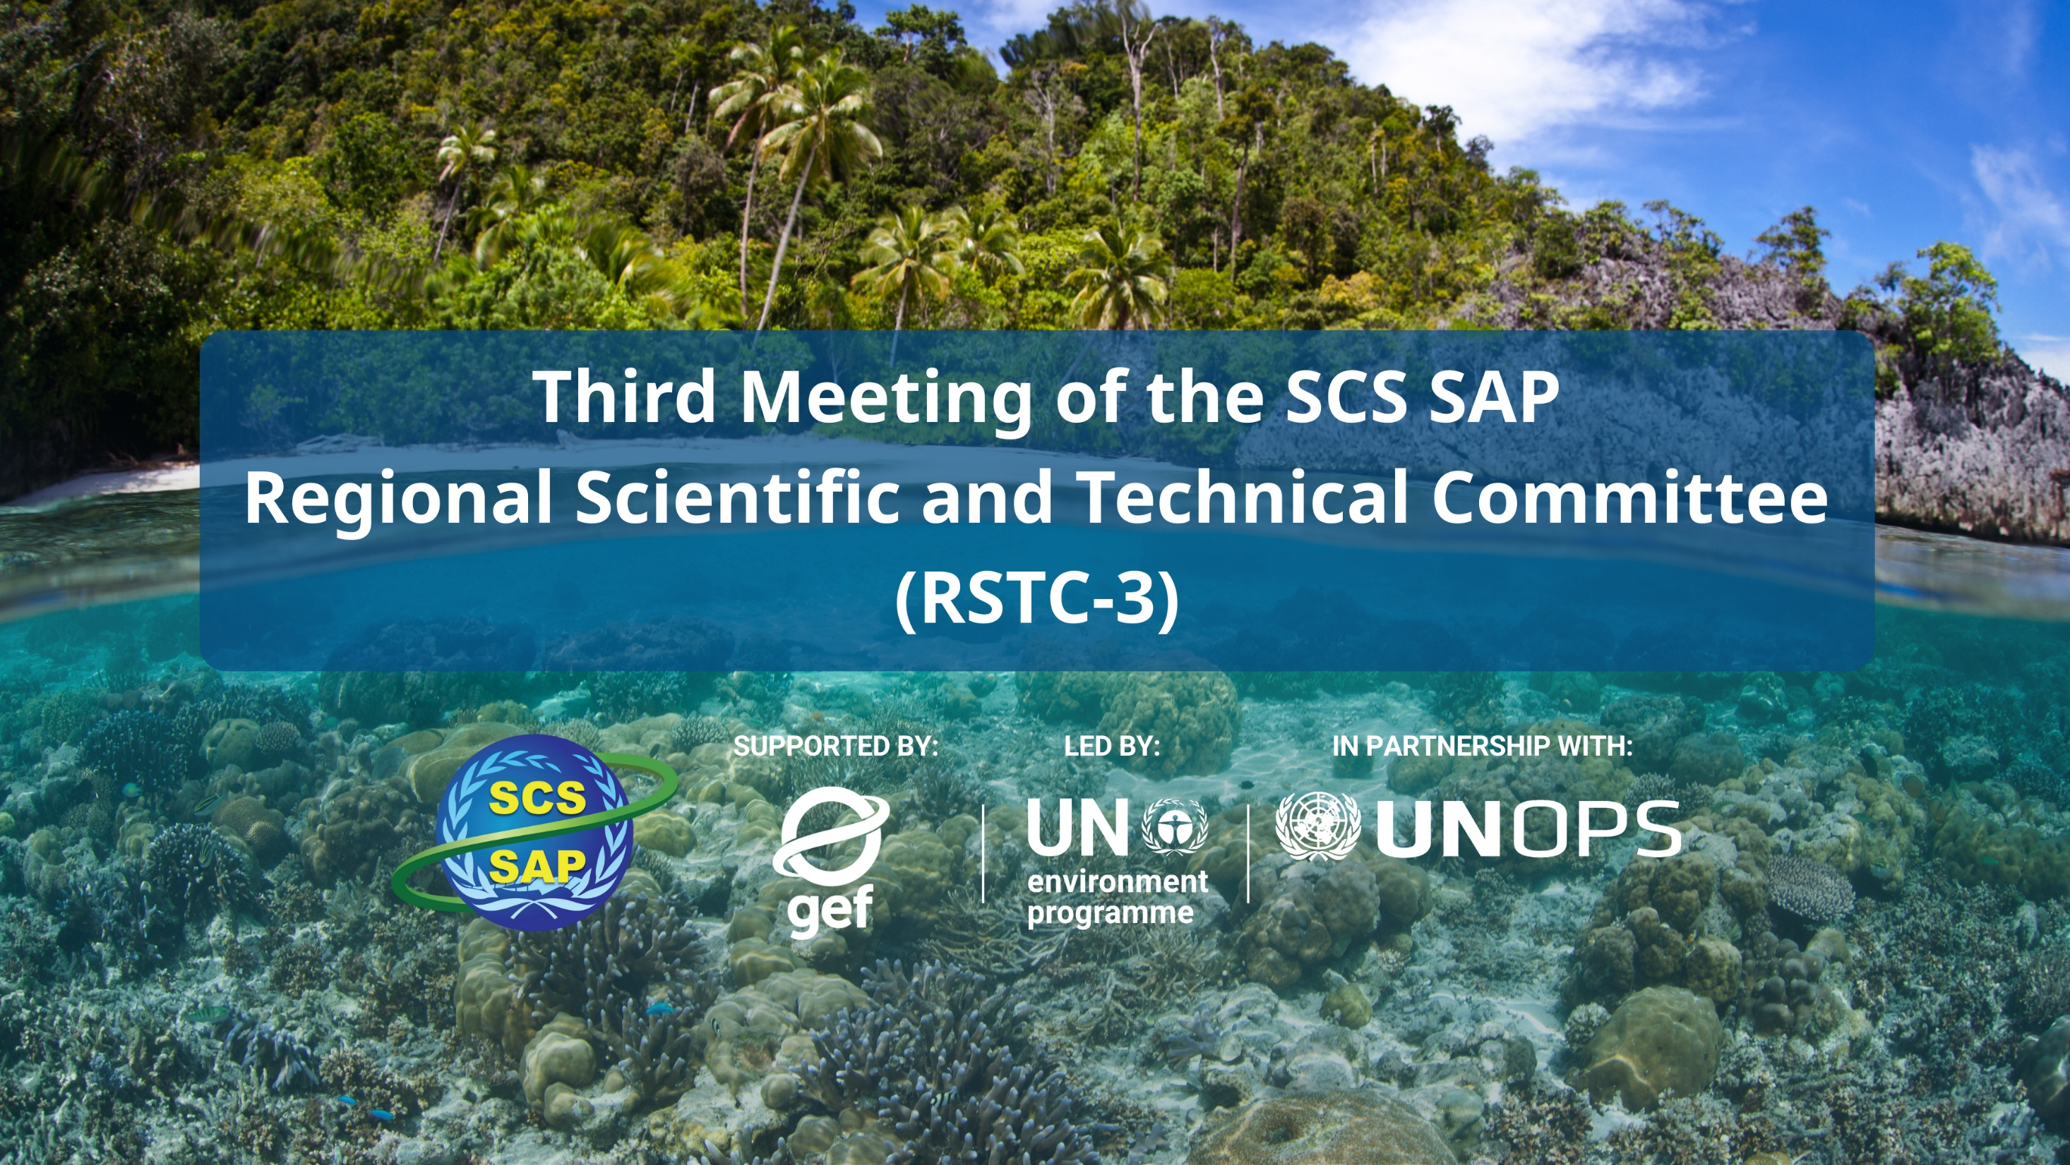
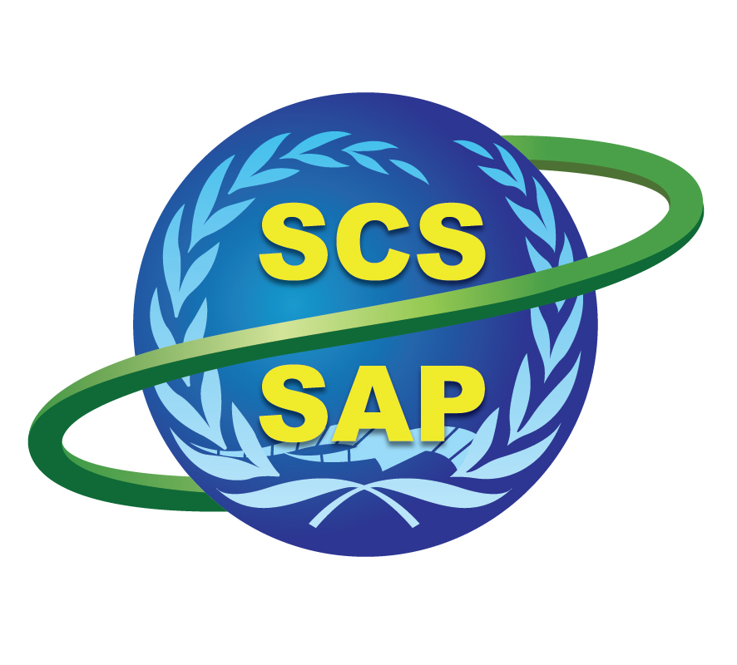



SUPPORTED BY LED BY IN PARTNERSHIP WITH

Slide 2
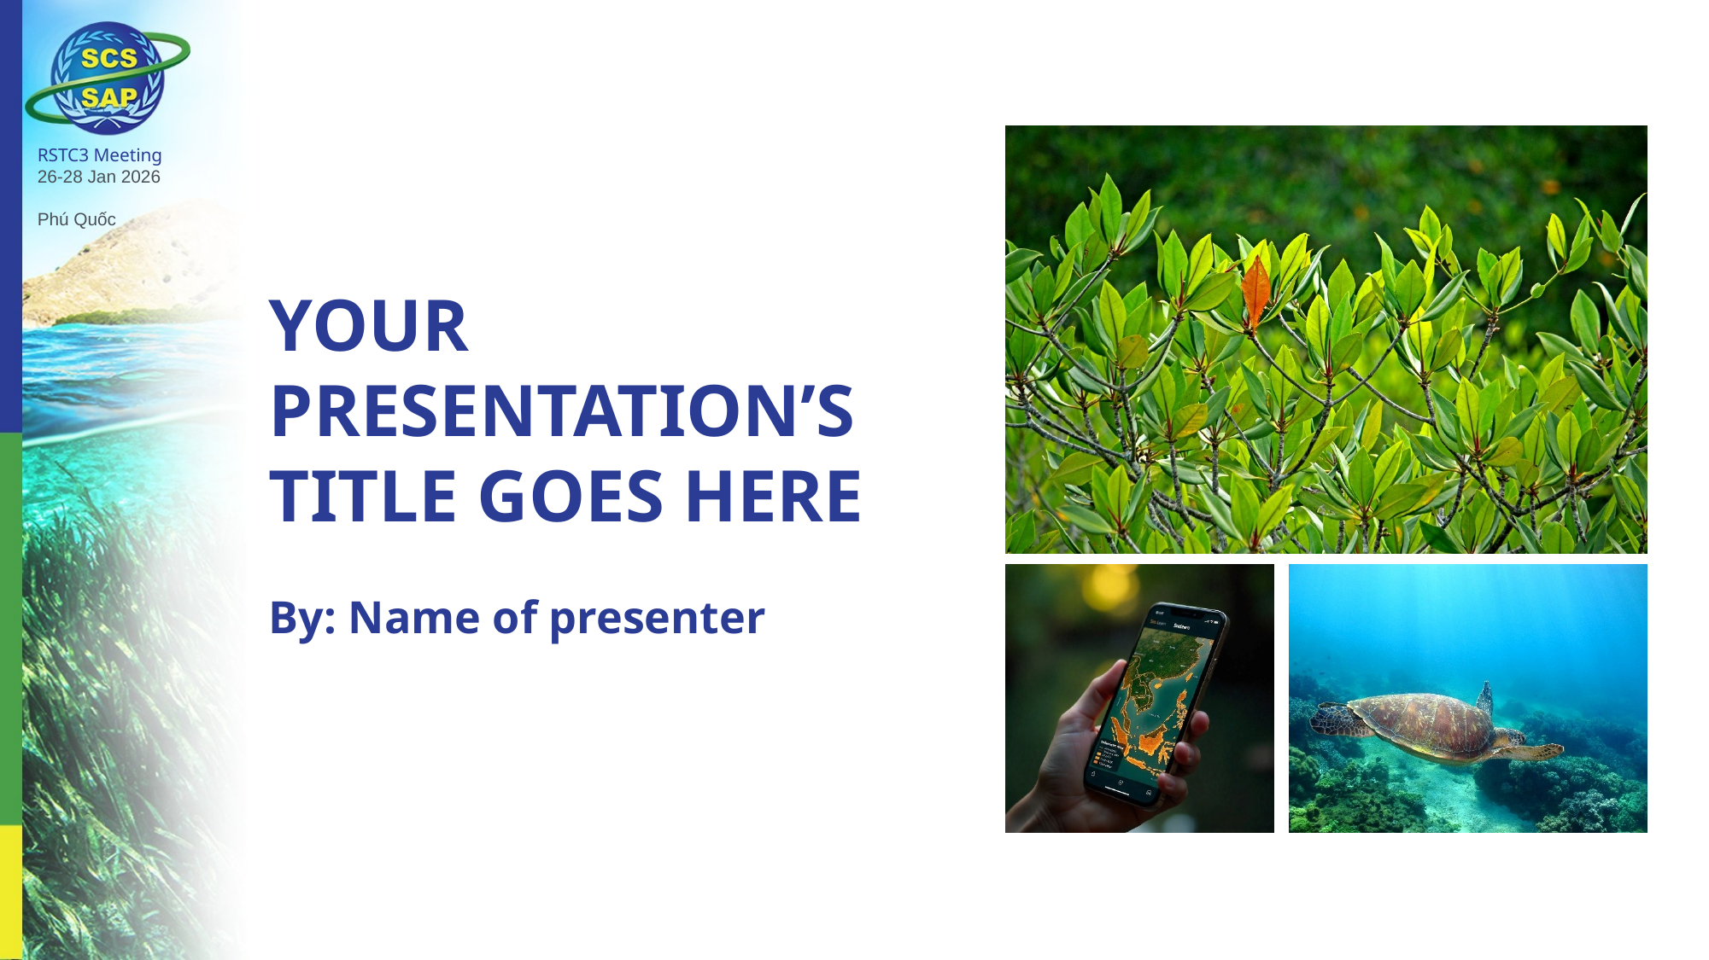
CAMBODIA (KHM)
National TDA – Key Messages
Implementing the Strategic Action Programme for the South China Sea and Gulf of Thailand (SCS SAP Project)
Presenter: Cambodia Delegation
Notes:
[#]
[Sources]
- Cambodia National Report on Transboundary Diagnostic Analysis (TDA), Fourth Draft, 21 Dec 2025.
[/Sources]

Slide 3

Agenda (template outline)
Key thematic / geographic areas of risk & vulnerability
2025 vs National TDA 1.0 (2000): changes in importance, severity, and impacts; which risks are transboundary vs national; priority concerns
Governance capacity to address and mitigate assessed risks
Major gaps in governance (cross-cutting + sector-specific)
Strategic recommendations to strengthen governance (national + regional cooperation)
Notes:
[#]
[Sources]
- RSTC3 Country TDA Report presentation outline template.
[/Sources]

Slide 4
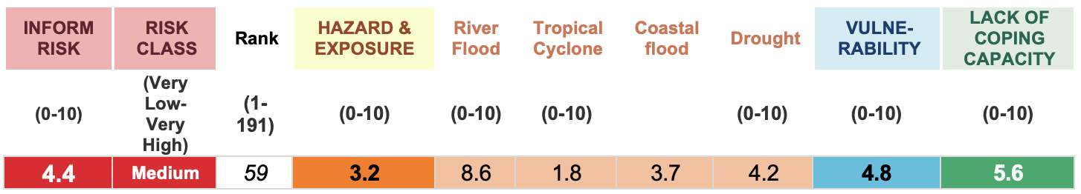
1. Key thematic / geographic areas of risk & vulnerability
1.1 Exposure to climate-change impacts
11–20 cm
>200k
+0.8–1.1°C
Projected sea-level rise by ~2050
People impacted by floods (2020–2022)
Sea-surface temperature anomaly (2023)
Sea-level rise threatens more than 35,000 ha of coastal settlements and rice fields; storm surge and erosion risks increase.
Urban flooding risk is amplified by reclamation and drainage deficits in fast-growing coastal towns.
Floods are the deadliest hazard; droughts affect the largest populations (e.g., ~2.5M affected in 2016).
Drought/ENSO cycles and warming increase water stress; salinity intrusion advances 5–7 km inland in some estuaries.
Storms + high lightning impacts add compound risk for ports, estuaries and tourism towns
Notes:
[#]
[Sources]
- Cambodia National TDA (2025), Executive Summary and Chapters 1–2 (climate hazards and impacts).
[/Sources]

Slide 5
1. Key thematic / geographic areas of risk & vulnerability
1.2 Exposure of populations & livelihoods
>1.07M
~17.8%
65–90%
Coastal population (4 provinces)
Poverty rate (2019/20)
Wetland income dependence (Koh Kong)
Fast coastal growth concentrates exposed assets—especially in Preah Sihanouk—and increases demand for basic services.
A large “near-poor” group remains vulnerable to climate and economic shocks (tourism/fisheries volatility).
Ecosystem degradation becomes an immediate welfare risk where livelihoods depend on mangroves, wetlands and fisheries.
Priority: risk-informed urban development + inclusive human development (TVET, health, MSMEs) to diversify incomes.
Notes:
[#]
[Sources]
- Cambodia National TDA (2025), Executive Summary and Chapter 2 (demographics, poverty, livelihood dependence).
[/Sources]

Slide 6
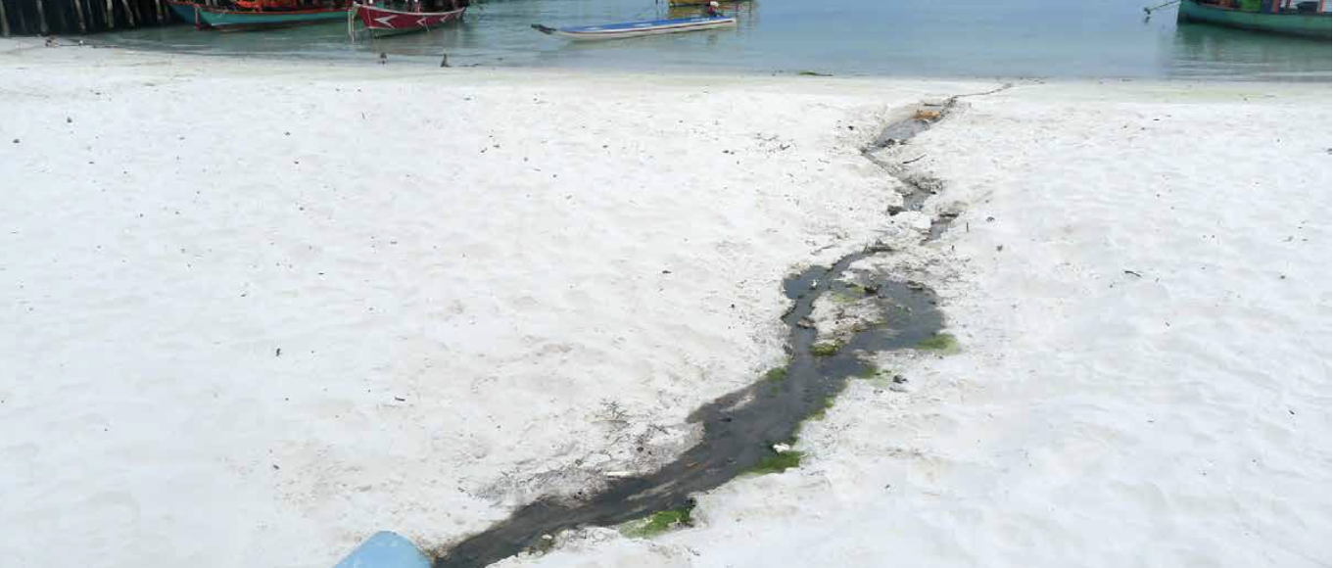
1. Key thematic / geographic areas of risk & vulnerability
1.3.1 System state mediated by pollution
Land-based sources dominate (~80–90%): untreated/partly treated wastewater, agriculture/aquaculture runoff, plastics, industrial zones.
Wastewater treatment coverage remains very limited in coastal growth nodes (less than 20%).
Monitoring indicates repeated microbial exceedances (10⁴–10⁵ CFU/100 mL) and industrial exceedances in high-pressure zones.
Plastic leakage estimated >85,000 tonnes/year; recycling rate ~10–12%.
Preah Sihanouk urban–industrial coast: wastewater, solid waste, ports/SEZs; high exposure of assets & people
Example: wastewater runoff discharging onto a tourist beachfront
Notes:
[#]
[Sources]
- Cambodia National TDA (2025), Executive Summary and Chapter 3 (pollution sources, hotspots, wastewater coverage, plastics).
[/Sources]

Slide 7
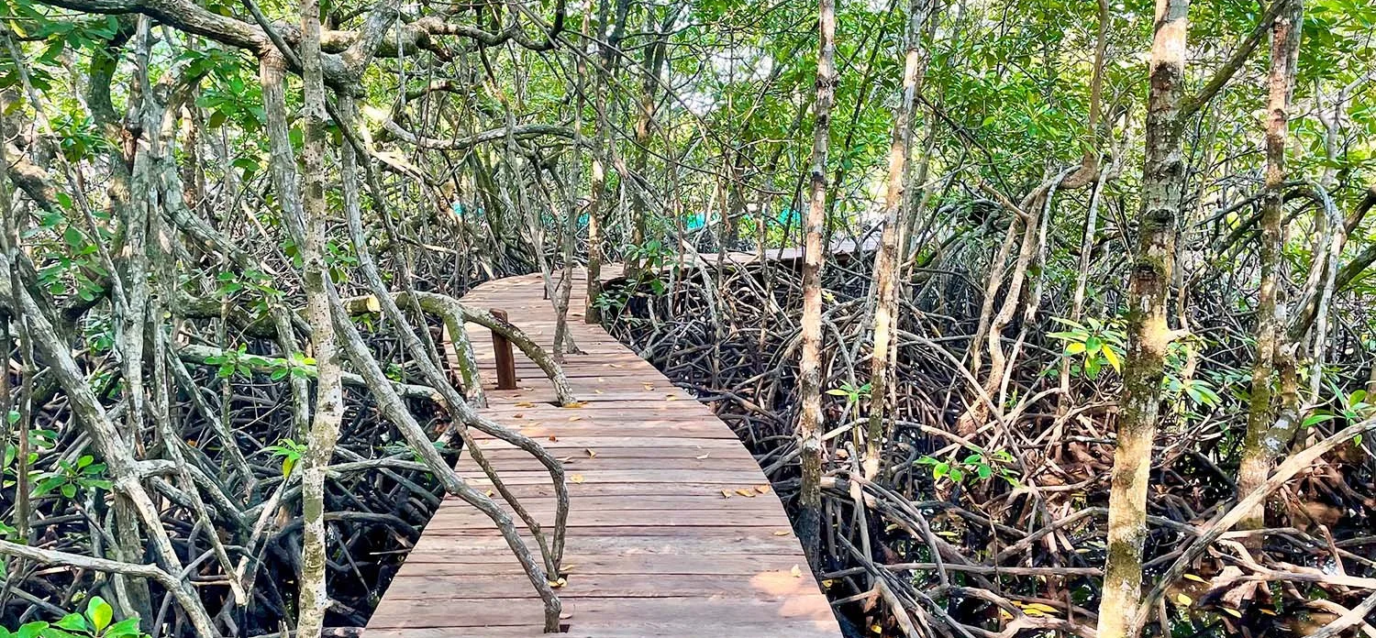
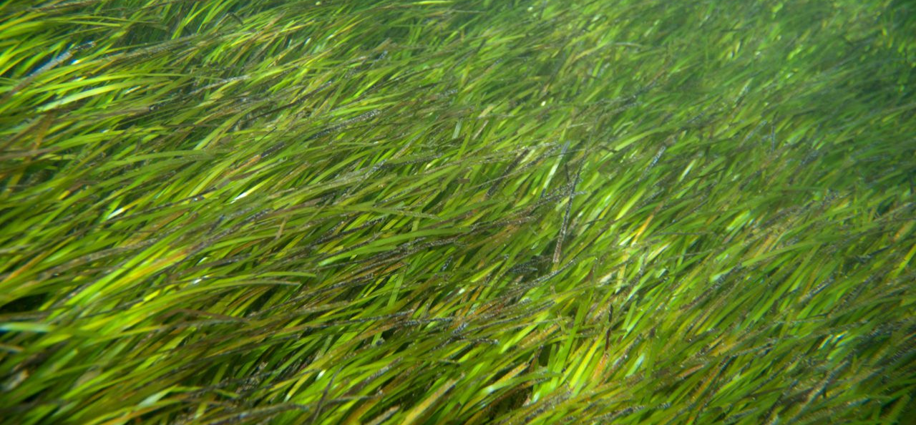
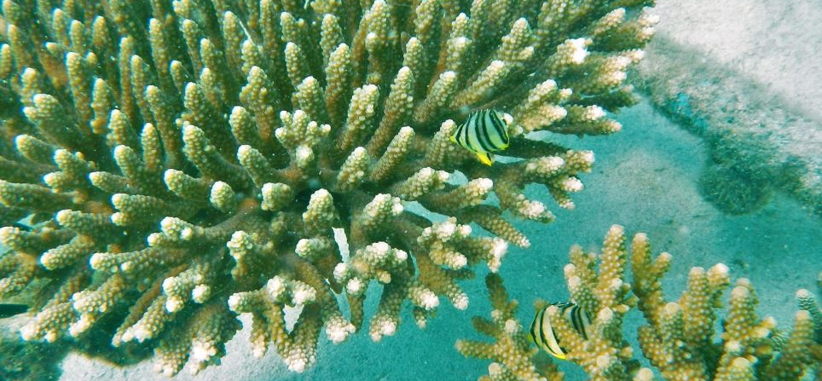
1. Key thematic / geographic areas of risk & vulnerability
1.3.2 System states manifested by coastal habitats
Dataset estimates vary, ~45,000–63,000 ha of mangrove nationwide,, highlighting need for harmonized baselines and consistent monitoring. Mangroves declined ~6% since 2014 but remain critical for protection and blue carbon.
Botum Sakor peat-mangroves (~4,768 ha) are a rare asset needing hydrology-first protection.
Koh Kong mangrove–estuary complex (Peam Krasop–Koh Kapik–Botum Sakor): blue carbon + high livelihood dependence
Seagrass is extensive (notably Kep–Kampot corridor) but highly sensitive to trawling and turbidity.
Coral reefs show mixed condition; cumulative pressure from turbidity, overfishing and marine heatwaves is increasing.
Koh Rong archipelago: reefs + tourism; rising bleaching and sediment stress
Mangroves (blue carbon, protection)
Seagrass (nursery & dugong habitat)
Coral reefs (tourism & fish habitat)
Notes:
[#]
[Sources]
- Cambodia National TDA (2025), Executive Summary and Chapter 4 (mangroves, coral reefs, seagrass).
[/Sources]

Slide 8
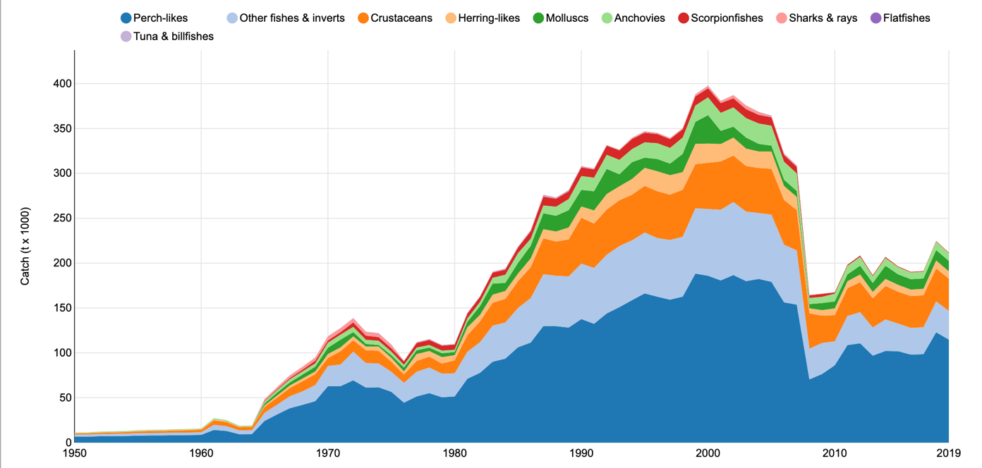
1. Key thematic / geographic areas of risk & vulnerability
1.3.3 System states manifested by fisheries & aquaculture
Demersal trawl CPUE fell from ~173 kg/hr (1960s) to ~26 kg/hr (recent), indicating severe depletion.
Trawls and purse seines generate ~85–90% of landings; bottom trawls contribute ~55–60%.
Preah Sihanouk and Koh Kong supply ~75–80% of coastal production; sharks and rays have collapsed to single-digit tonnes.
Ecosystem indices (MTI, FiB, PPR) indicate trophic downgrading and pressure beyond ecological capacity.
Demersal trawl CPUE (indicative)
Notes:
[#]
[Sources]
- Cambodia National TDA (2025), Executive Summary and Chapter 5 (CPUE trend, gear dominance, ecosystem indices).
[/Sources]

Slide 9
2. How 2025 differs from National TDA (2000) + what is transboundary?
2.1 Which of these risks are considered transboundary? Which are national and considered priority concerns?
Transboundary priorities (2025)
  Mekong–Tonle Sap–Bassac nutrient/sediment and water-quality pathways to the coast.
  Shared Gulf of Thailand fish stocks + IUU fishing; cross-border trade and fleets.
  Oil-spill risk and response coordination in the Gulf of Thailand shipping/port system.
  Marine-litter transport pathways across SCS–GOT currents.
National / localized priorities concern (2025)
  Hotspots around Sihanoukville and other coastal growth nodes: wastewater, solid waste, drainage.
  Habitat conversion/fragmentation (Koh Kong peat-mangroves; Kep–Kampot seagrass corridor; Koh Rong reefs).
  Aquaculture effluent, disease and biosecurity risks; beach and nearshore water-quality risks.
Notes:
[#]
[Sources]
- Cambodia National TDA (2000) vs Cambodia National TDA (2025) comparison (Chapter 1, Tables 1-1 and 1-2) and synthesis.
[/Sources]

Slide 10
2. How 2025 differs from National TDA (2000) + what is transboundary?
2.2 What changed since 2000: perceived importance
2.3 What changed since 2000: perceived severity
2.4 What changed since 2000: perceived impacts
Greater weight on cumulative impacts in coastal growth nodes (ports, SEZs, tourism corridors).
Pollution is now a constraint: wastewater, nutrients, plastics/ microplastics and industrial effluents.
Climate hazards are treated as a risk multiplier (sea-level rise, flood, drought, storms, marine heatwaves).
Ecosystem condition is linked more explicitly to livelihoods (fisheries income, tourism, flood protection).
More frequent/extreme floods and heat; urban flooding risk is amplified
Drought/ENSO cycles and warming increased
Rising sea level and erosion
Episodic coral bleaching emerging
Storms + high lightning incident
People & livelihoods: higher exposure from coastal population growth and expansion into hazard-prone areas; fishers face lower CPUE and higher costs.
Ecosystems: eutrophication and plastics reduce water quality; habitat fragmentation/pressure on mangroves, seagrass and reefs; reduced coastal protection.
Management challenge: pressures now outpace monitoring, enforcement, and O&M budgets in several provinces.
Notes:
[#]
[Sources]
- Cambodia National TDA (2000) vs Cambodia National TDA (2025) comparison (Chapter 1, Tables 1-1 and 1-2) and synthesis.
[/Sources]

Slide 11
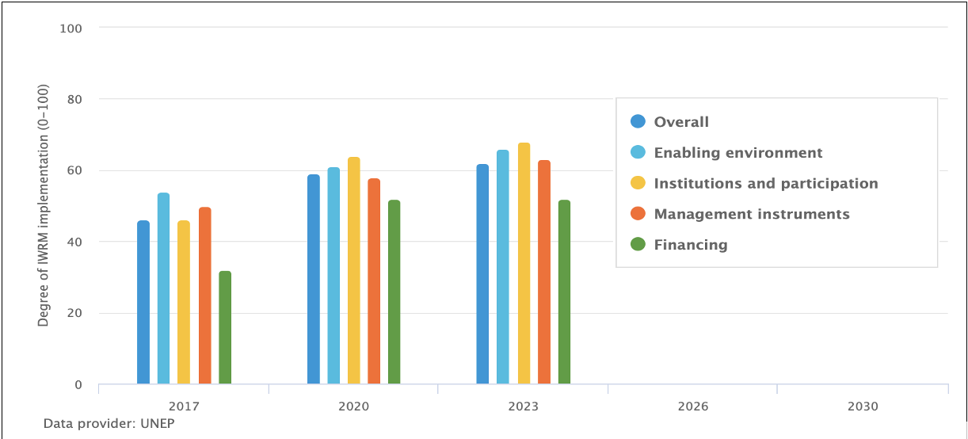
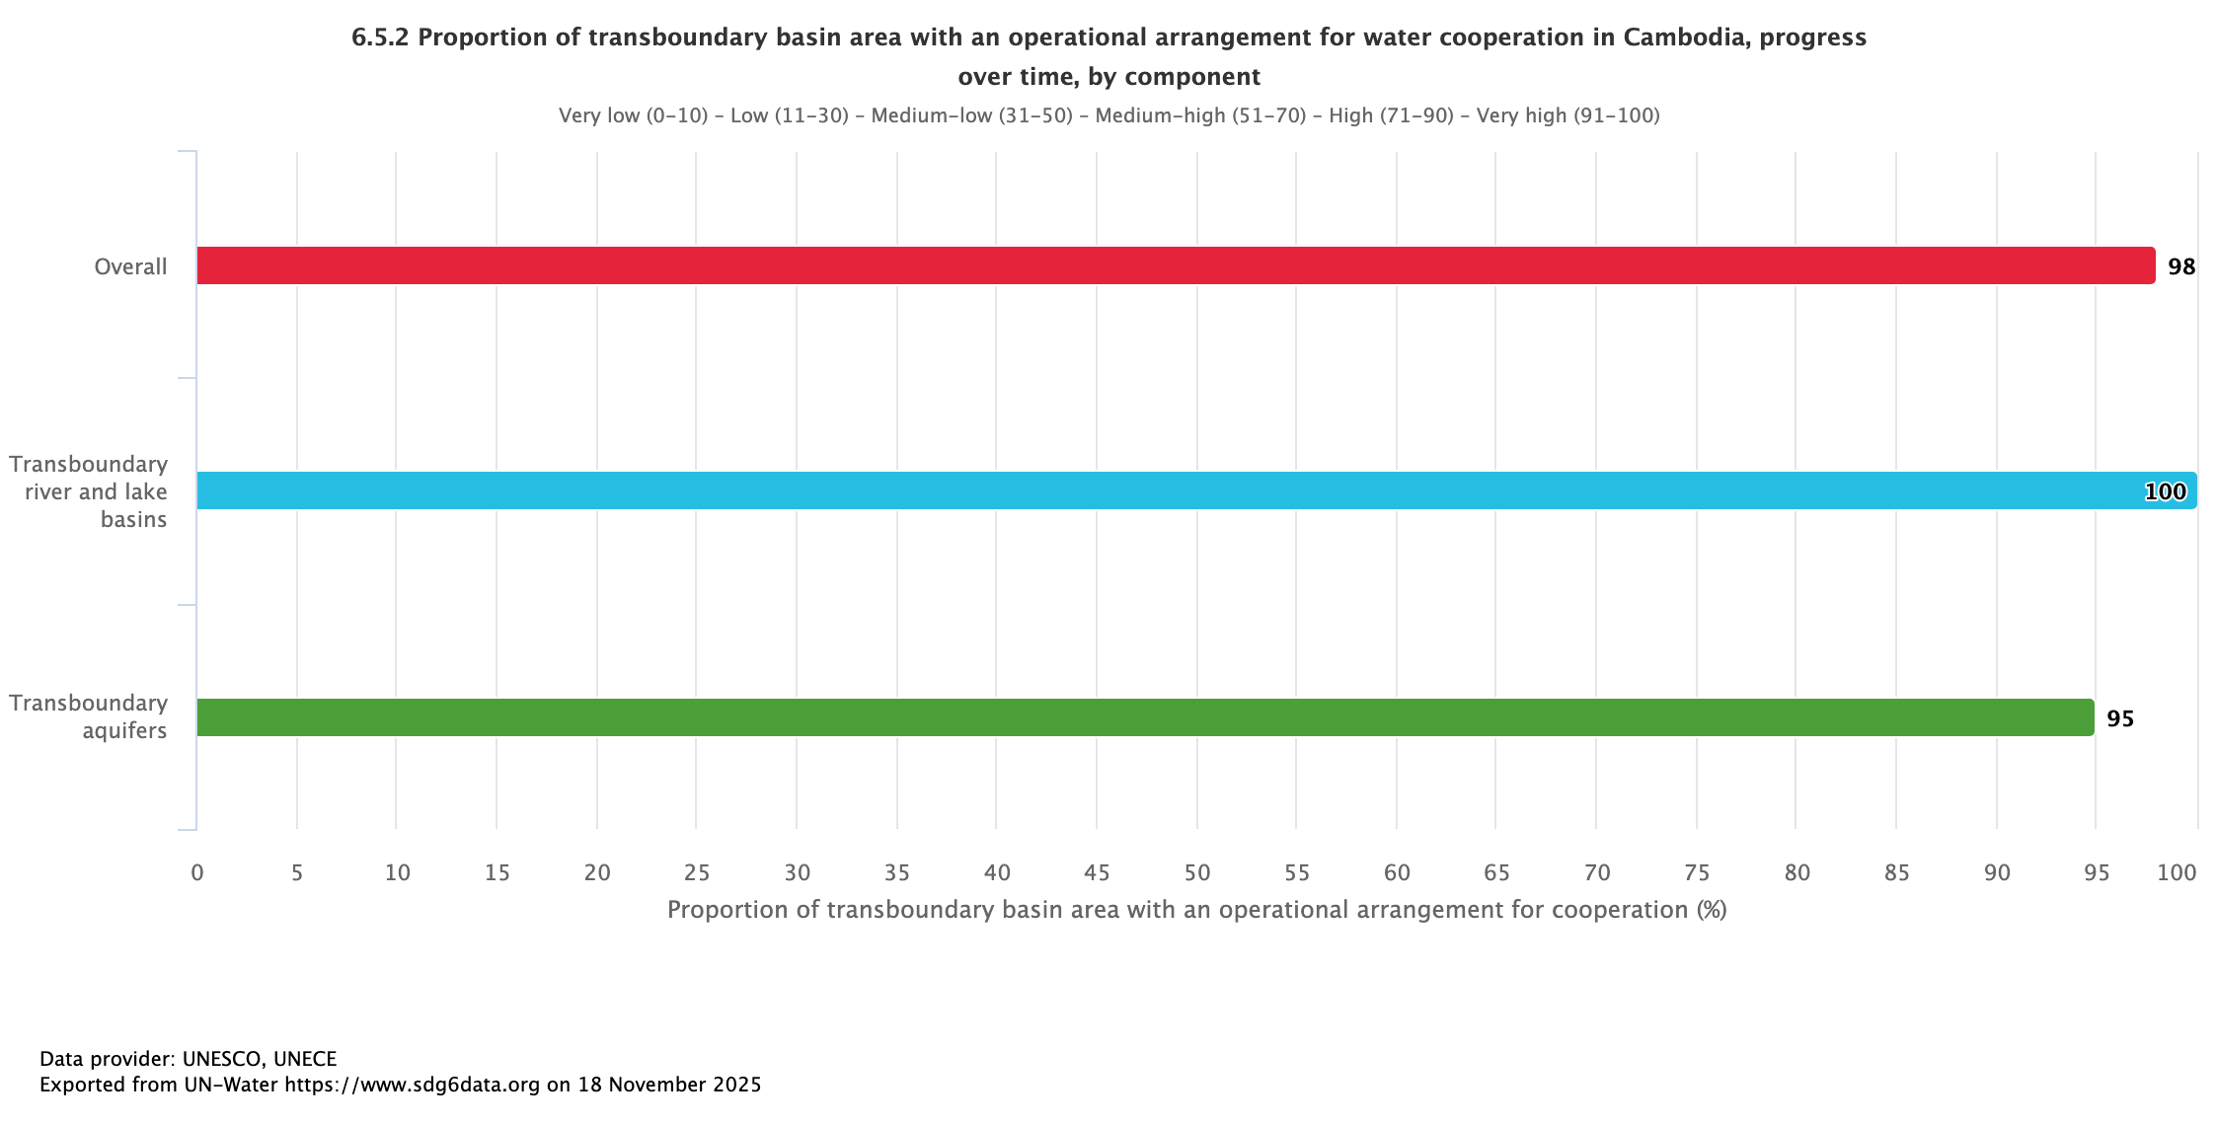
3. Governance capacity to address and mitigate assessed risks (2025)
3.1 Climate risks
  Climate risk assessments and policy instruments exist (NCR/NAP/DRR), with growing integration into planning.
  Early warning, emergency response and coastal adaptation measures are present but uneven across provinces.
  Integrated Water Resources Management (IWRM) (SDG 6.5.1): 62%
  Operational arrangements for water cooperation, relevant to transboundary nutrient/sediment pathways, (SDG 6.5.2): 98%
Notes:
[#]
[Sources]
- Cambodia National TDA (2025), Chapter 6 (governance capacity, gaps) and Executive Summary.
[/Sources]

Slide 12
3. Governance capacity to address and mitigate assessed risks (2025)
3.2 Risks to people & livelihoods
  Community-based management (CFis/CPAs) and livelihood programmes support adaptation and co-management in priority sites.
  Social protection and diversification measures exist, but exposure is rising with coastal growth and hazard-zone settlement.
3.3 Risks of pollution
  EIA/permit systems, effluent standards and emerging circular-economy measures provide a framework for control.
  Implementation lags in wastewater, solid waste, industrial pre-treatment and compliance monitoring.
Notes:
[#]
[Sources]
- Cambodia National TDA (2025), Chapter 6 (governance capacity, gaps) and Executive Summary.
[/Sources]

Slide 13
3. Governance capacity to address and mitigate assessed risks (2025)
3.4 Coastal habitat deterioration
  Protected areas, MFMAs and site-level management plans provide legal basis for mangrove, seagrass and reef protection.
  Management effectiveness varies due to financing, patrol capacity, and competing development pressures.
3.5 Impacted fisheries & aquaculture
  Fisheries governance includes licensing/zoning, community fisheries, and MFMA expansion toward EAFM.
  IUU, trawl incursions, weak data and limited enforcement constrain rebuilding; aquaculture biosecurity and effluent controls are limited.
Notes:
[#]
[Sources]
- Cambodia National TDA (2025), Chapter 6 (governance capacity, gaps) and Executive Summary.
[/Sources]

Slide 14
4. Major gaps in governance (cross-cutting + sector-specific)
4.1 Foundational marine governance gaps
  Marine mandates at sea are not fully clarified/operationalized; Marine Spatial Planning (MSP) and offshore enforcement remain incomplete.
  Transboundary coordination is uneven across water quality, fisheries compliance and oil-spill response.
4.2 Data, monitoring and transparency gaps
  Sparse/irregular monitoring (water quality, habitats, fisheries); limited lab capacity and data integration.
  Limited indicators to track outcomes (ecosystem condition, pollution loads, enforcement effectiveness).
4.3 Finance and implementation gaps
  Insufficient O&M budgets for wastewater/solid waste systems, protected areas, patrols and restoration.
  Compliance and enforcement capacity lags the pace of coastal development (ports/SEZs/tourism expansion).
4.5 Social and livelihood resilience gaps
  Co-management committees need stable financing, training and clearer benefit-sharing; high vulnerability persists in hazard-prone settlements.
Notes:
[#]
[Sources]
- Cambodia National TDA (2025), Chapter 6 (governance capacity, gaps) and Executive Summary.
[/Sources]

Slide 15
5. Strategic recommendations (national + regional cooperation)
Key National priorities
Key Regional cooperation (SCS–GOT)
Operationalize MSP with cumulative-impact thresholds and climate-risk layers.
Scale wastewater treatment + drainage; enforce industrial effluent standards in ports/SEZs.
Strengthen solid waste & plastics systems (collection, recycling markets, leakage prevention).
Expand and finance MPA/MFMA management, monitoring and patrols; reduce trawl incursion & bycatch.
Protect/restore mangroves and seagrass; prioritize peat-mangrove hydrology and nature-based adaptation.
Joint Gulf of Thailand oil-spill exercises and sensitivity mapping.
Transboundary stock assessments + coordinated IUU surveillance and compliance.
Coordinated marine-litter monitoring and source reduction, aligned with regional mechanisms.
Shared learning on wastewater and port/industrial compliance systems in coastal growth nodes.
Notes:
[#]
[Sources]
- Cambodia National TDA (2025), Executive Summary (priority directions for action) and Chapter 6 recommendations.
[/Sources]

Slide 16

Contact: Ministry of Environment / Fisheries Administration – Cambodia
For discussion at RSTC-3 (Phú Quốc, 26–28 Jan 2026)
Notes:
[#]
[Sources]
- Cambodia National TDA (2025).
[/Sources]

