Slide 1
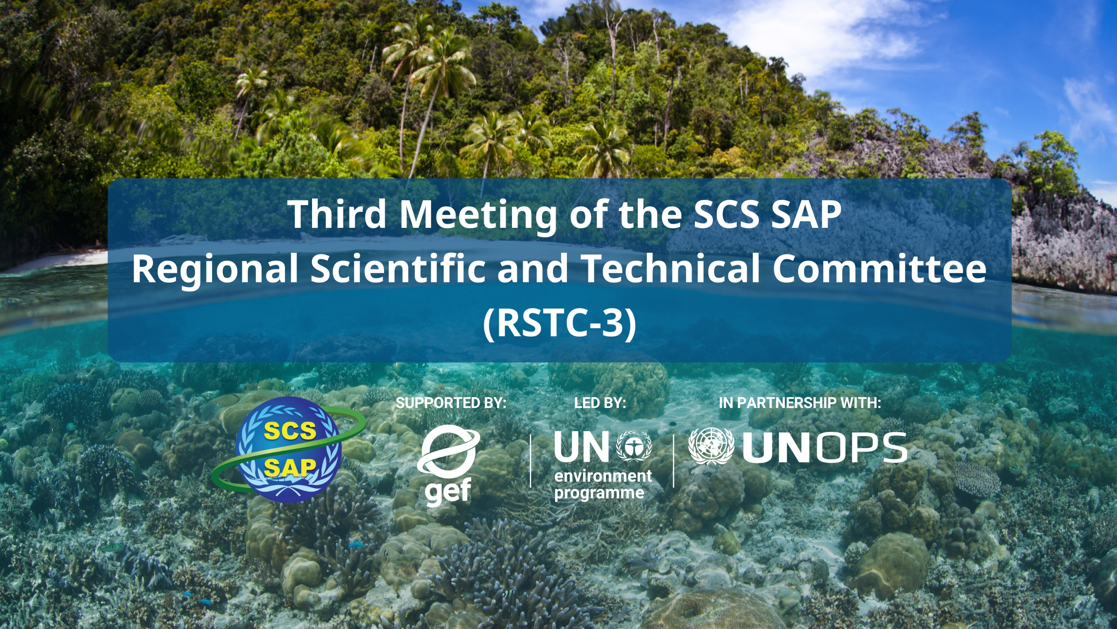




SUPPORTED BY LED BY IN PARTNERSHIP WITH

Slide 2

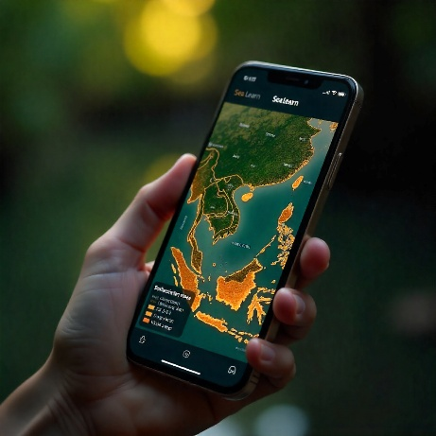
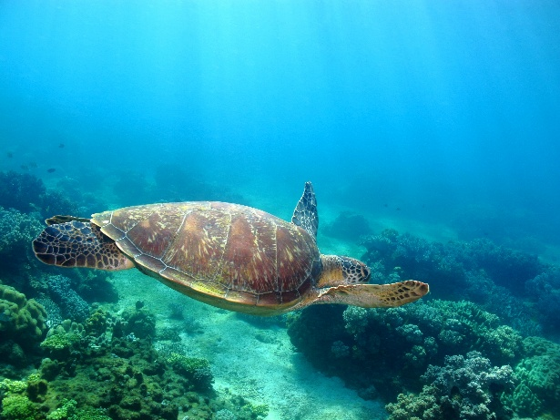
NATIONAL REPORT OF CHINA
on the Transboundary Diagnostic Analysis(TDA)
By: YUNJUN YU
RSTC3 Meeting
26-28 Jan 2026
Phú Quốc

Slide 3
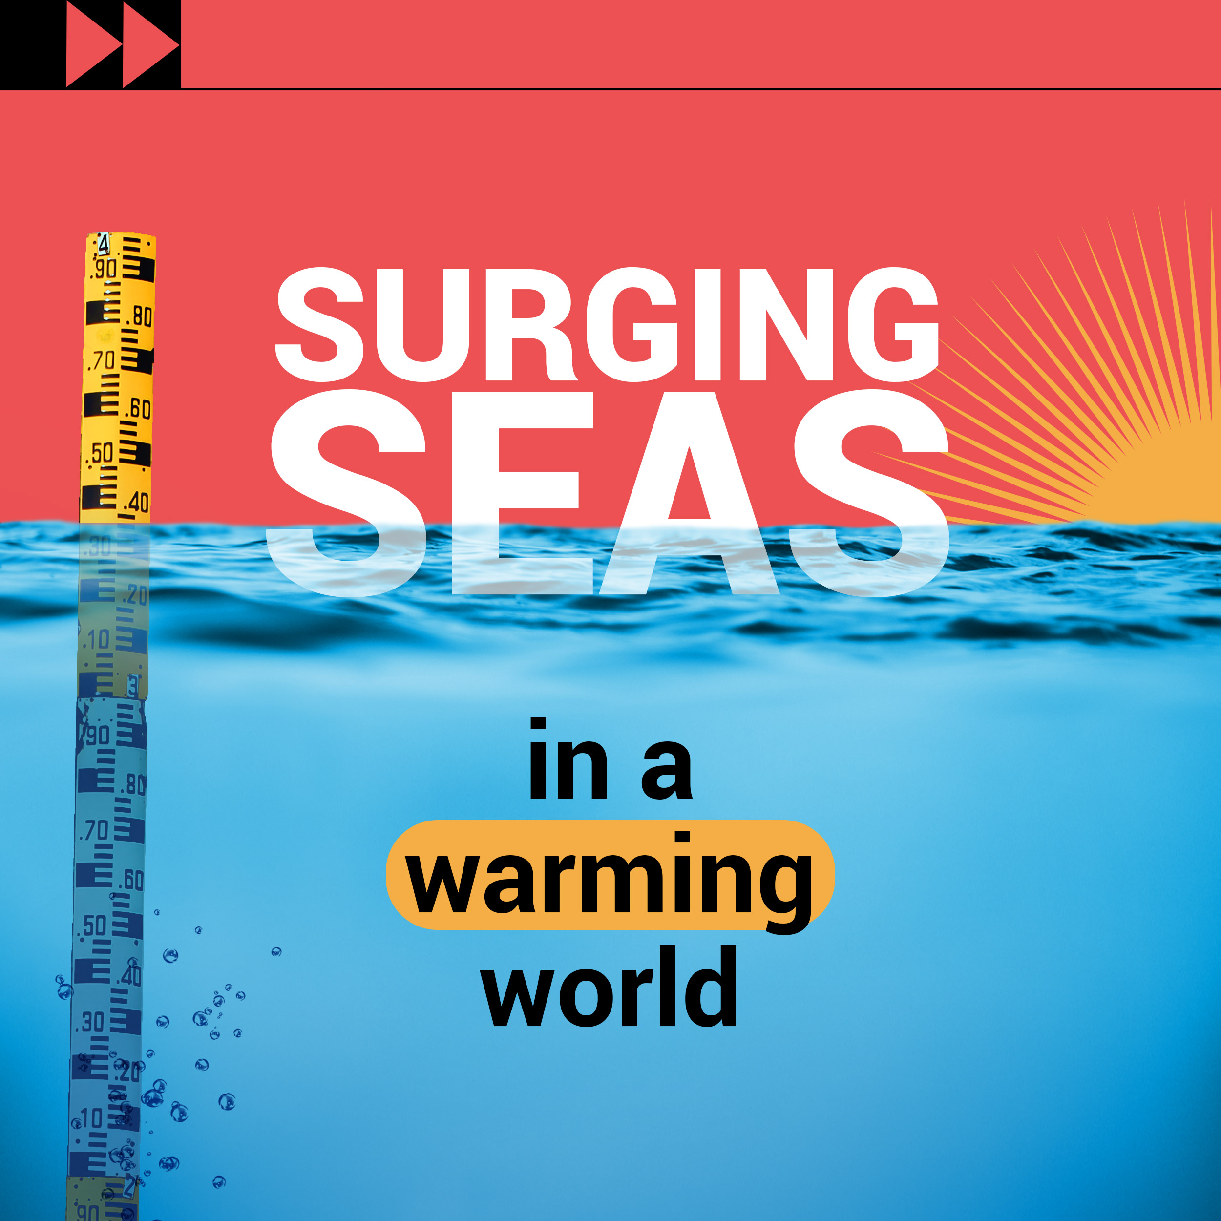
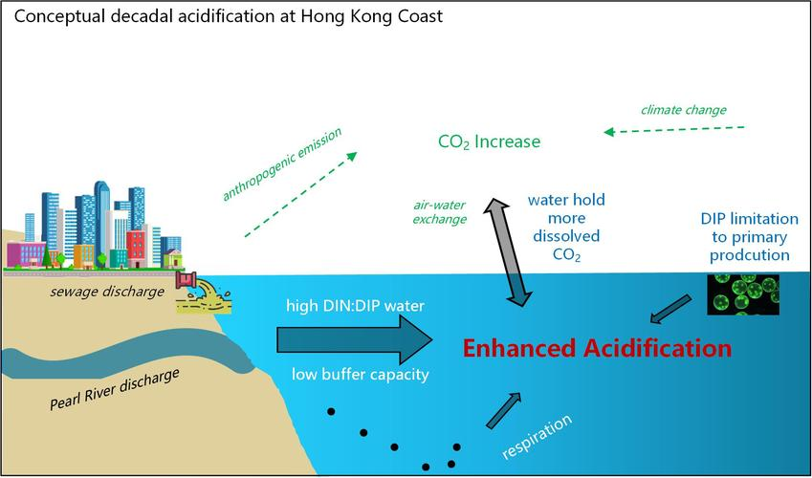
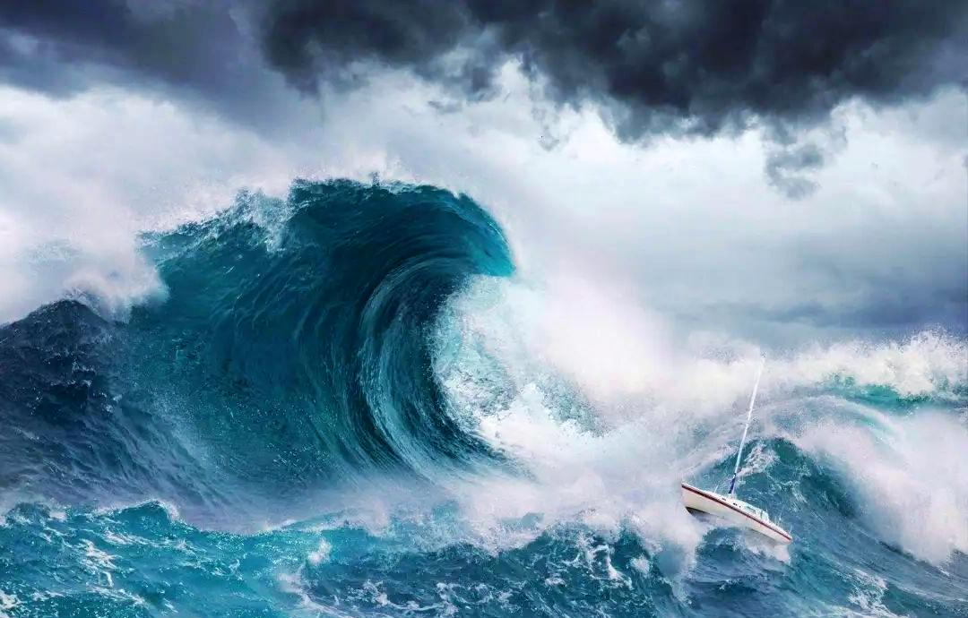
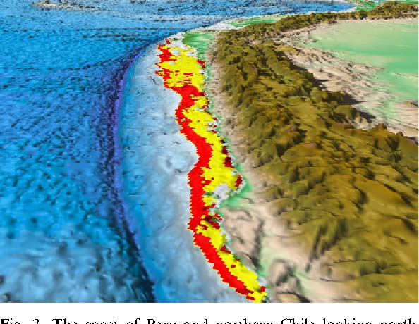
COUNTRY TDA REPORT PRESENTATION OUTLINE
1. Key thematic/geographic areas of risk and vulnerability because of:
1.1 Exposure to Climate Change Impacts
RSTC3 Meeting
26-28 Jan 2026
Phú Quốc
Sea Level Rise：
Coastal Erosion
Seawater Intrusion
Increased Pressure on Flood Defense Facilities
Ocean Acidification：
Impaired Organism Development
Decline in Biodiversity and Ecosystem Function
Seawater Warming：
Exacerbate Sea-Level Rise
Marine Hypoxia
Extreme Weather Events：
Increased Frequency of Storm Surges, Heavy Rainfall, and Other Extreme Events

Slide 4

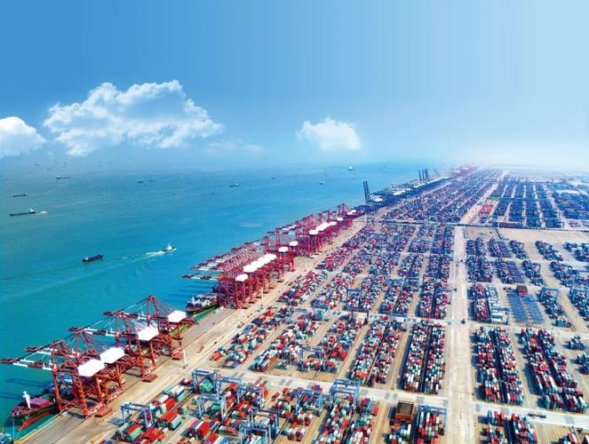
COUNTRY TDA REPORT PRESENTATION OUTLINE
1. Key thematic/geographic areas of risk and vulnerability because of:
1.2 Exposure of Populations and Livelihoods to Climate and Other Environmental Impacts
RSTC3 Meeting
26-28 Jan 2026
Phú Quốc
Sustainable Development of the Blue Economy is under prussure：
Facilities/Critical Elements Damaged
Resource Redistribution
Heightened Port Risks
Rising Industry Costs
Increased Pressure on Urban Development:
Impact on Infrastructure
Disruption to Urban Operations
Rising Investment in Climate Adaptation

Slide 5
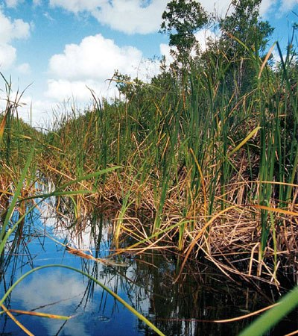
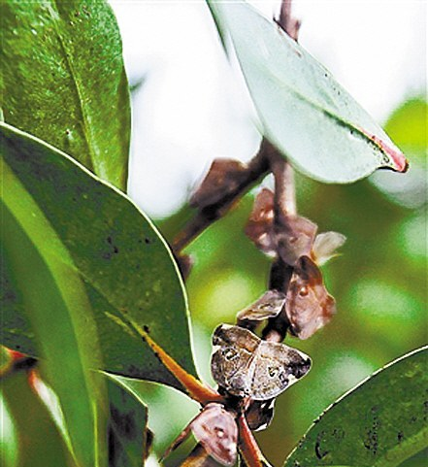
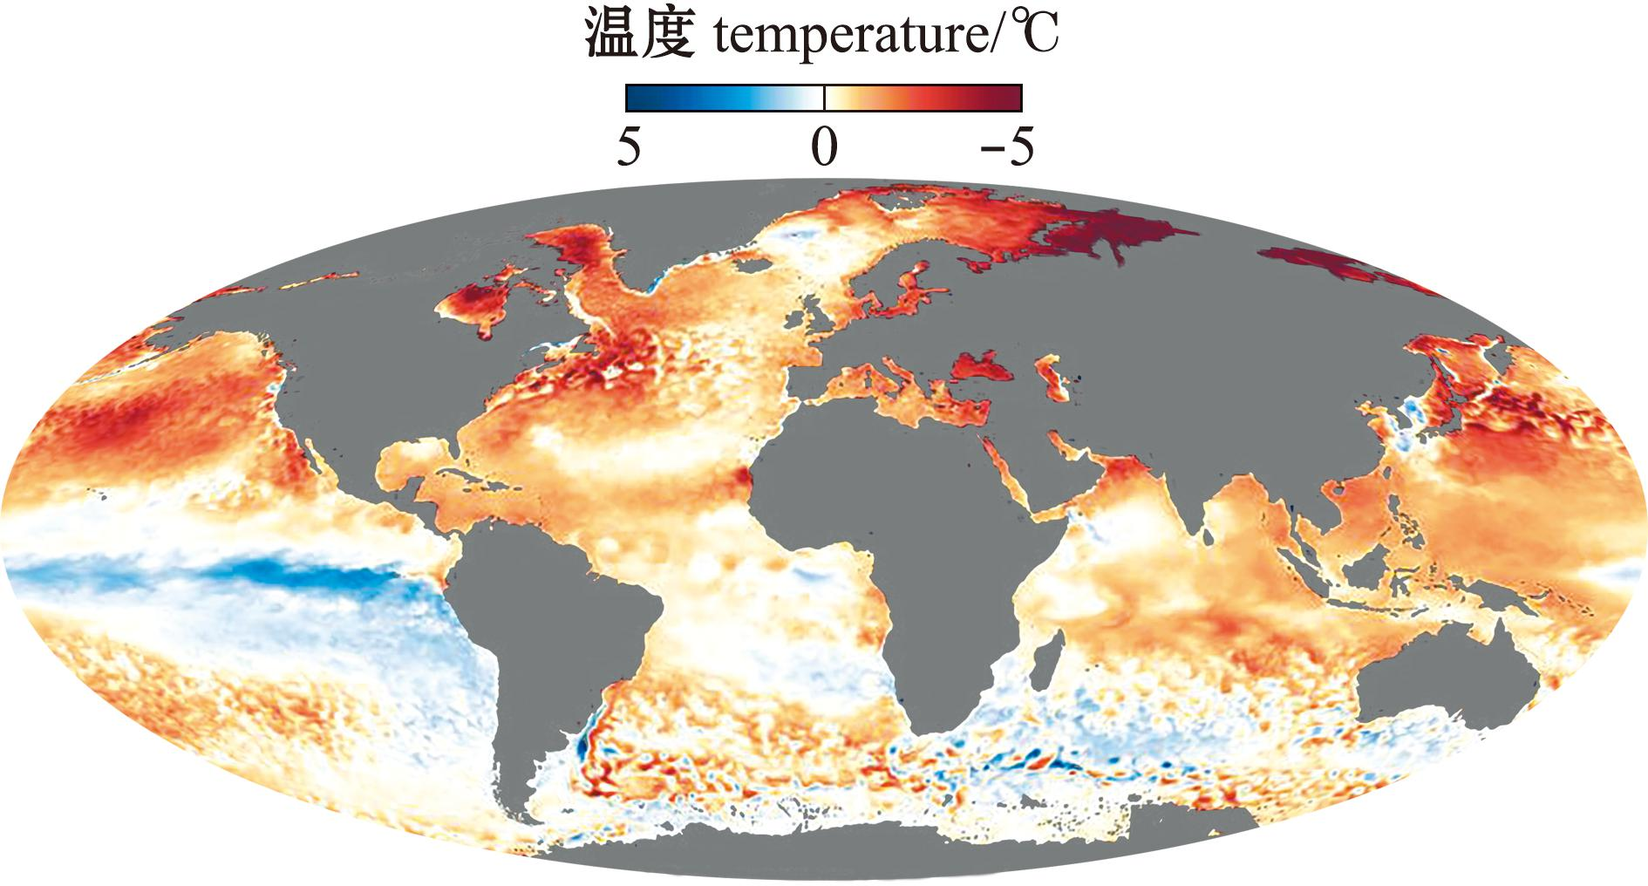
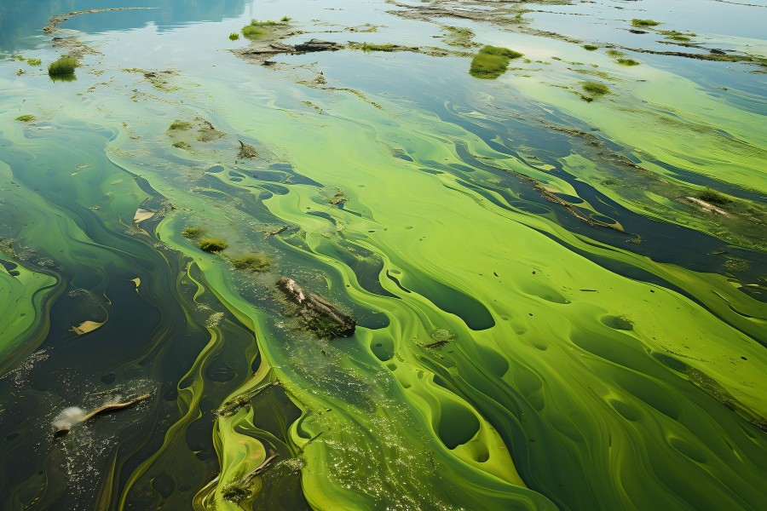
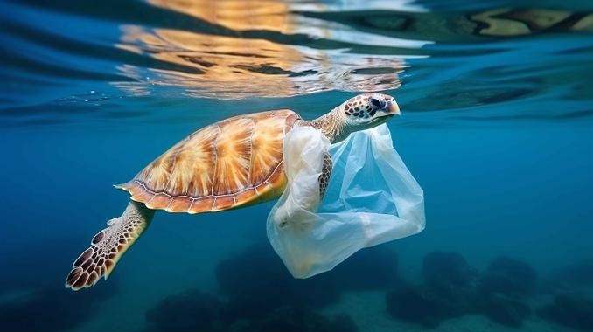
COUNTRY TDA REPORT PRESENTATION OUTLINE
1. Key thematic/geographic areas of risk and vulnerability because of:
1.3 Ecosystem Exposure to Climate and Exploitation
RSTC3 Meeting
26-28 Jan 2026
Phú Quốc
System State Mediated by Pollution
Nutrient over-enrichment leading to eutrophication and algal blooms
Marine litter affecting marine life, human health, scocio-economic, torism, etc.
System States Manifested by Coastal Habitats
Impact on mangroves and seagrass beds due to combined stressors
Invasive species and harmful organisms threats

Slide 6
COUNTRY TDA REPORT PRESENTATION OUTLINE
2. How does the current governance capacity address and mitigate the assessed risks?
2.1 Climate Risks
RSTC3 Meeting
26-28 Jan 2026
Phú Quốc
Strengthen strategic planning
Issuing and implementing the National Climate Change Adaptation Strategy 2035.
Improve the monitoring, assessment, and early warning systems for climate change.
The number of offshore ecological trend monitoring stations exceeding 1,600.
Carried out the construction of coastal shelterbelts and disaster prevention and mitigation facilities.
Regularly released marine climate prediction products and marine ecological early warning and monitoring bulletins.
Support the development of climate-resilient cities.

Slide 7
COUNTRY TDA REPORT PRESENTATION OUTLINE
2. How does the current governance capacity address and mitigate the assessed risks?
RSTC3 Meeting
26-28 Jan 2026
Phú Quốc
2.2 Risks to People and Livelihoods
Large-scale coastal ecological restoration projects
From 2016 to 2023, 25.258 billion RMB was invested to support 175 major marine ecological protection and restoration projects.
Nearly 1,680 kilometers of coastline and over 50,000 ha of coastal wetlands were restored.
Integrated coastal zone management plans to balance development and conservation.

Slide 8
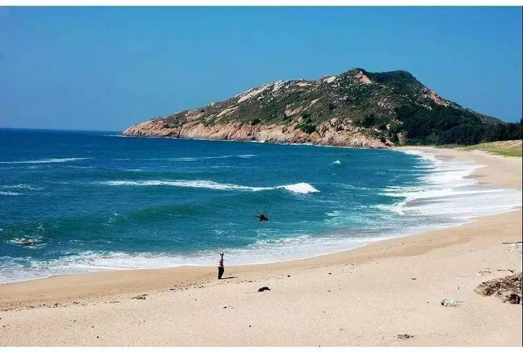
COUNTRY TDA REPORT PRESENTATION OUTLINE
2. How does the current governance capacity address and mitigate the assessed risks?
2.3 Risks of Pollution
RSTC3 Meeting
26-28 Jan 2026
Phú Quốc
Measures for Land-Based Nutrients：
Implementing the beautiful coast initiative
Implementation of the comprehensive management action plan for the Pearl River estuary in the South China Sea
Promoting agricultural non-point source pollution control
Marine Litter Governance：
Establishing a marine litter pollution prevention system
Launching the marine debris cleanup action
Strengthening plastic pollution control
Advancing the development of zero-waste cities

Slide 9
COUNTRY TDA REPORT PRESENTATION OUTLINE
2. How does the current governance capacity address and mitigate the assessed risks?
2.4 Risk of Coastal Habitat Deterioration
RSTC3 Meeting
26-28 Jan 2026
Phú Quốc
Strengthen Legislative Protection for Habitats：
In 2021, the Wetland Protection Law was enacted and implemented.
In 2025, the Fisheries Law was revised and implemented.
Multiple specialized local regulations have been formulated for typical ecosystems.
Establishment and management of marine protected areas：
Accelerating the establishment of a nature conservation system.
Targeted restoration programs：
A series of plans and special action programs have been issued covering coastal zones, biodiversity, mangroves and Spartina alterniflora .
Interim Measures for the Management of Voluntary Greenhouse Gas Emission Reduction Trading has been promulgated.

Slide 10
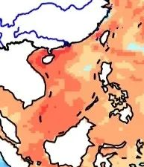
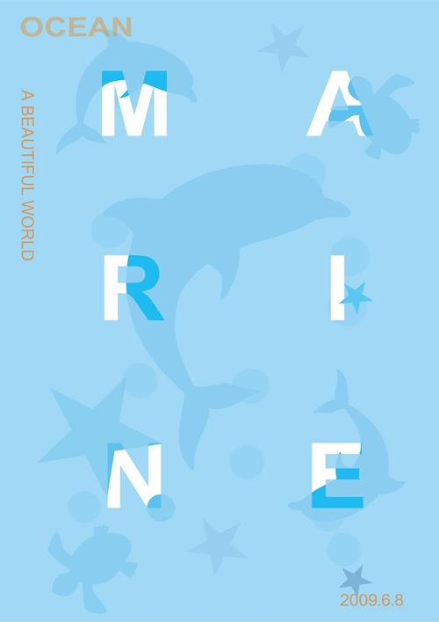

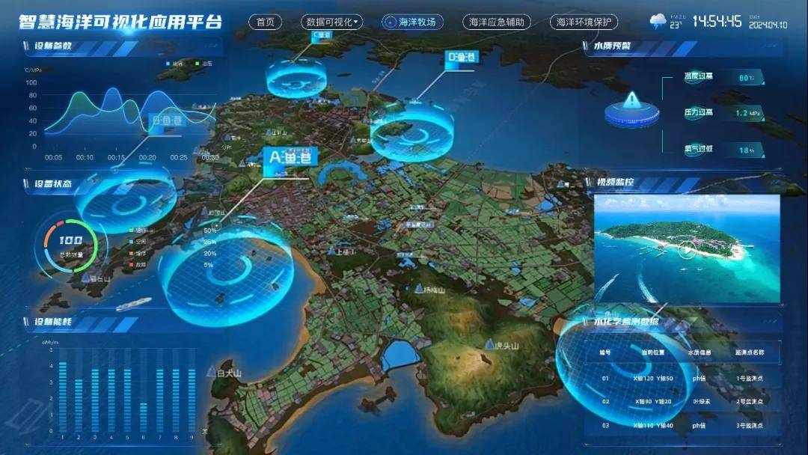
COUNTRY TDA REPORT PRESENTATION OUTLINE
RSTC3 Meeting
26-28 Jan 2026
Phú Quốc
3. What are the major gaps in governance?
A lack of systematic research on characteristic ecosystems
Insufficient Participation of Coastal Community Residents
•Insufficient cross-sectoral and cross-regional coordination mechanisms
Limited financial capacity for large-scale marine restoration

Slide 11
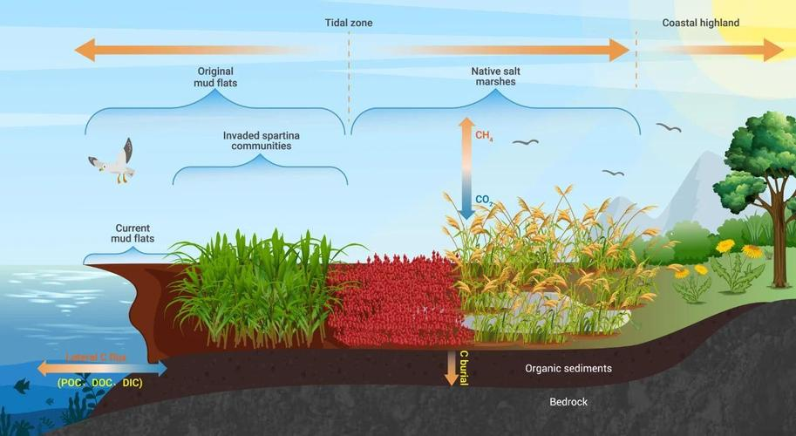
COUNTRY TDA REPORT PRESENTATION OUTLINE
RSTC3 Meeting
26-28 Jan 2026
Phú Quốc
4. What are strategic recommendations to improve governance of transboundary environmental problems and closing gaps in Item 3
Enhance research and development on marine ecological restoration technologies and climate change adaptation, improve conservation supervision capabilities.
With an emphasis on nutrient reduction, intensify the control of land-based pollution.
Prioritize source reduction of plastic waste at the regional level, strengthen information exchange among countries, establish pathways for high-value utilization of marine litter resources, and promote the scaling up of recycling industry chains

Slide 12
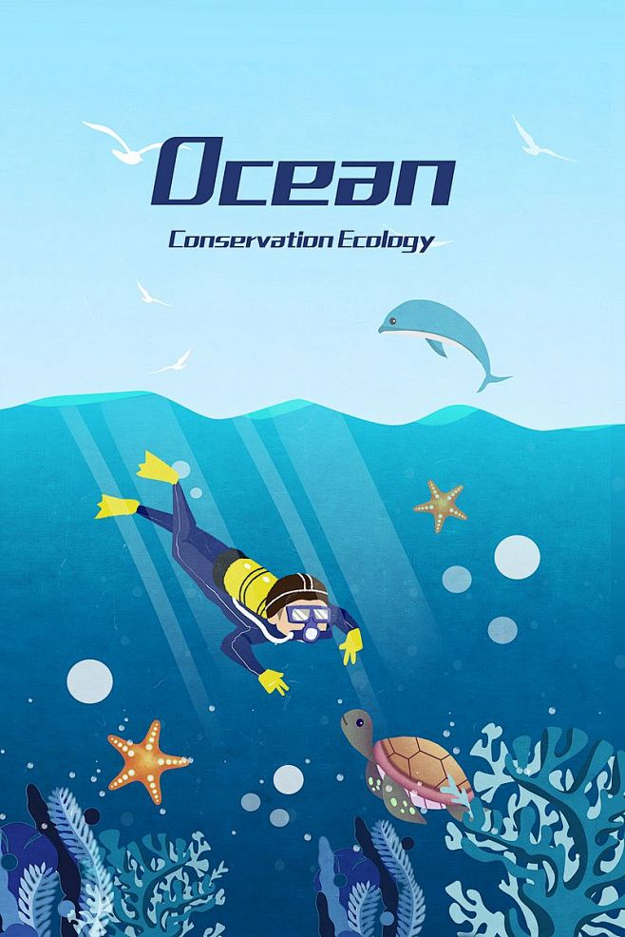
COUNTRY TDA REPORT PRESENTATION OUTLINE
RSTC3 Meeting
26-28 Jan 2026
Phú Quốc
4. What are strategic recommendations to improve governance of transboundary environmental problems and closing gaps in Item 3
Continually advance marine ecological protection and restoration, and enhance the prevention and control of invasive alien species.
Further refine related regulations and standards.
Promote public participation and raise awareness of marine ecological protection among community residents.
Enhance regional cooperation on marine environmental protection in the South China Sea.
Establish relevant technical guidelines and information exchange mechanisms at the regional level.

Slide 13
THANK YOU

