Slide 1
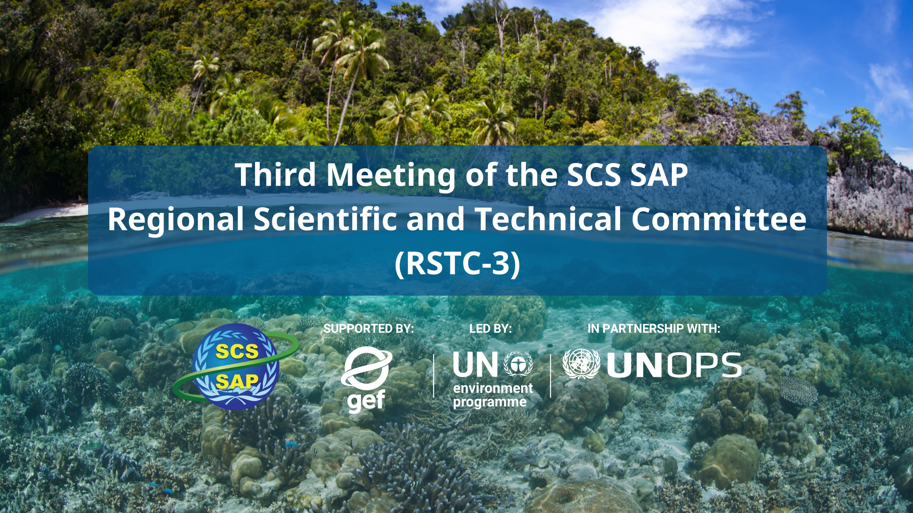
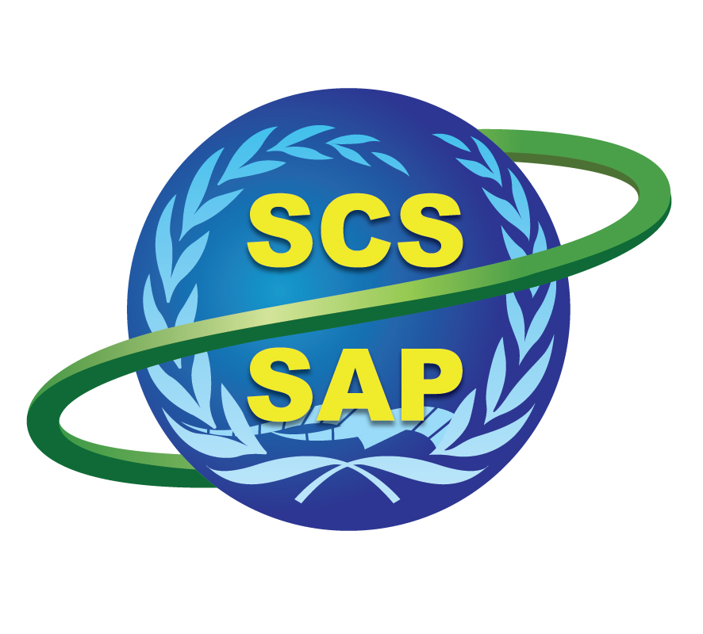



SUPPORTED BY LED BY IN PARTNERSHIP WITH

Slide 2
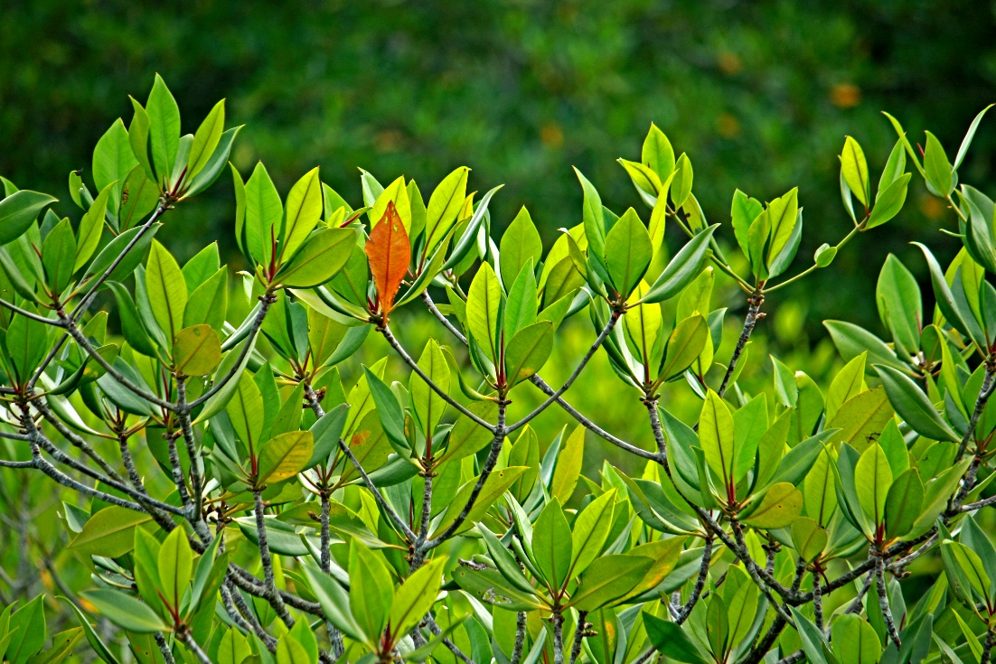
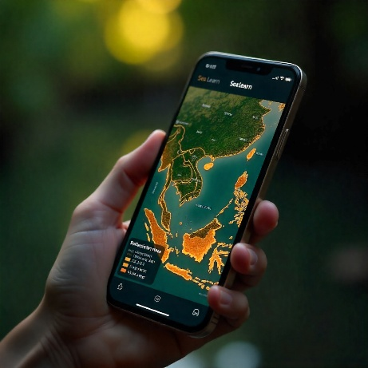
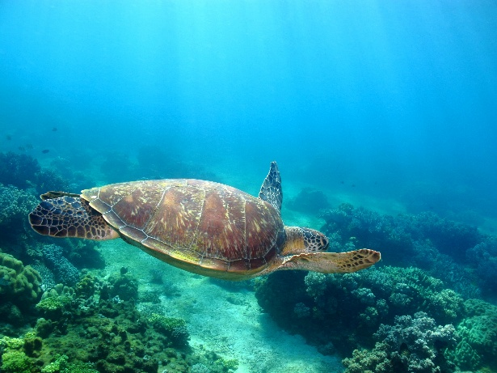
RSTC3 Meeting
26-28 Jan 2026
Phú Quốc
COUNTRY TDA REPORT - VIET NAM
By: Tran Thi Thu Ha

Slide 3
COUNTRY TDA REPORT PRESENTATION OUTLINE
RSTC3 Meeting
26-28 Jan 2026
Phú Quốc
EXPOSURE TO CLIMATE CHANGE IMPACTS
6 - 7 tropical cyclones causing damages to coastal provinces per year
Around 110 deaths, 320 injuries, 70,000 homeless, 1.7 million people affected per year
USD 600 million economic loss (1-1.5 of national GDP) per year

Slide 4
COUNTRY TDA REPORT PRESENTATION OUTLINE
RSTC3 Meeting
26-28 Jan 2026
Phú Quốc
EXPOSURE OF POPULATION AND LIVELIHOODS TO CLIMATE CHANGE IMPACTS
Nearly 50% of national population lives in coastal areas
86% coastal population lives in low-lying area (mainly 1-5 m above sea level)
11.8 million people are directly exposed to the threat of intense flooding
Over 35% of coastal built-up areas are located on eroding coastlines
Agriculture: $1 billion of agriculture GPD are directly exposed to the threat of intense flooding
Aquaculture: 1.1 million tons of aquaculture production is at risk of intense flooding
Tourism: 42% of coastal hotels are located near eroding beaches
Industry: 50% of coastal industrial zones are directly exposed to the intense flooding

Slide 5
COUNTRY TDA REPORT PRESENTATION OUTLINE
RSTC3 Meeting
26-28 Jan 2026
Phú Quốc
ECOSYSTEM EXPOSURE TO CLIMATE AND EXPLOITATION
Mangroves
Coral reef
Sea grass
7.3%/year decline in 2000 - 2024
Aquaculture expansion is dominant driver (43.4%)
Agriculture conversion is the second largest driver (29/1%)
Coastal erosion and inundation emerges as increasingly significant driver (21.2%)
Destructive fishing is the main driver
Sedimentation from watershed land-use change, coastal construction and dredging operations present a chronic stressor
Ocean warming and acidification pose long-term threats to coral reef
46.5% loss over 3 decades
Aquaculture expansion, coastal development, sedimentation, eutrophication, destructive fishing, typhoon and heavy mental contamination are traditional drivers of sea grass loss
Ocean warming and acidification pose emerging long-term threats

Slide 6
COUNTRY TDA REPORT PRESENTATION OUTLINE
RSTC3 Meeting
26-28 Jan 2026
Phú Quốc
CURRENT ACTIONS TO ADDRESS IDENTIFIED RISKS
Socio-economic and climate-related risks
Pollution
Ecosystems
Developing comprehensive legal framework and actively participating in regional cooperative framework (PEMSEA, COBSEA, Asean Forum, Mekong River Commission, etc.)
Investing in infrastructure, capacity building, public awareness raising
Gaps: shortfall in technical expertise and equipment for monitoring and treating pollution; inconsistent enforcement of pollution laws; lack of funding for infrastructure investment; public awareness and behavior on reducing pollution are still limited
Developing coastal hazard and risk database, serving for coastal policies and strategies development
Investing in structural and non-structural measures (i.e.,, building sea-dye system, planting mangroves)
Establishing legal, regulatory and policy frame work (i.e., 2014 National Strategy on Integrated Coastal Zone Management, 2015 Law on Marine and Island Resources and Environment, etc.)
Risk information remains fragmented and incomplete; Structural and non-structural remain underappreciated and legal framework is still need to be improved
Developing legal framework and improving institutional mandates
Developing monitoring system
Restoring degraded ecosystems
Legal enforcement deficits represent the most critical constraint; fragmented institutional mandates cause coordination failure; monitoring systems remains inadequate for adaptive management; funding for restoring natural ecosystem is limited

Slide 7
Major Governance Gaps
RSTC3 Meeting
26-28 Jan 2026
Phú Quốc
1. Vietnam's governance system shows a solid legal base but suffers from fragmentation, uneven implementation, and weak integration across sectors and levels. These gaps elevate risks in pollution control, fisheries sustainability, and ecosystem protection.
2. Mandates overlap between agencies (e.g., Vietnam Administration of Seas and Islands (VASI), the Nature Conservation and Biodiversity Department (NBCD), the Department of Fisheries, Fisheries Surveillance (DoF), or inter-sectors causing inefficiencies in enforcement and planning. Despite the 2025 institutional consolidation (MAE), the governance architecture retains a "Very High Risk" integration score (TWAP: 0.25–0.35).
3. Horizontal coordination remains weak, with poor data sharing across fisheries, conservation, ports, and tourism sectors. Critical marine drivers (Maritime Transport, Offshore Energy, Defense) remain structurally disconnected from the ecosystem management mandate, limiting the effectiveness of Integrated Coastal Management (ICM). Monitoring systems remain fragmented; fisheries, biodiversity, and environmental quality data exist in non-integrated silos, preventing cumulative impact assessment.

Slide 8
Major Governance Gaps
RSTC3 Meeting
26-28 Jan 2026
Phú Quốc
4. Decentralization burdens low-capacity provinces with monitoring, enforcement, and planning without adequate staffing, training, or budgets, leading to inconsistent compliance. A sharp divergence exists between "industrial" coastal provinces (high fiscal autonomy, strong enforcement) and "ecological" provinces (grant-dependent, weak capacity), undermining national uniformity. Only 9 of 28 coastal provinces are fiscally self-sufficient, limiting local action on MPAs and pollution. IUU fishing persists due to limited patrols, VMS gaps, and procedural issues in sanctions, despite legal tools. MPA budgets cover basics but not full operations like habitat restoration
5. Local departments face conflicting incentives between central policy mandates (conservation targets) and local administrative leadership (economic growth targets), often leading to the deprioritization of environmental objectives
6. Community involvement remains limited. Participatory models (e.g., co-management) are frequently reliant on external donor cycles, lacking the institutional anchoring to survive post-project. Small-scale fishers and vulnerable groups remain marginalized in formal decision-making processes regarding zoning and licensing, reducing the social legitimacy of governance

Slide 9
Major Governance Gaps
RSTC3 Meeting
26-28 Jan 2026
Phú Quốc
7. Existing cooperation is fragmented; while engagement in international agreements is high (UNCLOS, CBD), no coherent regional framework exists for managing shared fishery stocks, migratory species or transboundary pollution at the Large Marine Ecosystem (LME) scale for the South China Sea or Gulf of Thailand.
8. Weak LME-scale coordination in South China Sea and Gulf of Thailand for shared stocks and pollution, plus incomplete land-sea linkages. Emerging MSP offers promise but lacks full operationalization.

Slide 10
Strategics to improve governance
RSTC3 Meeting
26-28 Jan 2026
Phú Quốc
1. Strengthen cross-sectoral and multi-level integration: Operationalize the National Marine Spatial Planning (MSP) framework by establishing inter-ministerial protocols that link MSP to sector decisions (ports, fisheries, energy) to reduce conflicts. Additionally, improve land–sea integration for pollution control by creating shared pollution "pressure maps" and standardizing water-quality reporting across coastal provinces.
2. Improve legal and policy coherence: Enhance regulatory alignment at the land–sea interface by reviewing discharge standards for coastal industries to ensure they are enforceable at the provincial level. Furthermore, reduce fragmentation in fisheries compliance by issuing unified guidance for case handling across different sanctioning authorities and aligning domestic policy tools with international port-based controls.

Slide 11
Strategics to improve governance
RSTC3 Meeting
26-28 Jan 2026
Phú Quốc
3. Strengthen provincial implementation capacity: Establish a simple national benchmarking system to track enforcement effort (inspections, patrol hours) comparably across coastal provinces. Capacity building should be targeted based on subregional pressures—focusing on port compliance in the Gulf of Tonkin and fisheries/aquaculture compliance on the Southwest Coast—while strengthening provincial project execution for pollution-reduction infrastructure.
4. Enhance inclusive participation and equity: Move community-based co-management from pilot projects to institutionalized governance using the Fisheries Law, supported by clear provincial plans and guidance. Improve transparency by standardizing public consultation for coastal projects and monitoring the distributional impacts of compliance reforms (like VMS) to identify and support vulnerable fleet segments.

Slide 12
Strategics to improve governance
5. Advance sustainable financing and PPP approaches: Improve the visibility of marine-relevant public spending by introducing specific budget tags for monitoring and enforcement to identify funding gaps. Simultaneously, strengthen economic instruments like Extended Producer Responsibility (EPR) for marine litter and pilot Public-Private Partnerships (PPP) for bankable services such as port waste reception.
6. Deepen regional and transboundary cooperation: Harmonize monitoring indicators for marine pollution and litter with regional platforms (COBSEA, ASEAN) to enable comparable reporting. Strengthen fisheries cooperation through treaty-based mechanisms for shared stocks and establish information-exchange protocols for port and vessel compliance, while improving joint preparedness for shipping-related risks like oil spills.

Slide 13


THANK YOU
tranthithuha.ktmt@gmail.com
(+84) 983295929

