Slide 1
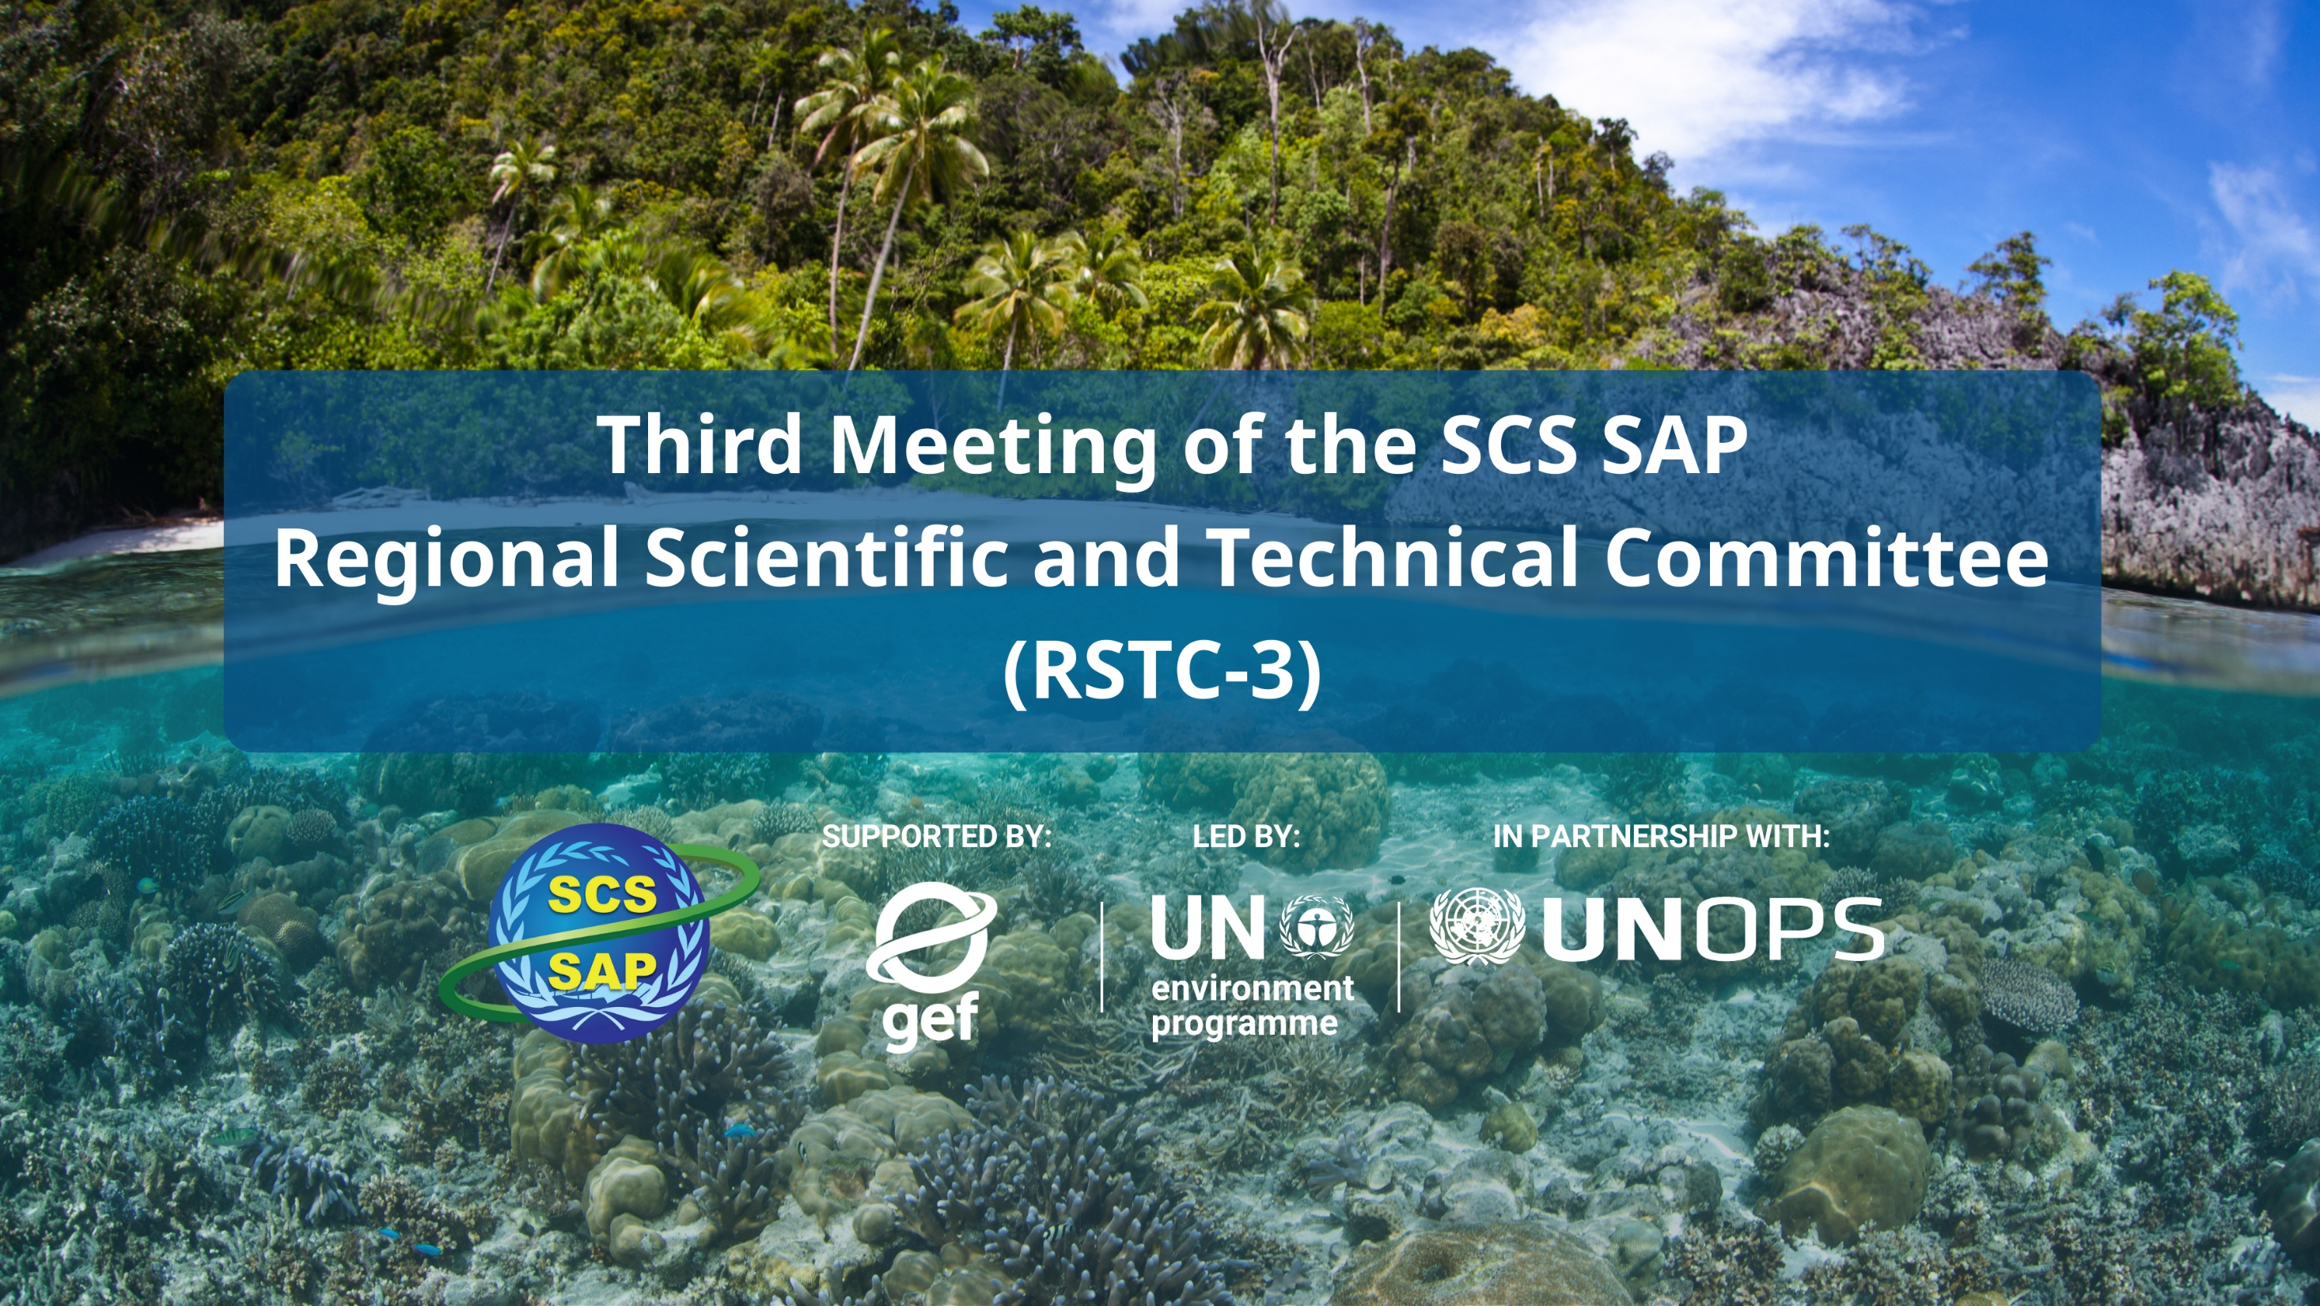
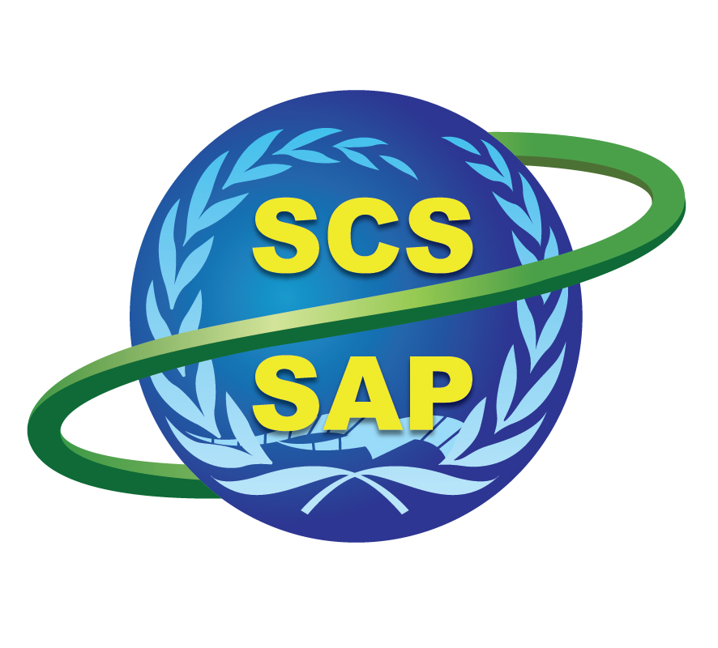



SUPPORTED BY LED BY IN PARTNERSHIP WITH

Slide 2
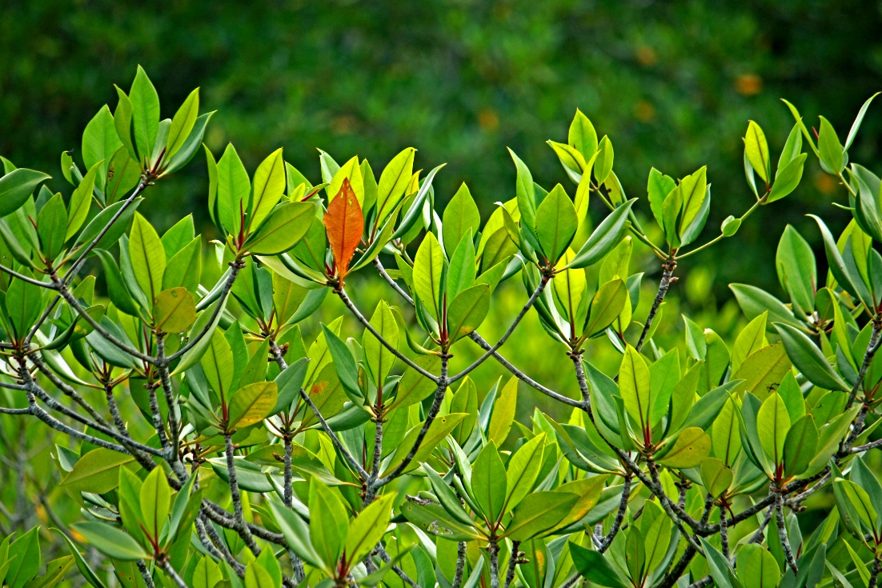
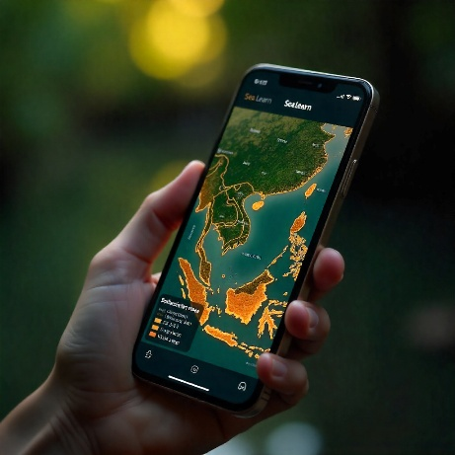
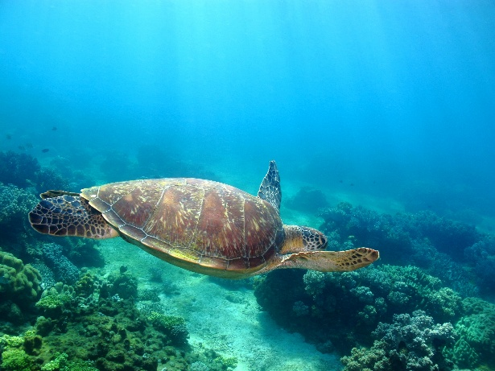
The Indonesia’s South China Sea :
National management perspective
Ministry of Environment of Indonesia
Center for Coastal and Marine Resources
Studies (CCMRS) IPB University
RSTC3 Meeting
26-28 Jan 2026
Phú Quốc

Slide 3
Ministry of Environment of Indonesia
Ms. Irene Aditya Yuniarti
Ms. Nur Isna Khairunnisa
Center for Coastal and Marine Resources
Studies (CCMRS) IPB University
Prof. Dr. Yonvitner (Team Leader & Ecosystem)
Prof. Dr. Luky Adrianto (Socio Economics)
Prof. Dr. Ario Damar (Pollution)
Prof. Dr. M. Riyanto (Fisheries)
Dr. Taryono (Governance)
Ms. Isdahartati
Project National Coordinator
Mr. Heru Waluyo Kesowo
RSTC3 Meeting
26-28 Jan 2026
Phú Quốc

Slide 4
1. Key thematic/geographic areas of risk and vulnerability
No. | Thematics | Sub-themes
1 | Socio Economics | - Social–ecological systems - High exposure to climate hazards - Anthropogenic pressures - Geomorphological vulnerability - Ecologically rich and conservation
2 | Climate-related | Decline in Food and Fisheries Production and Tourism
 |  | Decline in Land Productivity and Fisheries Supply Chain Management
3 | Marine Pollution | Plastic/Marine Debris Pollution
 |  | Oil Spill
 |  | Domestic waste
4 | Ecosystem | Habitat Destruction
 |  | Habitat Quality Degradation
5 | Marine capture fisheries and aquaculture | Illegal Fishing
 |  | Overfishing in Fisheries Management Area (WPP) 711
 |  | Conflicts over Fishing Grounds
 |  | Abandoned, Lost, or Otherwise Discarded Fishing Gear (ALDFG)
 |  | Incidental Capture of Endangered, Threatened, and Protected (ETP) Species
6 | Governance | Regulations
 |  | Governance mechanisms on local, national and regional levels
 |  | Regional thematics cooperation : pollution, ecosystems and fisheries
RSTC3 Meeting
26-28 Jan 2026
Phú Quốc

Slide 5
2. How does these areas of risk and vulnerability as assessed in year 2025 differ from the National TDA Report 1.0 (year 2000)?
No. | Theme | TDA 2000 | TDA 2025
1. | Climate change risk | Less discussed | Food and Fisheries Production; Tourism
 |  |  | Decline in Land Productivity and Fisheries Supply Chain Management
2 | Coastal ecosystems : mangroves, coral reefs, seagrass and coastal wetland | Habitat Destruction Threats Current management Challenges Opportunities | Habitat Destruction Threats : 10-20% Current management Challenges Opportunities
 |  | Habitat Quality Degradation | Habitat Quality Degradation
 |  | Exploitation of living aquatic resources
3 | Pollution | Land-based pollution; nutrient pollution | Plastic/Marine Debris Pollution : 20-30% increases
 |  | Industry and hydrocarbon | Oil Spill : recurrent at Bintan
 |  | Hazardous waste | Hazardous waste : better handling
 |  |  | Domestic waste : 30-40% increase population
 |  |  | Fish cage culture waste : 20-40% uneaten food
 |  | Current managements | Current managements
 |  | Challenges | Challenges
RSTC3 Meeting
26-28 Jan 2026
Phú Quốc

Slide 6
2. How does these areas of risk and vulnerability as assessed in year 2025 differ from the National TDA Report 1.0 (year 2000)?
No. | Theme | TDA 2000 | TDA 2025
4 | Fisheries | Fisheries and habitat management | Illegal Fishing
 |  | Regional Refugia Fish Management | Overfishing in Fisheries Management Area (WPP) 711
 |  |  | Conflicts over Fishing Grounds
 |  |  | Abandoned, Lost, or Otherwise Discarded Fishing Gear (ALDFG)
 |  |  | Incidental Capture of Endangered, Threatened, and Protected (ETP) Species
5 | Socio Economics | Economic Valuation Cost-Benefits Analysis for environmental issues | 1. Socio-economics risk 2. Livelihood dynamics 3. Anthropogenic pressures 4. Climate-community resilience 5. Economic Valuation 6. Blue Economy Context
6 | Governance | Less discussed Regional cooperation mechanisms | Regulations
 |  |  | Governance mechanisms on local, national and regional levels
 |  |  | Regional thematics cooperation : pollution, ecosystems and fisheries
RSTC3 Meeting
26-28 Jan 2026
Phú Quốc

Slide 7
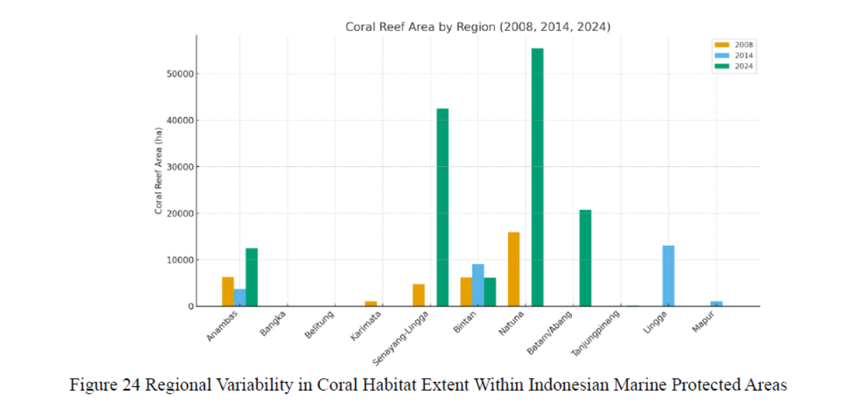
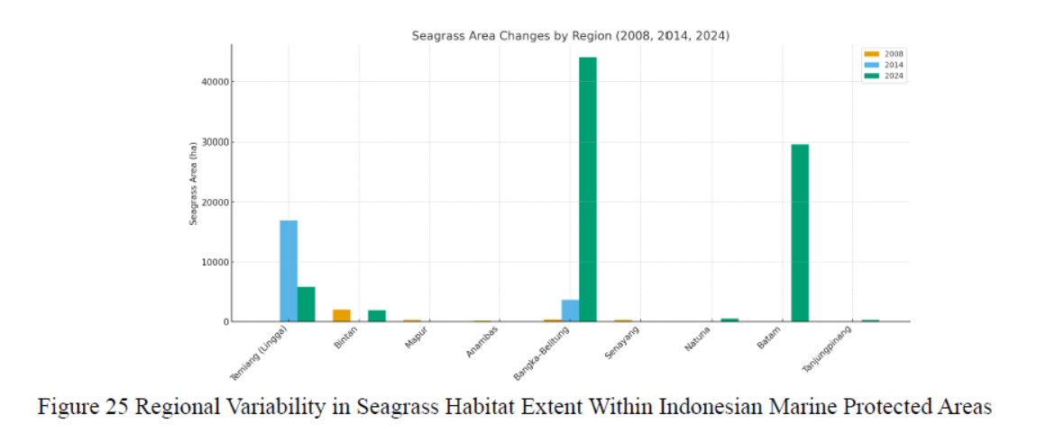
2. How does these areas of risk and vulnerability as assessed in year 2025 differ from the National TDA Report 1.0 (year 2000)?
Ecosystems Coral Reef
Ecosystems Seagrass

Slide 8
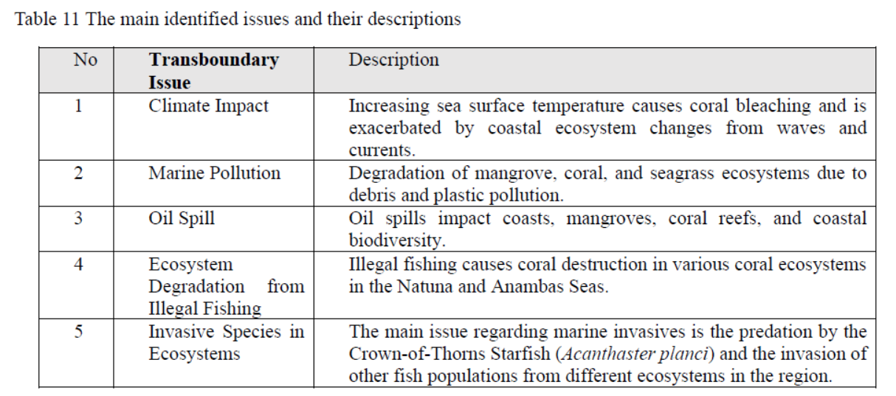
2. How does these areas of risk and vulnerability as assessed in year 2025 differ from the National TDA Report 1.0 (year 2000)?
Threats

Slide 9
2. How does these areas of risk and vulnerability as assessed in year 2025 differ from the National TDA Report 1.0 (year 2000)?
Socio-Economics Risk Assessment
Province | Coastal Region Area (km²) | % of National Area | Est. Coastal Population (2023) | GDP Dependency on Fisheries & Marine Sector (%) | Socio-Economic Risk Index*
West Kalimantan | 147,037.04 | 7.66% | 1.52 million | 28–32% | High (0.71)
South Sumatera | 86,771.68 | 4.52% | 0.98 million | 22–26% | Moderate (0.58)
Bangka Belitung | 16,690.13 | 0.87% | 0.35 million | 36–40% | High (0.74)
Riau Islands | 8,084.00 | 0.42% | 0.29 million | 30–34% | High (0.69)
Climate-Environmental Threats
Province | Coastal Region Area (km²) | % of National Area | Sea-Level Rise Rate (mm/year) | Extreme Event Frequency (events/year) | Risk Level*
West Kalimantan | 147.037,04 | 7,66 | 4,8 | 6 | High
South Sumatera | 86.771,68 | 4,52 | 4,5 | 5 | Medium-High
Bangka Belitung | 16.690,13 | 0,87 | 4,2 | 4 | Medium
Riau Islands | 8.200,00 | 0,43 | 4,0 | 3 | Medium

Slide 10
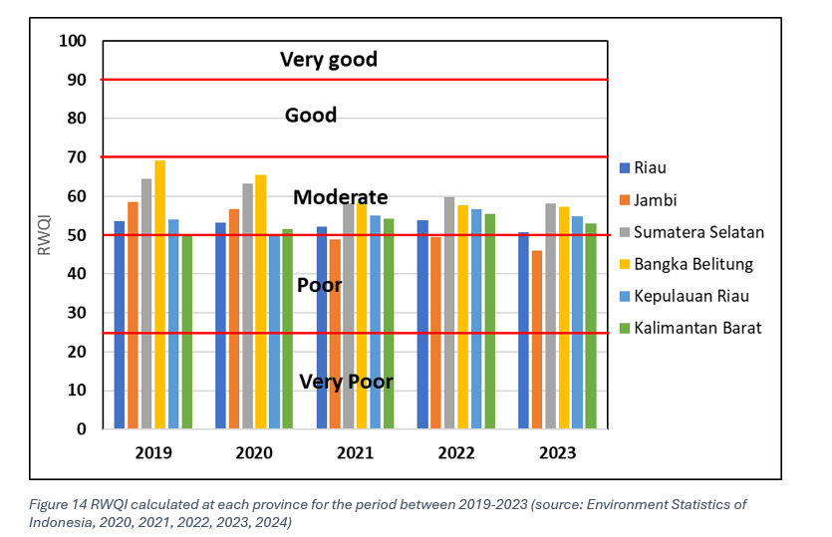
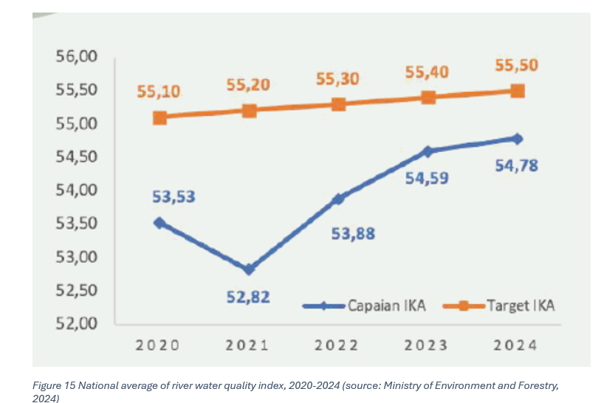
2. How does these areas of risk and vulnerability as assessed in year 2025 differ from the National TDA Report 1.0 (year 2000)?
River Water Quality Index

Slide 11
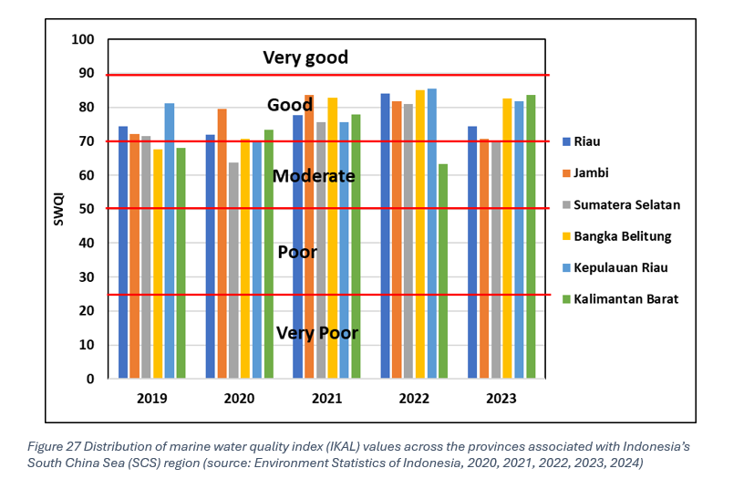
2. How does these areas of risk and vulnerability as assessed in year 2025 differ from the National TDA Report 1.0 (year 2000)?
Sea Water Quality Index

Slide 12
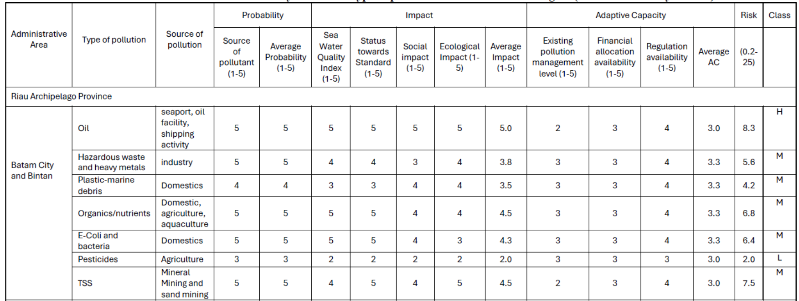
2. How does these areas of risk and vulnerability as assessed in year 2025 differ from the National TDA Report 1.0 (year 2000)?
Pollution Risk Assessment

Slide 13
3. How does the current governance capacity address and mitigate the assessed risks?
RSTC3 Meeting
26-28 Jan 2026
Phú Quốc
No. | Threat | Performance and effectiveness
1. | Socio-economic and climate threat
 | Decline in Food Production, Fisheries, and Tourism | Low
 | Decline in Land Productivity and Fisheries Supply Chain Management | Low
2 | Marine Pollution
 | Plastic/Marine Debris Pollution | Medium
 | Oil Spill | Medium
 | Domestic waste | Medium
3 | Ecosystem Stress
 | Habitat Destruction | Low
 | Habitat Quality Degradation | Low
4 | Marine capture fisheries and aquaculture
 | Illegal Fishing | Low
 | Overfishing in Fisheries Management Area (WPP) 711 | Medium
 | Conflicts over Fishing Grounds | Low
 | Abandoned, Lost, or Otherwise Discarded Fishing Gear (ALDFG) | Low
 | Incidental Capture of Endangered, Threatened, and Protected (ETP) Species | Medium

Slide 14
RSTC3 Meeting
26-28 Jan 2026
Phú Quốc
4. What are the major gaps in governance?
Government of Indonesia have launched several policies which are related to SCS management (Medium Term and Longterm Development Plan/RPJMN and RPJPN), but still in-effective implementation.
Performance and effectiveness of governance ranges from low to medium.
Risk of Indonesia SCS water governance are low for policy completeness, but medium level for integration and engagement during implementation.
Regional cooperation of SCS exists, but it requires strengthening on marine pollution (e.g., oil sludge) and expansion to include transboundary issues like ecosystem degradation, plastic waste, and ALFDG Abandoned, Lost or Discarded Fishing Gear (ALDFG).
Need the improvement of Domestic Institutional Arrangements and Collaborative Instruments Across and Within Provinces for SCS water management.
Effective SCS water of Indonesia management necessitates a land-sea collaboration platform among central government, five provinces, and twenty regencies/cities.

Slide 15
5. What are strategic recommendations to improve governance of transboundary environmental problems and closing gaps in Item 4.
Strategic Recommendation for Ecosystems
Harmonizing legal entity, mandat, align with restoration targets, spatial planning, and enforcement, and monitoring system.
Rehabilitation and restoration of ecosystem mangrove, seagrass, coral to maintaining ecosystem support for ecology and social fungtion
Science and knowledge improvement local capacity building, embed community-based knowledge in wetland management, and integrate mangrove, coral, seagrass and wetlands into Indonesia’s NDC and ASEAN reporting systems.
Regional cooperation on mangrove, coral, seagrass, and wetland local capacity building, embed community-based knowledge in wetland management, and integrate wetlands into Indonesia’s and global target including NDC, APEC, and WEF and ASEAN regional.

Slide 16
Strategic Recommendation for Pollution
RSTC3 Meeting
26-28 Jan 2026
Phú Quốc
Enhancing coordination among government institutions in implementing various National Strategic Action Plans for pollution management, including domestic wastewater, solid waste, and marine plastic.
Improvement of infrastructures of domestic waste water pollution management
Improving river, coastal and marine pollution monitoring program
Regional/ASEAN coordination on marine oil pollution, especially in the marine-transport shipping route

Slide 17
RSTC3 Meeting
26-28 Jan 2026
Phú Quốc
Strategic Recommendation for Socio-Economics
Community-oriented Islands-Nature Based Solutions e.g. fisheries-tourism, blue carbon free islands, etc
Diversify coastal livelihood (fisheries, tourism)
Climate-adaptive islands spatial planning and management

Slide 18
Strategic Recommendation for Fisheries
Enhancing Fisheries Monitoring and Enforcement: Strengthen surveillance and law enforcement systems by using technology, good governance, and community involvement to fight illegal fishing effectively.
Implementing Sustainable Fisheries Management in WPP 711: Use science-based catch limits, manage fishing efforts, and encourage responsible practices to ensure the long-term sustainability of fish stocks in Fisheries Management Area 711.
Improving Fisheries Governance and Resolving Fishing Ground Conflicts: Set up co-management zones, mediation processes, and livelihood diversification programs to reduce conflicts and create fair, inclusive governance among fishing communities.
Managing Abandoned, Lost, or Discarded Fishing Gear (ALDFG): Introduce gear registration, retrieval programs, biodegradable materials, and mandatory reporting to reduce the impact of ghost gear on marine ecosystems.
Reducing Bycatch and Protecting Endangered, Threatened, and Protected (ETP) Species: Use bycatch reduction technologies, enforce temporary closures, train crews in safe release practices, and expand electronic monitoring to protect vulnerable marine species.

Slide 19
Strategic Recommendation for Governance
RSTC3 Meeting
26-28 Jan 2026
Phú Quốc
Recommended priority actions including regional cooperation
Establish a multi-level governance framework (central-provincial-regency) for integrated blue economy development, pollution control, and coastal ecosystem conservation.
Strengthening illegal fishing eradication through enhanced monitoring, enforcement, and regional cooperation.
Revitalize ASEAN working groups via diplomatic channels to address transboundary sludge pollution affecting Batam and Bintan.
Create a dedicated regional platform for managing marine plastic debris and ALFDG Abandoned, Lost or Discarded Fishing Gear (ALDFG).
Enhance the effectiveness of SCS working groups focused on coastal ecosystem conservation (mangroves, seagrass, coral reefs).

Slide 20


THANK YOU
pkspl.ipb.ac.id
PKSPL IPB
@pkspl-ipb-university

