Slide 1
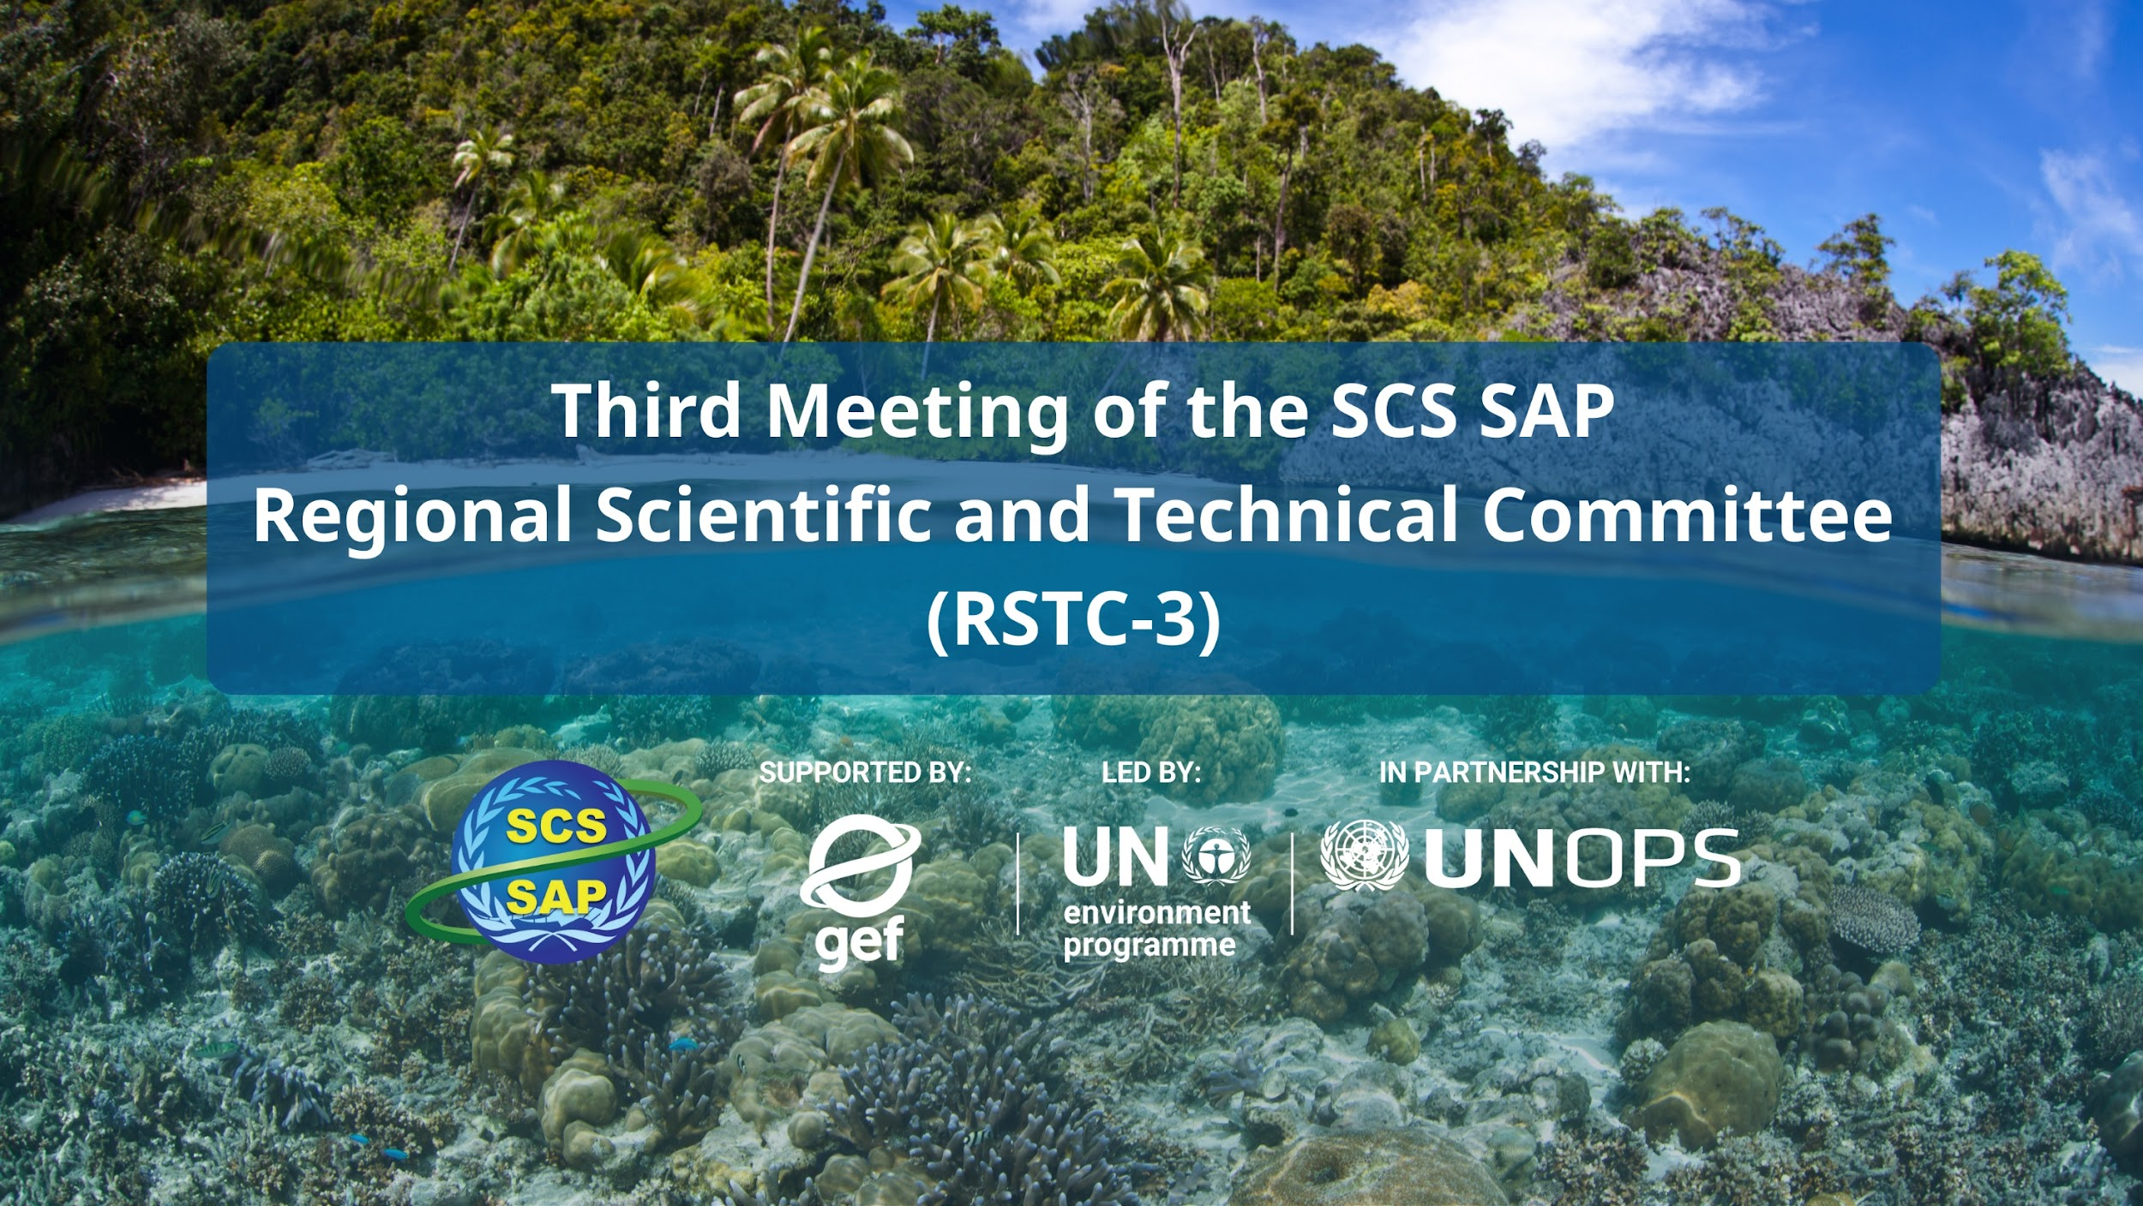
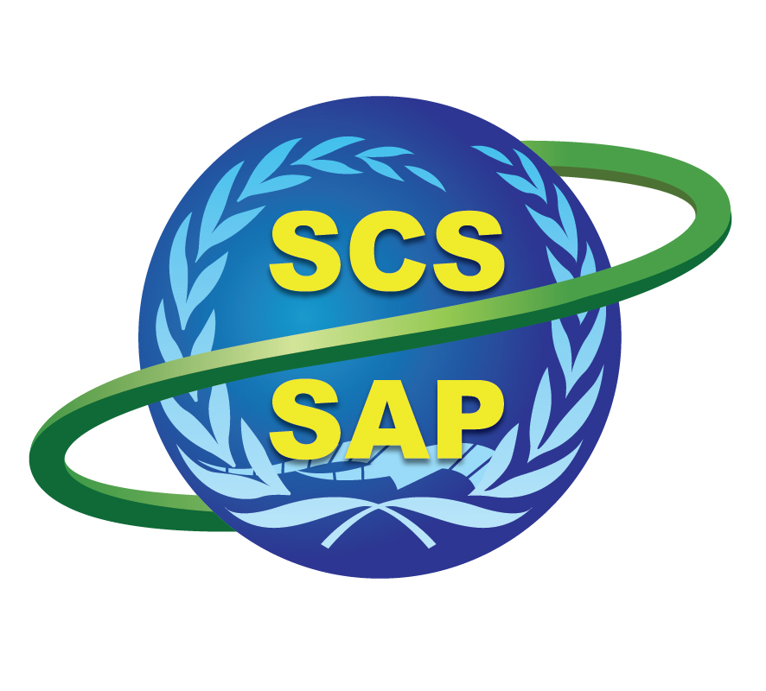



SUPPORTED BY LED BY IN PARTNERSHIP WITH

Slide 2
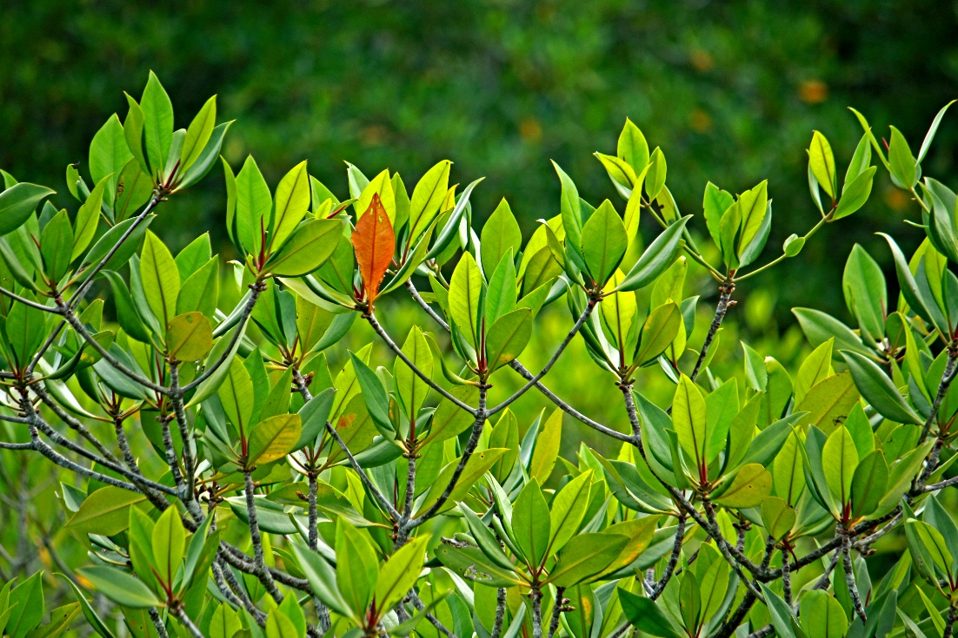
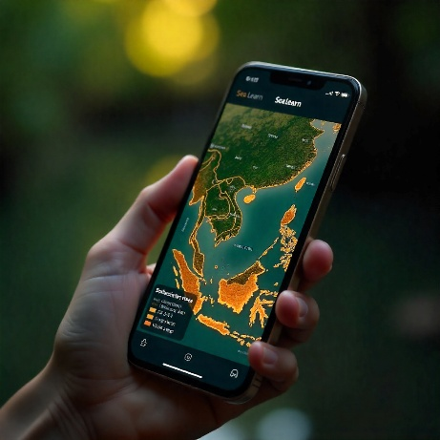
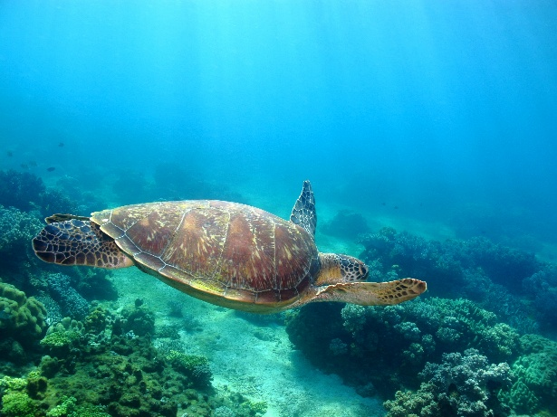
RSTC3 Meeting
26-28 Jan 2026
Phú Quốc
Philippine Transboundary Diagnostic Analysis (TDA) Report
To be presented by:
Michael Angelo B. Promentilla, PhD
Philippines TDA-SAP Coordinator
De La Salle University/SCPW

Slide 3
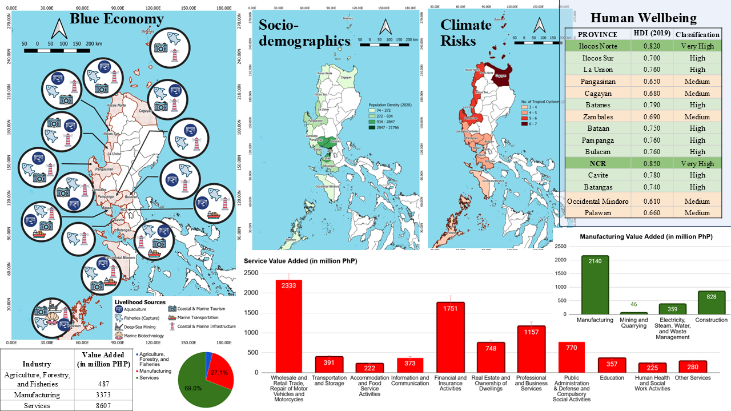
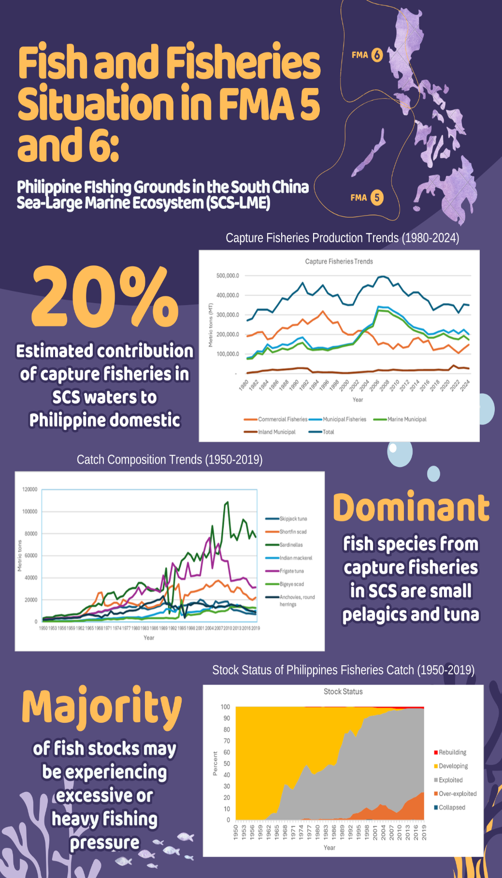
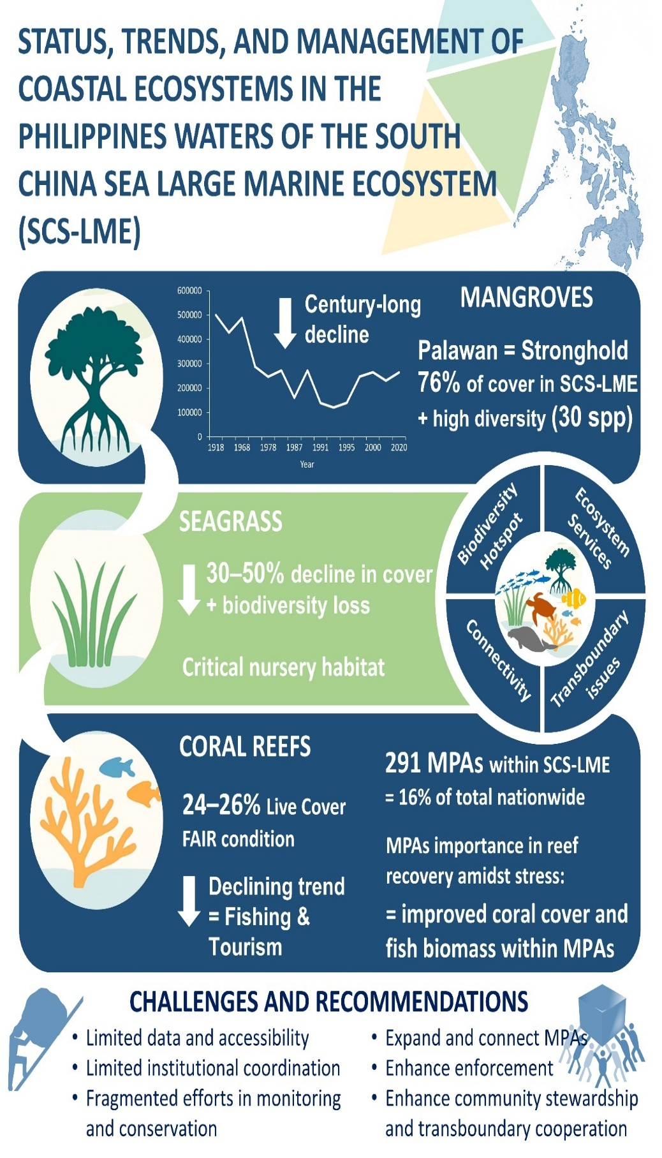
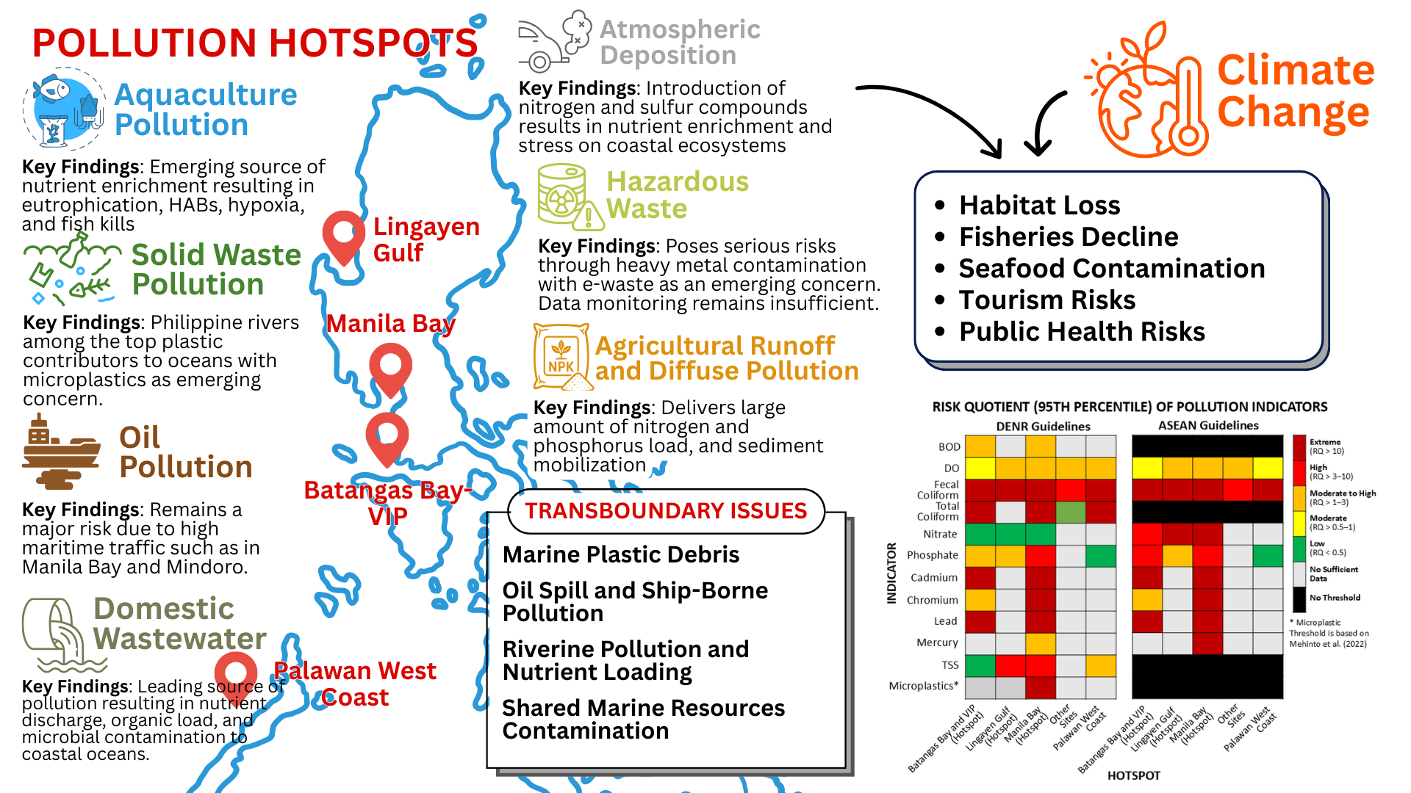
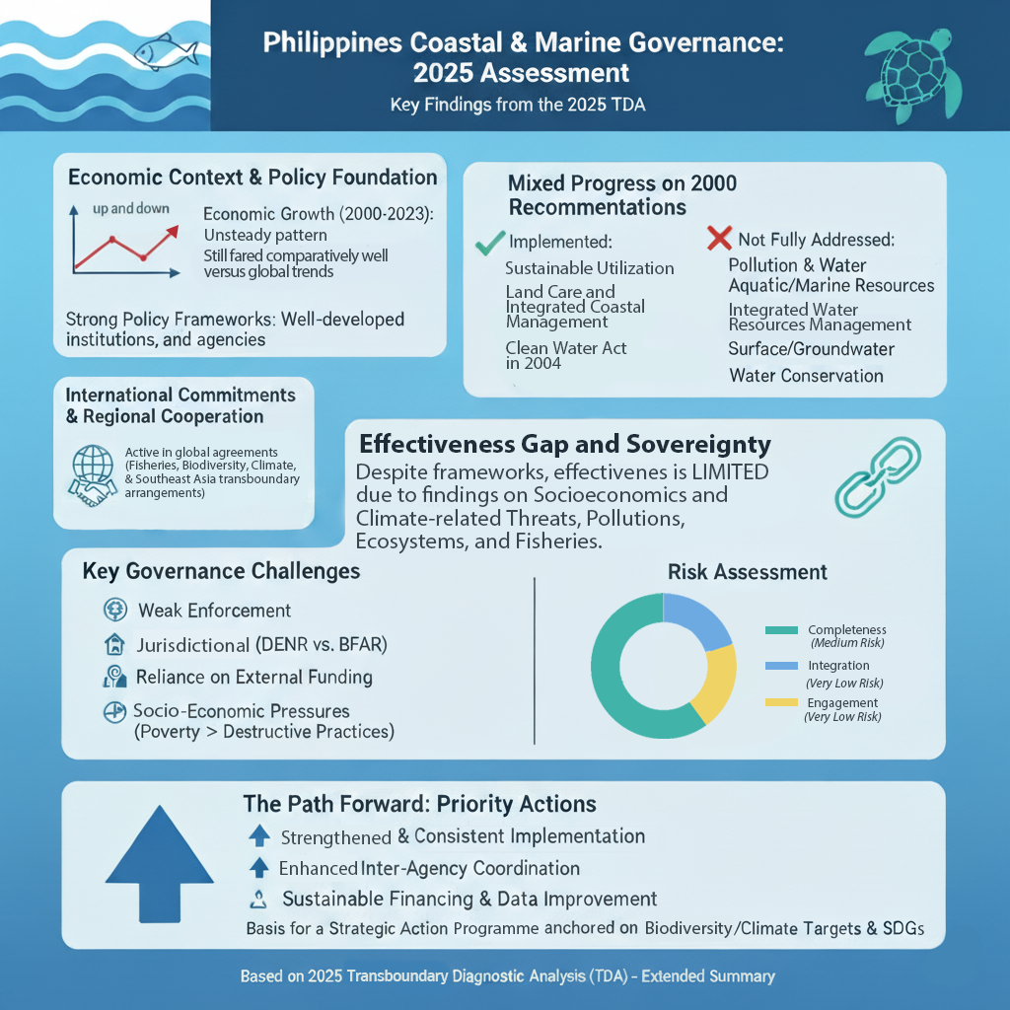
Graphical Abstracts:
RSTC3 Meeting
26-28 Jan 2026
Phú Quốc

Slide 4
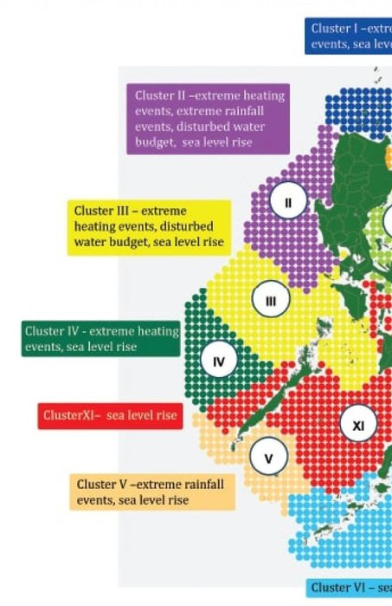
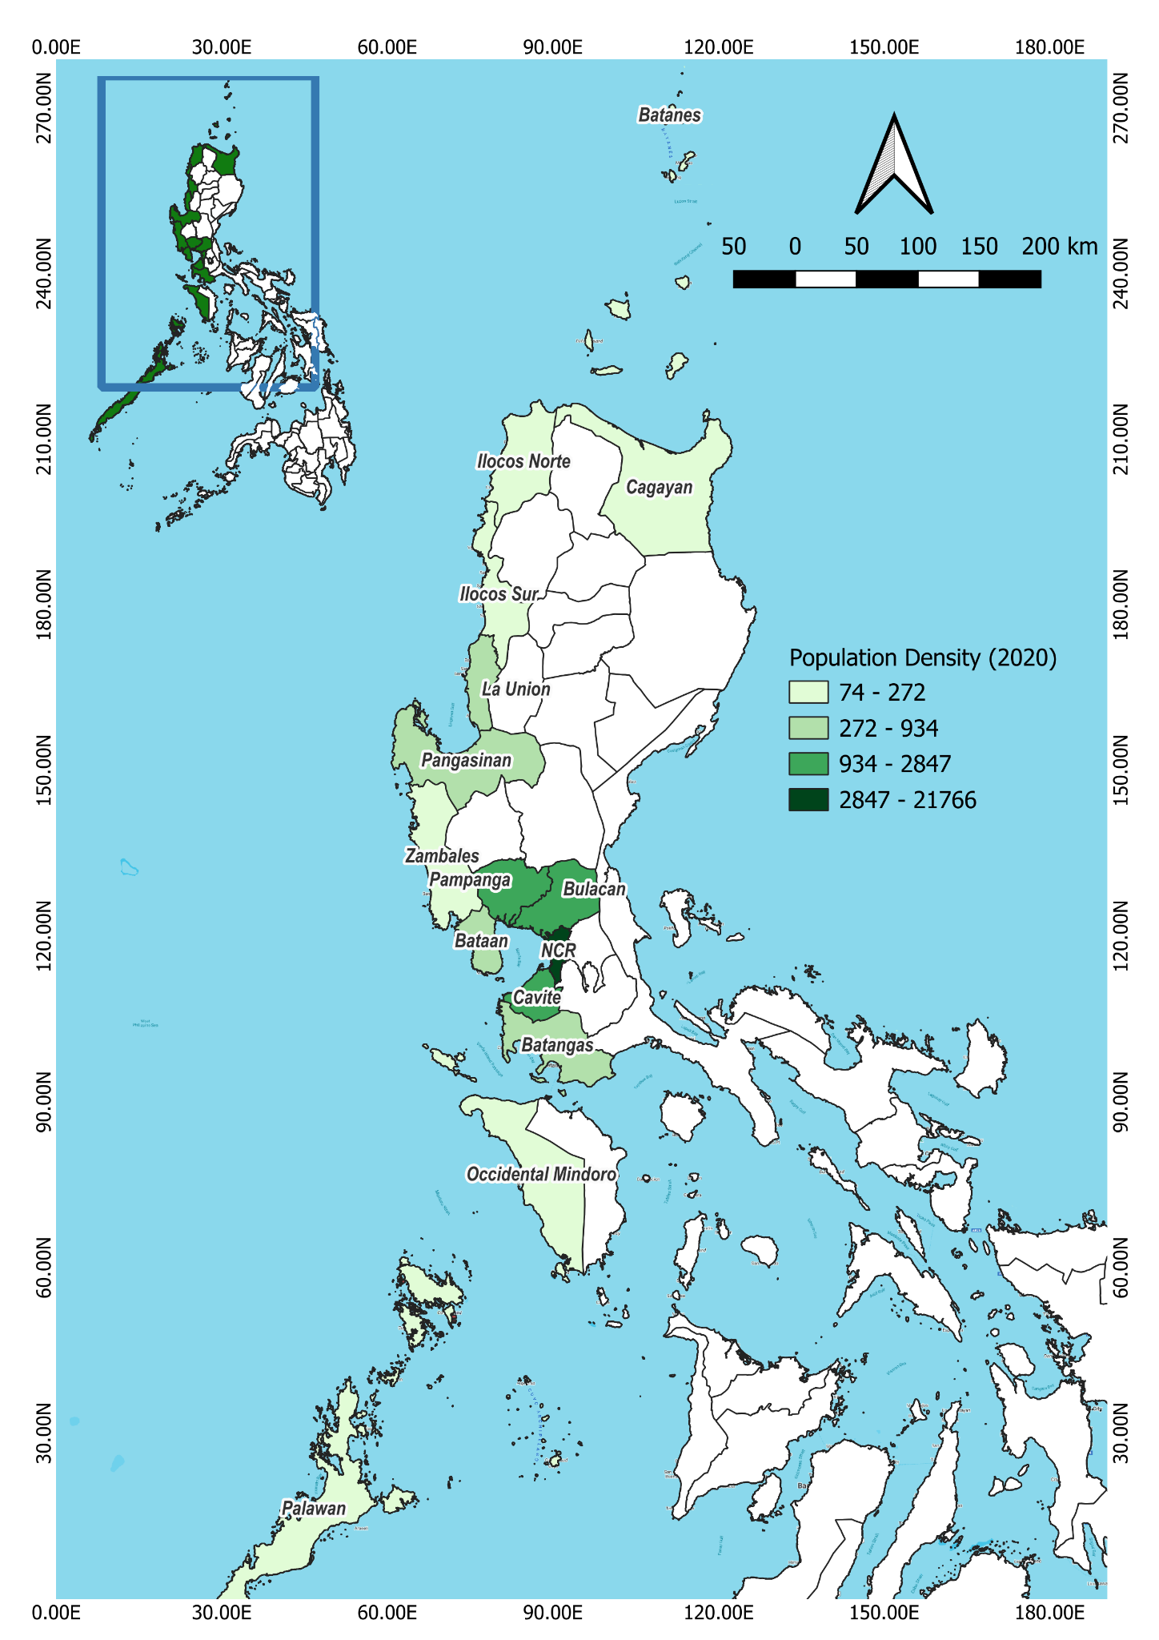
1. KEY THEMATIC/GEOGRAPHIC AREAS OF RISK AND VULNERABILITY
1.1 EXPOSURE TO CLIMATE CHANGE IMPACTS
RSTC3 Meeting
26-28 Jan 2026
Phú Quốc
The Philippines faces high and systemic exposure to climate change impacts, especially in coastal and marine areas where climate hazards intersect with socioeconomic dependence on natural resources.
Extreme heating and rainfall events, sea-level rise, and flooding disproportionately affect coastal populations and livelihoods, increasing risks to food security, income stability, and human well-being, especially among small-scale fishers and coastal communities with limited adaptive capacity.
Figure 1. FMA 5 (Cluster III & IV) and FMA 6 (Cluster II) exposure to climate change impacts (David et al., 2016)
Figure 2. Population Data of Localities in 2020 (PSA, 2020)

Slide 5
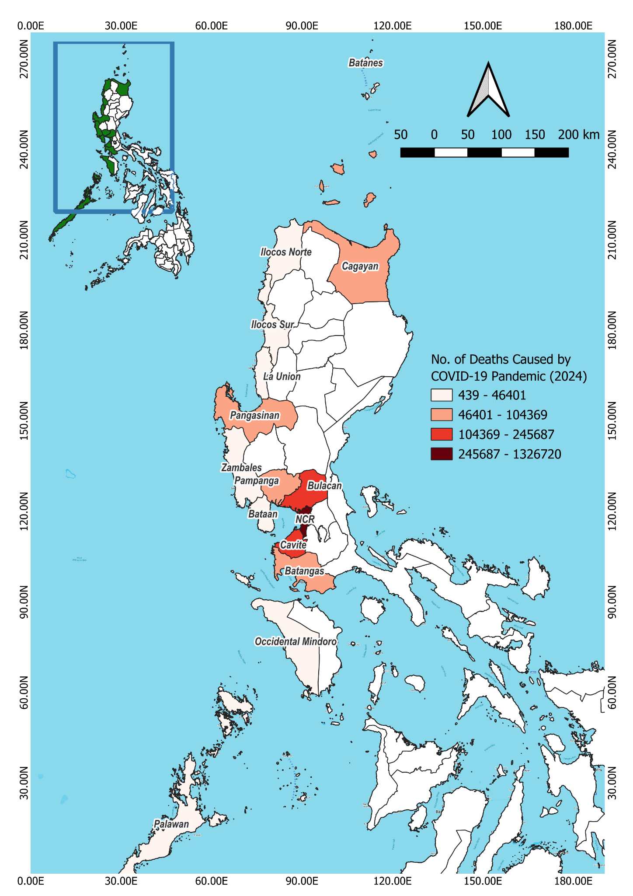
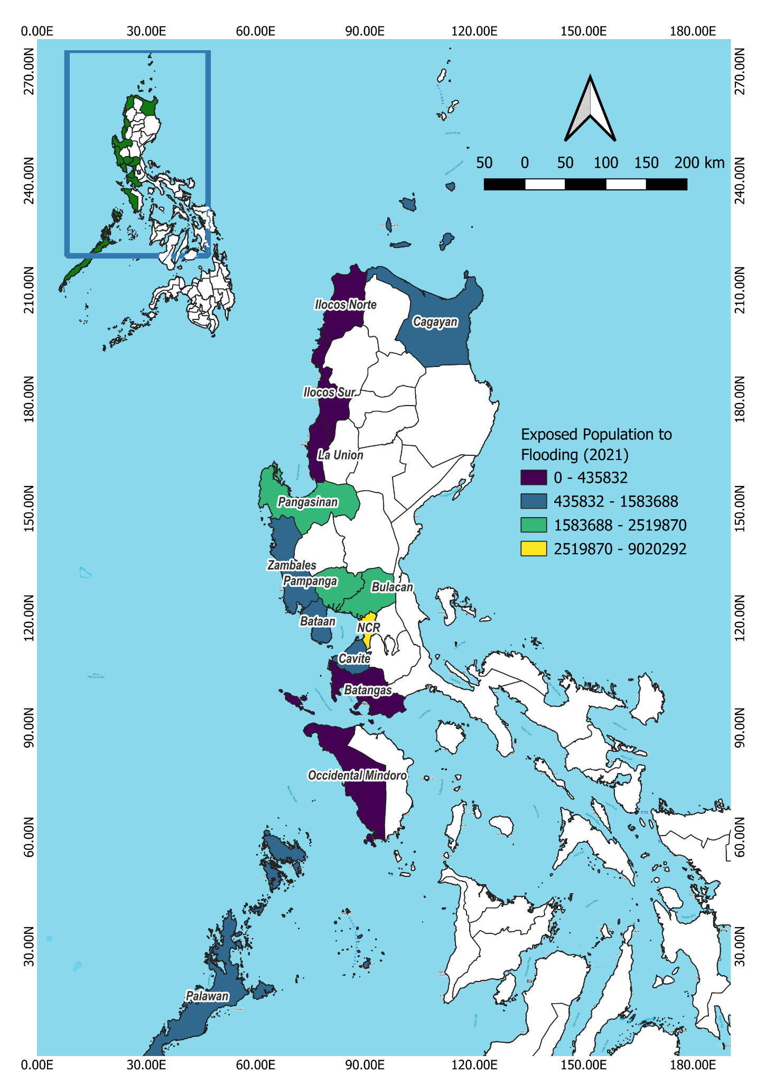
1.2 EXPOSURE OF POPULATIONS AND LIVELIHOODS TO CLIMATE AND OTHER ENVIRONMENTAL IMPACTS
RSTC3 Meeting
26-28 Jan 2026
Phú Quốc
Figure 3. High density areas had the highest number of deaths due to higher exposure and contact with other people.
Figure 4. Urban areas have the highest exposed capital

Slide 6
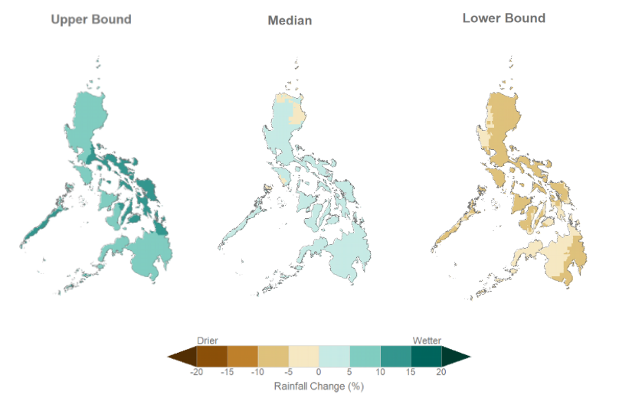
1.2 EXPOSURE OF POPULATIONS AND LIVELIHOODS TO CLIMATE AND OTHER ENVIRONMENTAL IMPACTS
RSTC3 Meeting
26-28 Jan 2026
Phú Quốc
Figure 5. Uncontrolled urban growth increase exposure and vulnerability to hazards and disasters (Maskrey & Lavell, 2023): increasing temperature, more intense rainfall.
Populations and livelihoods along the South China Sea-Large Marine Ecosystem (SCS-LME) are unevenly exposed to climate and environmental risks. Urban areas especially the National Capital Region and adjacent provinces such as Palawan, Batangas, and Pangasinan who heavily depend on fisheries and marine coastal ecosystems face the highest exposure of people and economic assets to climate and other environmental impacts.

Slide 7
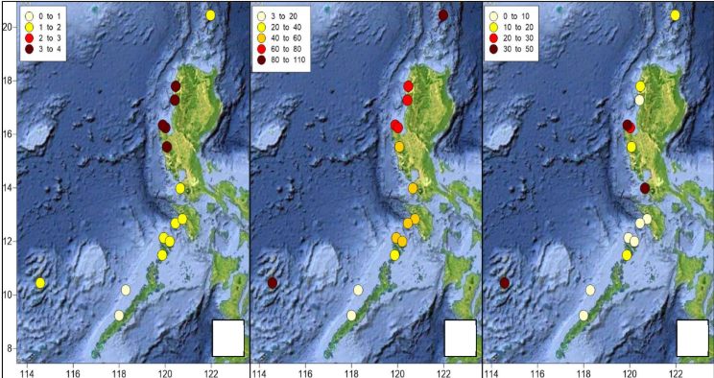
1.3 ECOSYSTEM EXPOSURE TO CLIMATE AND EXPLOITATION
Marine and coastal ecosystems across the assessed provinces fringing the SCS-LME are experiencing compound pressures from climate-related hazards (typhoon, extreme heat, extreme rainfall, storm surges, flooding, and sea-level rise); however, the degree of these ecosystems exposure to climate and exploitation per province or site could NOT be ascertained due to limited published data.
These climate pressures exacerbates the impacts of anthropogenic threats–increasing the vulnerability of marine and coastal ecosystems.
RSTC3 Meeting
26-28 Jan 2026
Phú Quốc
Figure 6. Exposure to different threats: a) climate typology (Alino et al., 2019); storm frequency (Cinco et al., 2016); and fisher density across the South China Sea in Philippine waters (LME). Color darkens with increase in values.

Slide 8
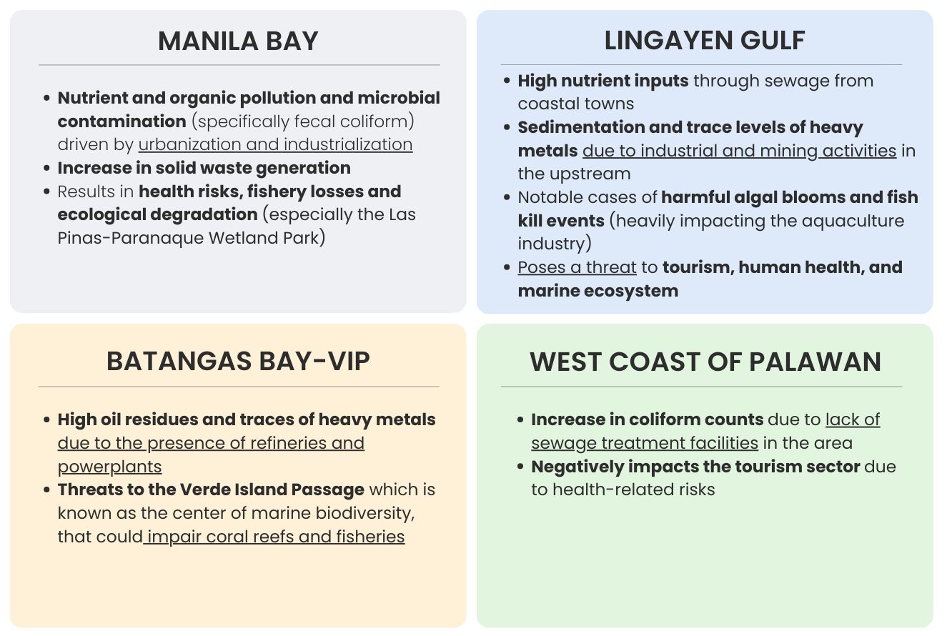
1.3.1 SYSTEM STATES MEDIATED BY POLLUTION (E.G. NUTRIENTS, PLASTICS, OTHER POLLUTANTS)
RSTC3 Meeting
26-28 Jan 2026
Phú Quốc
Figure 7. Summary of pollution hotspots identified in TDA 2.0 (2025)

Slide 9
1.3.2 SYSTEM STATES MANIFESTED BY COASTAL HABITATS (CORAL REEFS, SEAGRASSES, MANGROVES, WETLANDS)
RSTC3 Meeting
26-28 Jan 2026
Phú Quốc
Coastal Ecosystem | Area Cover | Biodiversity Condition | Increase or Decrease Over the years
Mangroves | 35,553 ha of mangroves in the SCS-LME (14% of the national total), with the majority in Western Palawan (76.5%), followed by Cagayan (13.5%). | Generally improving condition due to expansion; no widespread degradation reported in cited source | Increase of approximately 5,667 ha from 2000–2023, with notable gains around 2020
Seagrass | Estimated 12,685 km² (1,268,500 ha) in SCS-LME, representing ~85% of national seagrass cover | Declining health condition reported, particularly in Palawan (2004–2020); limited time-series data across provinces | Decrease of approximately 10,560 km² (1,056,000 ha) from 2008–2020 (~54% decline)
Coral Reef | ~371,210 ha (≈30% of PH reef area; Palawan ≈80%). Reported to shift from coral-dominated to algal/rubble-dominated reefs, especially outside MPAs | Recorded reduced complexity and biodiversity (40% poor, 40% fair, 13% good, 7% excellent in surveyed reefs); key biodiversity areas (e.g., Apo Reef, El Nido, Malampaya Sound) remain vital but increasingly pressured. | Overall decline, with increasing degradation outside MPAs
Wetlands (MSPLS & LLPWP; includes mangroves, coral reefs) | 11,633.78 ha recorded for coastal wetlands | Highly stressed, especially in urbanized areas (e.g., Manila Bay). Shows overall declining trend particularly in MSPLS and LLPWP due to anthropogenic pressure | Overall declining trend, varies in poor-good condition

Slide 10

1.3.3 SYSTEM STATES MANIFESTED BY FISHERIES AND AQUACULTURE
RSTC3 Meeting
26-28 Jan 2026
Phú Quốc
Figure 9. Graphical abstract illustrating fish and fisheries situation in FMA 5 and 6.

Slide 11
2. HOW DOES THESE AREAS OF RISK AND VULNERABILITY AS ASSESSED IN YEAR 2025 DIFFER FROM THE NATIONAL TDA REPORT 1.0 (YEAR 2000)?
RSTC3 Meeting
26-28 Jan 2026
Phú Quốc
Philippine TDA 1.0 (2000) | Philippine TDA 2.0 (2025)
Natural calamities (typhoons and volcanic eruptions) | Climate & Extreme Events
Illegal and Destructive Upland Activities | Sea-Level Rise
Devalued Resource Rents (Low economic valuation) | Environmental Degradation (Land-Use Change & Habitat Destruction)
Poor Zoning and Permit Management | Pollution & Water Quality Degradation
Inappropriate Tenure Arrangements (human settlement, coastal conversion i.e., mangroves into fishponds) | Sedimentation & Coastal Erosion
Unclear Jurisdictional Responsibilities | Over-Exploitation of Resources in Coastal Waters
Inadequate Procedural Mechanisms | Altered Hydrology and Sediment Flow
Coastal Pollution from Uncollected Waste | Illegal, Unreported, and Unregulated (IUU) fishing
Illegal means of fishing and enforcement lapses
Reduced fish stock and declining fish biomass
Reduced biodiversity
Degradation of coastal habitats
Reduced coastal productivity
Increased Resource Use Conflicts and Competition between Commercial and Municipal Fishing Sectors
Declining Catch Rates and Income of Fishers

Slide 12
2.1 WHICH OF THESE RISKS ARE CONSIDERED TRANSBOUNDARY? WHICH ARE NATIONAL? WHICH OF THESE ARE CONSIDERED PRIORITY CONCERNS?
RSTC3 Meeting
26-28 Jan 2026
Phú Quốc
Transboundary Issues | National Issues
Marine plastic debris Oil spills and ship-borne pollution Riverine pollution and nutrient loading Shared marine resources contamination Illegal, unreported and unregulated (IUU) fishing Overfishing and depletion of fish stock in coastal waters Habitat destruction and environmental degradation Species loss and biodiversity threats Climate change impacts | Land and sea-based pollution Habitat degradation of mangroves, seagrass beds, coral reefs, and wetlands Limited data and research on wetlands Unsustainable fisheries and resource use conflict Weak enforcement and fragmented governance Limited resources (i.e., manpower, technical knowledge and skills) to implement policies and programs Limited institutional capacity Species loss and biodiversity threats Climate change impacts

Slide 13
2.1 WHICH OF THESE RISKS ARE CONSIDERED TRANSBOUNDARY? WHICH ARE NATIONAL? WHICH OF THESE ARE CONSIDERED PRIORITY CONCERNS?
RSTC3 Meeting
26-28 Jan 2026
Phú Quốc
Priority Concerns
Nutrient/Plastic Pollution
Marine plastic debris Nutrient-driven eutrophication, HAB, and hypoxia Sewage-driven HAB and public health outbreaks Bioaccumulation of toxic contaminants Oil spill and ship-borne pollution Shared marine resources contamination
Biodiversity Loss
Ecosystem degradation Declining reef condition outside MPAs Unsustainable fishing/IUU fishing Coral bleaching
Climate Change
*cuts across all priority concerns

Slide 14
2.2-2.4 DIFFERENCE/S IN PERCEIVED IMPORTANCE, SEVERITY, IMPACTS ON PEOPLE AND LIVELIHOODS, AND ECOSYSTEM HEALTH
RSTC3 Meeting
26-28 Jan 2026
Phú Quốc
Changes in perceived importance since 2000 | Changes in perceived severity since 2000 | Changes in perceived impacts on people, livelihood, and ecosystem health since 2000
Climate change is now recognized as part of the three planetary crisis, rather than merely as a driver of habitat damage | Climate and extreme events increased significantly as frequency and intensity became more apparent | Loss of life and property, disrupted fisheries productivity, habitat damage
Sea level rise has yet to be reported in the TDA 1.0 (2000). No baseline data for comparison to TDA 2.0 (2025). | Perceived severity varies across assessment components and has intensified from the 2000 TDA to the 2025 TDA. Coastal and marine habitats exhibited differentiated degree of severity with mangroves, coral reefs, and wetlands being increasingly vulnerable, whereas in seagrass meadow, severity of sea-level rise remain slight. In fisheries and aquaculture, the severity is more pronounced. | Flooding, reduced coastal livelihoods, habitat loss
Land use conversion remains a persistent concern since 2000 | Concerns on land use conversion and resulting habitat destruction have increased with population growth and development pressures | Increased hazard exposure, livelihood insecurity, ecosystem fragmentation

Slide 15
Changes in perceived importance since 2000 | Changes in perceived severity since 2000 | Changes in perceived impacts on people, livelihood, and ecosystem health since 2000
Pollution & water quality degradation mainly caused by inadequate waste treatment and disposal remains as persisting problems. Frequency of major oil spill events, aquaculture, and other emerging pollutants warrants attention. | Pollution & water quality degradation in Philippine coastal and marine habitats have intensified since the early 2000s, despite growing awareness and efforts to mitigate them. Owing to the rapid urbanization, industrialization, and tourism, pollutant loads were driven beyond the capacity of existing infrastructure. | Health risks, weakened ecosystem resilience to climate change, reduced fishery productivity, water & habitat degradation
Sedimentation was listed some of the most common and influential factors affecting coral reefs | Sedimentation and coastal erosion have become more critical due to continued deforestation and land conversion | Land loss, damaged fishing areas, habitat destabilization
Over-exploitation of resources has always been a major concern, with fisheries being a key focus now | Over-exploitation of resources has intensified causing declining fish stocks, biodiversity loss, habitat degradation, and reduced fisher income | Food insecurity, declining resources, biodiversity loss
IUU Fishing has yet to be identified in the TDA 1.0; the risk was instead referred to as increased resource use conflicts and competition between the municipal and commercial fishing sectors. | Illegal, Unreported, and Unregulated (IUU) Fishing has become a persistent and pressing problem; where illegal fishing has been identified as a top threat. | Depletion of fish stocks, food and livelihood insecurity, exploitation or destruction of habitats, intensified competition over resources
RSTC3 Meeting
26-28 Jan 2026
Phú Quốc

Slide 16
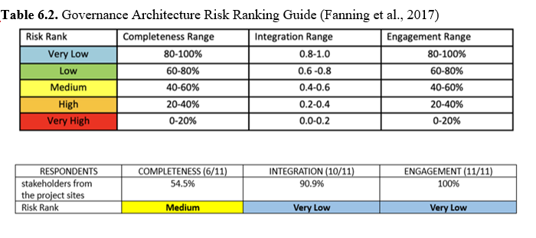
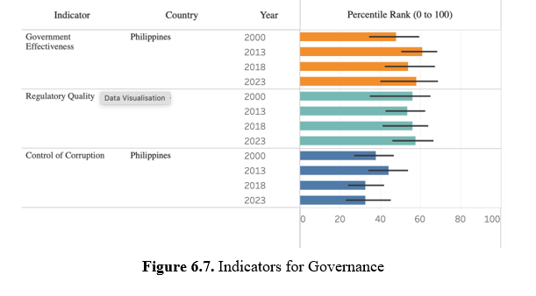
3. HOW DOES THE CURRENT GOVERNANCE CAPACITY ADDRESS AND MITIGATE THE ASSESSED RISKS?
RSTC3 Meeting
26-28 Jan 2026
Phú Quốc
Since the SAP 1.0, the Philippines has established governance frameworks, laws, and institutions to address major environmental risks, including climate change, fisheries, coastal management, and pollution.
These mechanisms provide a foundation for managing key transboundary risks identified in the TDA, although effectiveness varies across sectors and geographic areas.
Figure 10. Governance Architecture Risk Ranking Guide (Fanning et al., 2017)
Figure 11. Indicators for Governance.

Slide 17
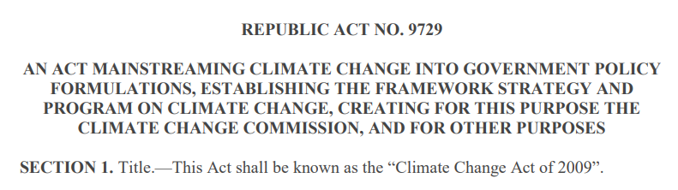
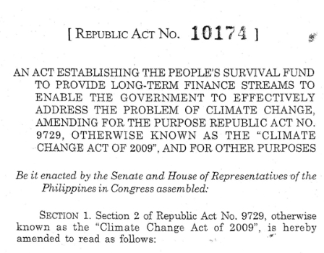
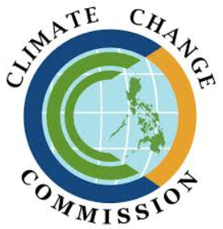
3.1 CLIMATE RISKS
RSTC3 Meeting
26-28 Jan 2026
Phú Quốc
Climate Risks are addressed through national climate policies, laws and adaptation planning:
The Climate Change Commission, established under the Climate Change Act, provides governance capacity for addressing climate change and related environmental issues

Slide 18
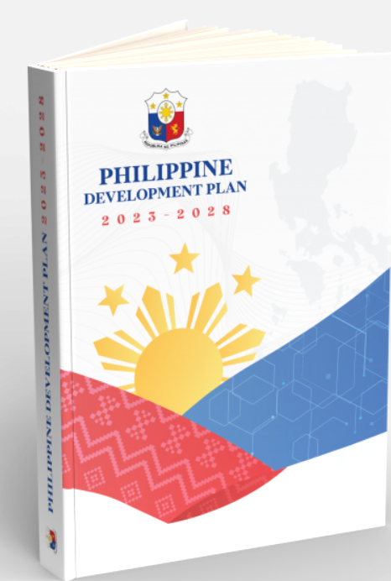
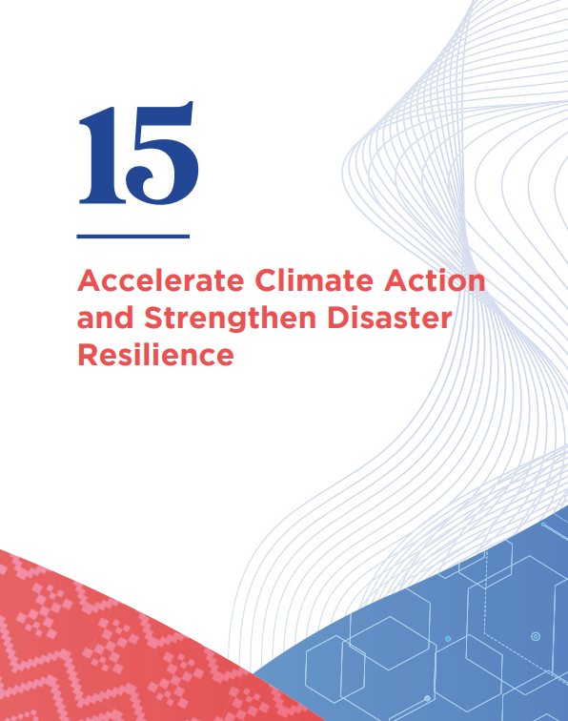
3.1 CLIMATE RISKS
RSTC3 Meeting
26-28 Jan 2026
Phú Quốc
The Philippine Development Plan (PDP) 2023–2028 outlines strategies to accelerate climate action and strengthen disaster resilience (Chapter 15).
Figure 12. Chapter 15 of the PDP focuses on strengthening climate resilience and addressing environmental challenges through risk reduction, adaptive capacity, and sustainable development pathways.

Slide 19
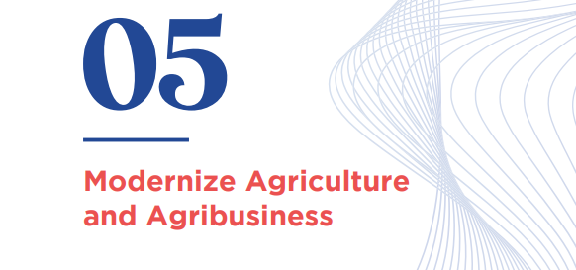
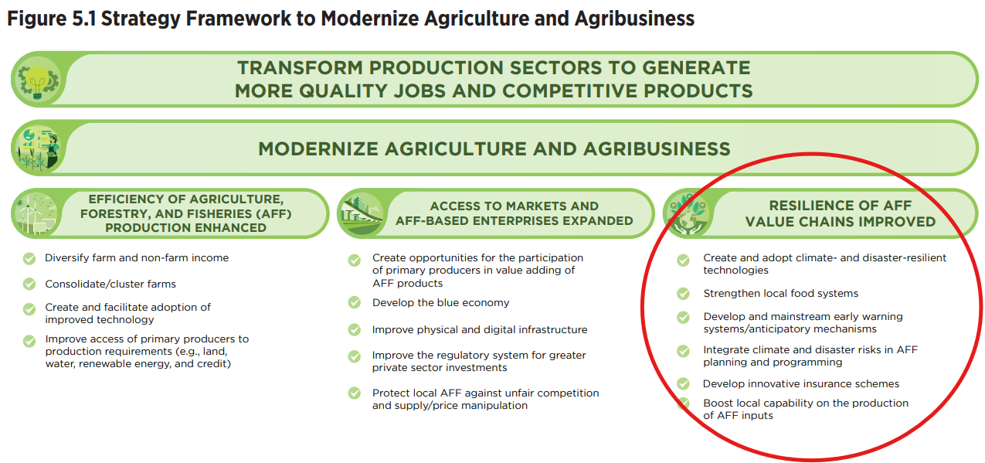
3.2 RISKS TO PEOPLE AND LIVELIHOODS
RSTC3 Meeting
26-28 Jan 2026
Phú Quốc
Philippine Development Plan 2023–2028 also promotes sustainable coastal and marine environments and food security, supporting modernization of agriculture and development of the blue economy (Chapter 5).
Figure 13. Chapter 5 emphasizes modernizing agriculture and agribusiness by supporting coastal and marine livelihoods, enhancing sustainable use of marine resources, and expanding blue economy opportunities to improve people’s income and resilience.

Slide 20
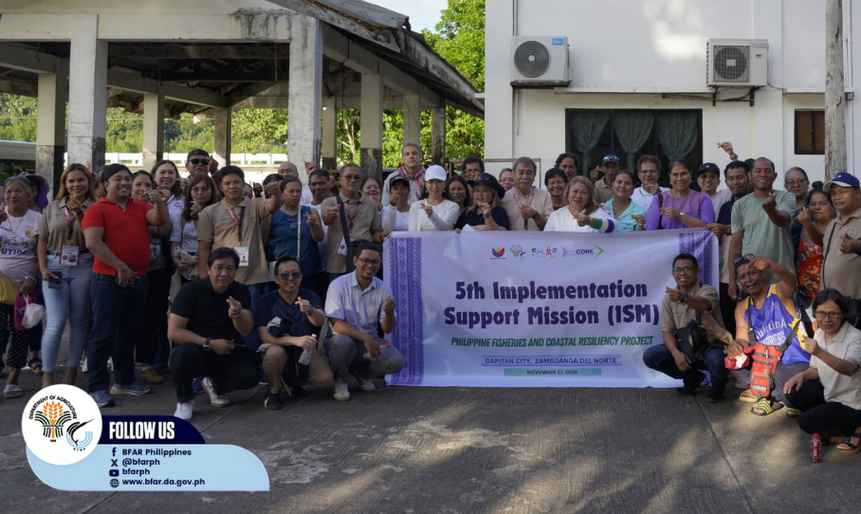
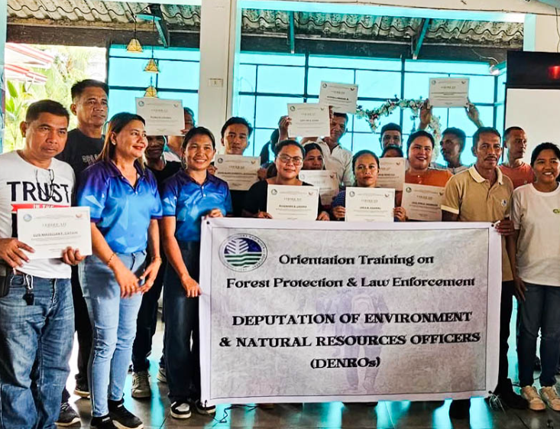
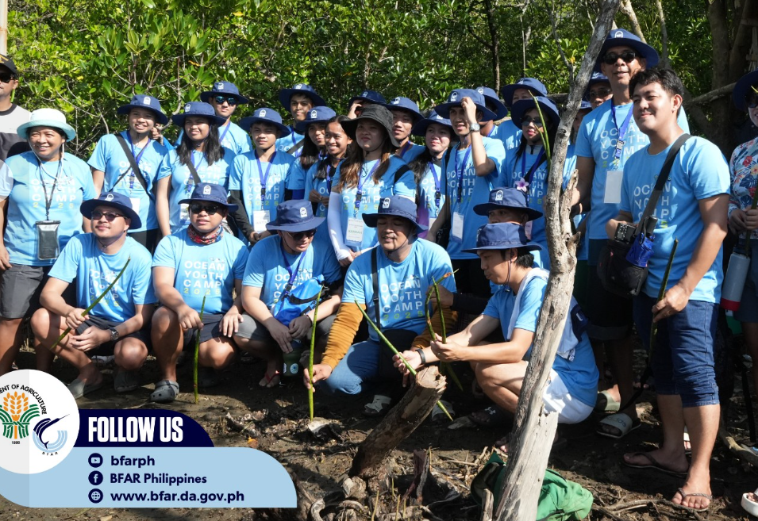
3.2 RISKS TO PEOPLE AND LIVELIHOODS
RSTC3 Meeting
26-28 Jan 2026
Phú Quốc
Capacity Building Initiatives:
Enhance skills and knowledge of fishers, aquaculture operators, and LGUs on sustainable fisheries management, climate-resilient practices, and resource monitoring;
Support government agencies, LGUs, and communities in protected area management, habitat restoration, marine spatial planning, and biodiversity monitoring.
Improve technical capacity of implementing agencies and LGUs for water quality monitoring, solid waste management, marine litter reduction, and enforcement of environmental regulations.
Figure 14. (Right) Some government initiatives on capacity building to strengthen livelihoods, climate resilience, and sustainable management of environmental and natural resources, in line with the Philippine Development Plan.

Slide 21
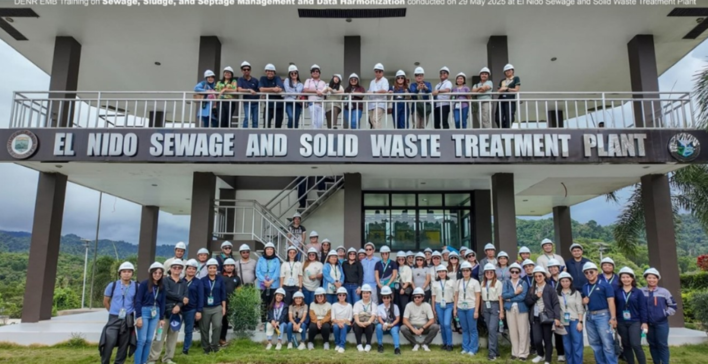
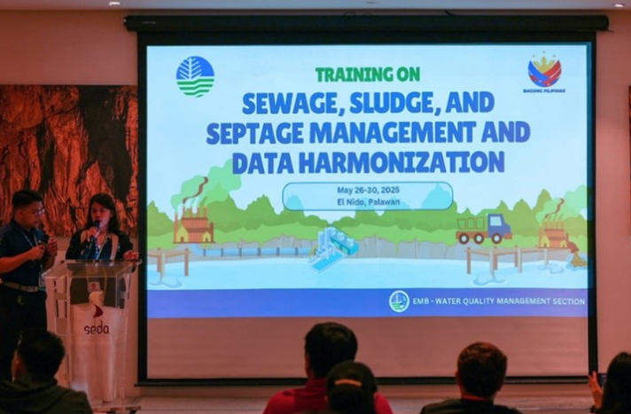
3.3 RISKS OF POLLUTION
RSTC3 Meeting
26-28 Jan 2026
Phú Quốc
Water quality management and monitoring programs including the establishment and oversight of Water Quality Management Areas, setting of effluent and ambient water quality standards, and regular monitoring of inland, coastal and marine waters.
Pollution control and compliance mechanisms such as environmental impact assessment (EIA) processes, permitting systems, compliance monitoring, and enforcement actions for coastal developments, wastewater discharges and industries.
Solid waste and marine litter management initiatives, including in coordination with LGUs (e.g., waste segregation, collection, disposal systems and implementation of producer-led plastic recovery and diversion program)
Inter-agency coordination mechanisms to support integrated pollution management.
Oil spill preparedness and response programs.
Regional and transboundary pollution cooperation initiatives.
Figure 15. Some initiatives of the DENR-EMB in the implementation of various programs to address pollution.

Slide 22
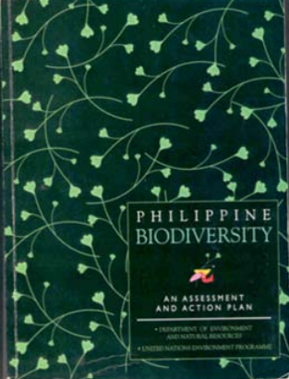
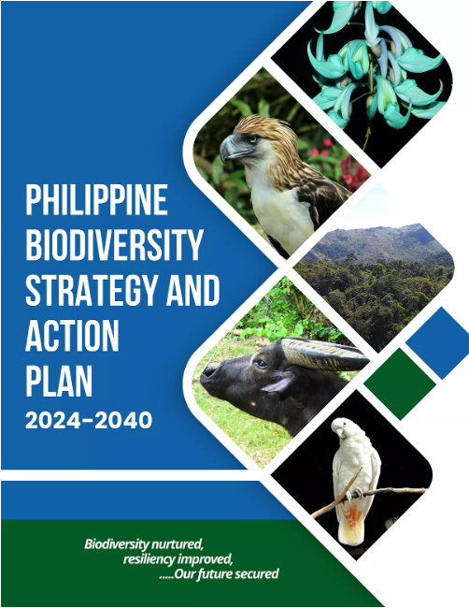
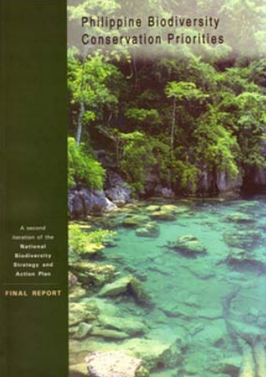
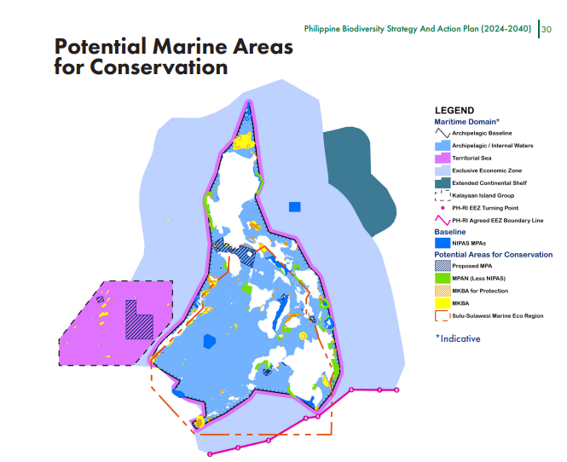
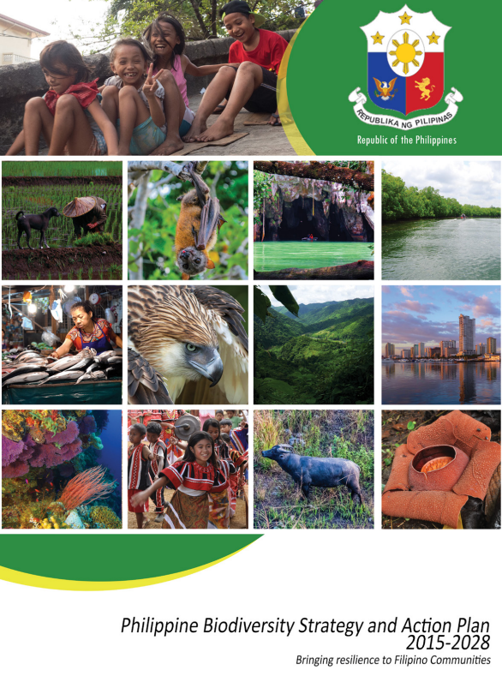
3.4 RISKS OF COASTAL HABITAT DETERIORATION
RSTC3 Meeting
26-28 Jan 2026
Phú Quốc
Philippine Biodiversity Strategy and Action Plan (PBSAP) 2024-2040
Strengthen coastal habitat protection through effective management, marine spatial planning, and biodiversity conservation targets
Guides government agencies in implementing the Kunming-Montreal Global Biodiversity Framework
Aims to expand marine protected areas (MPAs) from 3.2 million ha to 35.24 million ha by 2040
Figure 16. PBSAP 2024-2040 and its previous iterations.

Slide 23
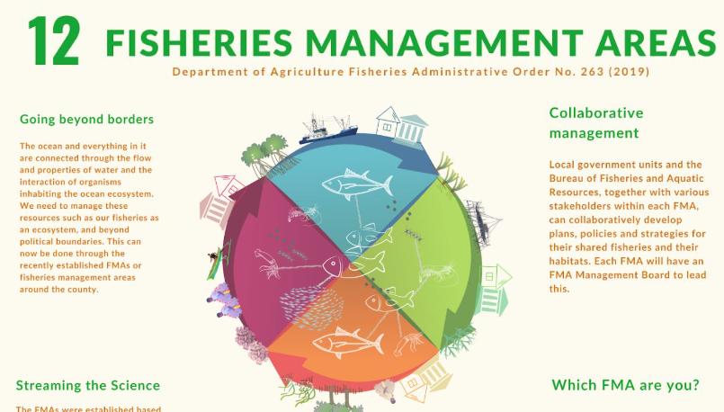

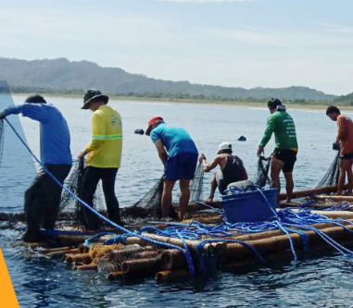
3.5 RISKS OF IMPACTED FISHERIES AND AQUACULTURE
RSTC3 Meeting
26-28 Jan 2026
Phú Quốc
Implementation of various fisheries and aquaculture programs for ecosystem-based and transboundary fisheries governance, effort and vessel regulation, stock assessment and monitoring, sustainable aquaculture, and capacity-building and livelihood support for municipal fisherfolk.
Restoring fishery habitats (mangroves, seagrasses, coral reefs, wetlands and inland bodies of water) through protection and rehabilitation;
Protecting spawning grounds and spawning cycles based on research and participatory processes;
Delineating and zoning of coastal lands and water uses to resolve conflicting uses with the Comprehensive Land Use Plans (CLUPs); and
Developing and harmonizing inter-LGU coastal resources management plans based on participatory coastal resources appraisals, among others.
Figure 17. Some initiatives of DA-BFAR in addressing challenges and risk impacts in fisheries and aquaculture.

Slide 24
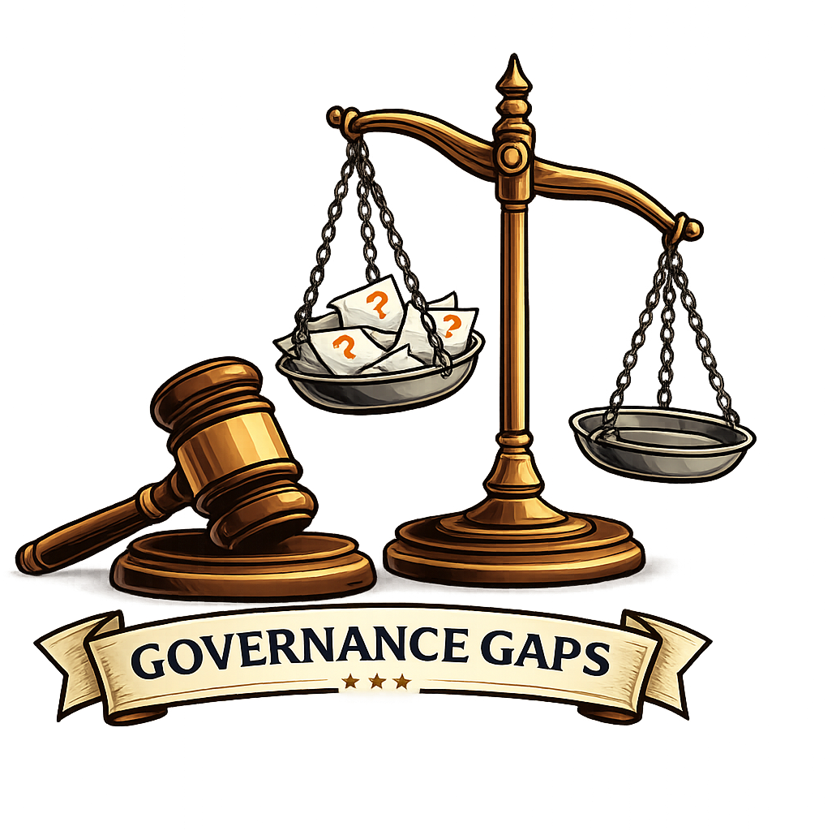
4. WHAT ARE THE MAJOR GAPS IN GOVERNANCE?
RSTC3 Meeting
26-28 Jan 2026
Phú Quốc
Major governance gaps in the Philippine’s management of transboundary marine and coastal issues are rooted in:
Fragmented institutional coordination and implementation
Weak enforcement
Competing commitments for coastal and marine conservations
Limited technical and financial capacity at local levels
Insufficient long-term data and monitoring
Lack of accessible and inter-operable national databases
Heavy reliance on external funding for sustainability

Slide 25

5. WHAT ARE STRATEGIC RECOMMENDATIONS TO IMPROVE GOVERNANCE OF TRANSBOUNDARY ENVIRONMENTAL PROBLEMS AND CLOSING GAPS IN ITEM 4?
RSTC3 Meeting
26-28 Jan 2026
Phú Quốc
Strategic Priorities Include:
Improving socio-economic resilience of coastal communities
Investing in wastewater and pollution control infrastructure
Integrating ecosystem-based and nature-based solutions
Strengthening fisheries management and IUU enforcement
Enhancing enforcement, monitoring, and data accessibility
Strengthening inter-agency and multilevel coordination that have administrative continuity and are results-oriented
Establishment of a cumulative capacity-building programme across various levels of governance
Reinforcing regional cooperation under SAP 2.0 to address shared risks and transboundary challenges

Slide 26
THANK YOU

