Slide 1
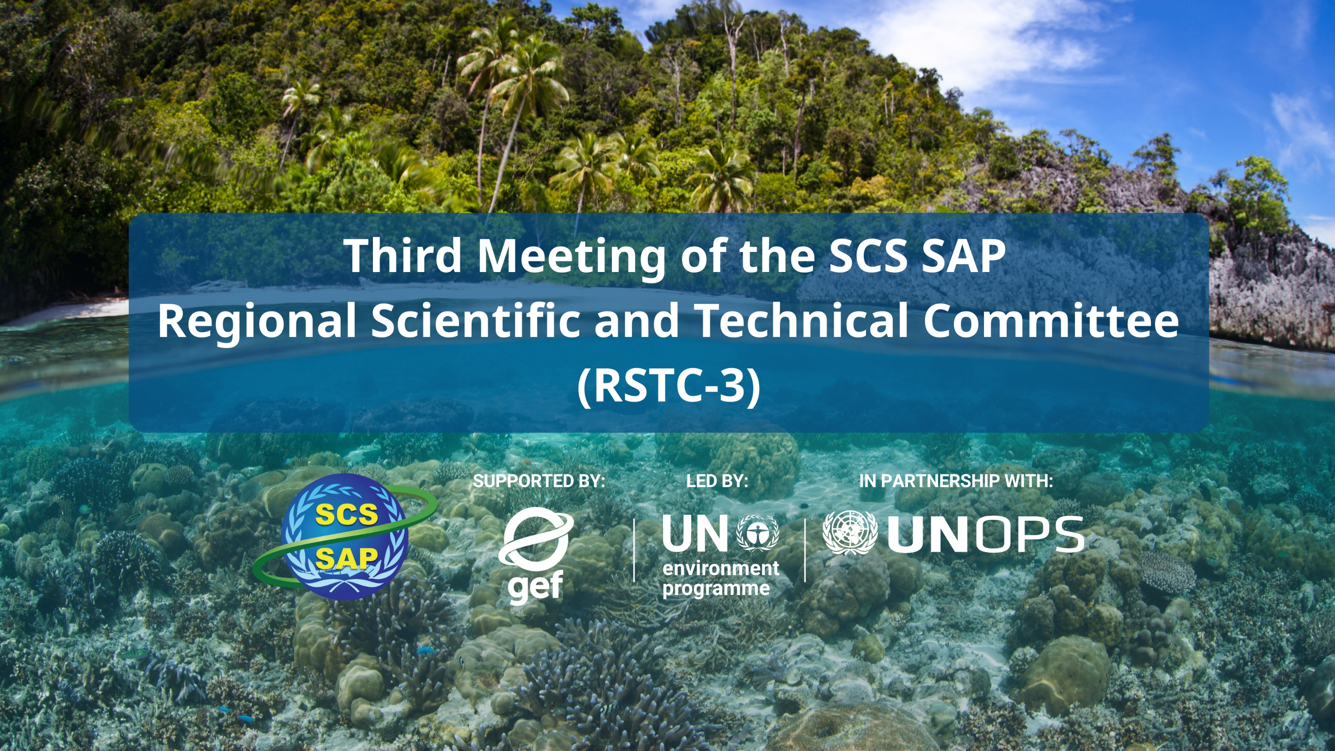
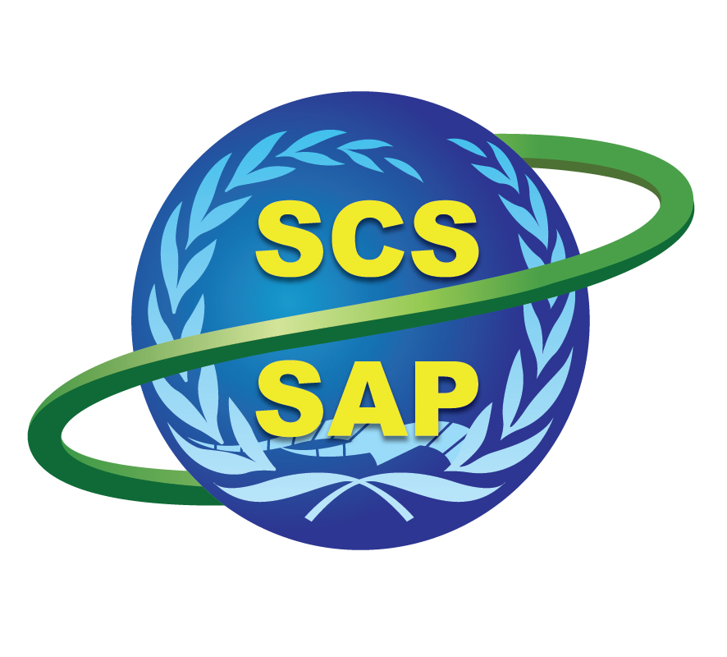



SUPPORTED BY LED BY IN PARTNERSHIP WITH

Slide 2
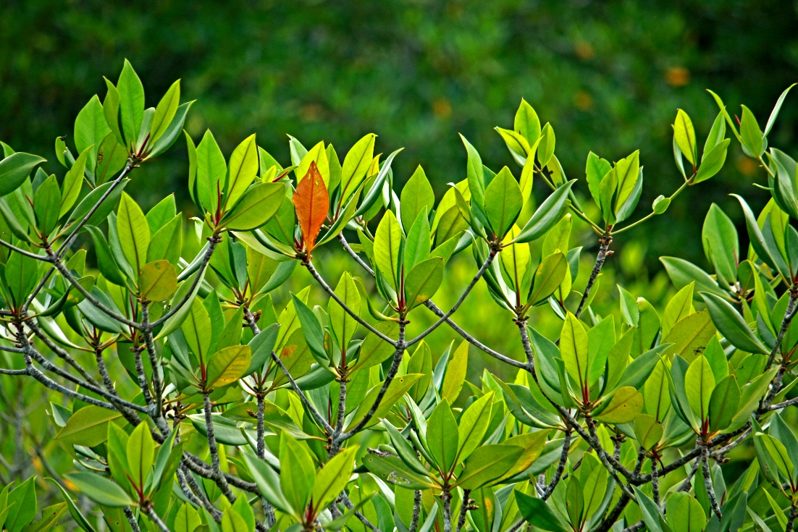
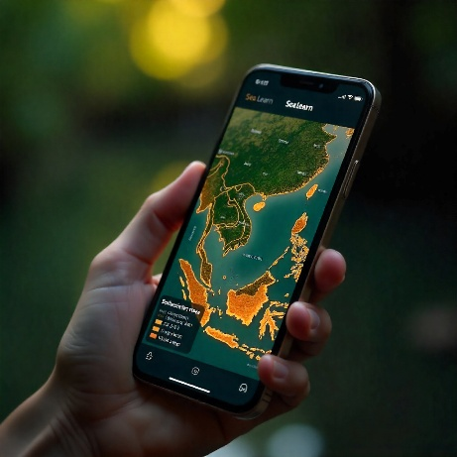
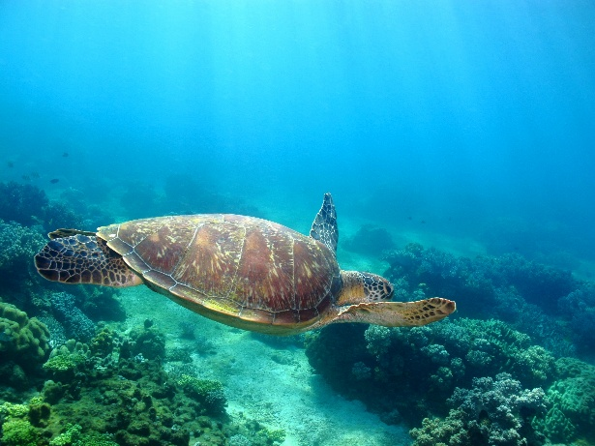
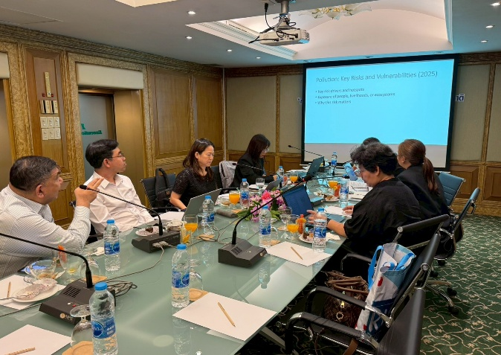
National TDA: Thailand
By:
Professor Suvaluck Satumanatpan, PhD
Mahidol University
RSTC3 Meeting
26-28 Jan 2026
Phú Quốc

Slide 3
From Diagnosis to Action (Tables 1–5)
Risks & vulnerabilities
Governance capacity and gaps
Strategic responses

Slide 4
Key Risks & Vulnerabilities (2025)
Climate change and sea-level rise
Socioeconomic exposure
Pollution pressures
Ecosystem degradation
Fisheries risks

Slide 5
COUNTRY TDA REPORT PRESENTATION OUTLINE
I. Key thematic/geographic areas of risk and vulnerability because of:
Risk Category | Risk | Vulnerability
1. Exposure to climate change impacts/Exposure of population and livelihood
1.1 Exposure to climate change impacts | Coastal flooding and storm surge | Low-lying coastal areas across the Gulf of Thailand are highly exposed
 | Sea-level rise and coastal erosion | Soft-sediment coastlines and estuaries face shoreline retreat
1.2 Exposure of population and livelihoods to climate and other environmental impact | High exposure of coastal urban populations and economic assets | Dense population and asset concentration in Bangkok and the EEC increase vulnerability because a single extreme event can cause widespread damage
 | Livelihood dependence on coastal and marine resources | Small-scale fishing communities in southern coastal provinces have limited livelihood alternatives, increasing vulnerability to climate and environmental shocks.

Slide 6
I. Key thematic/geographic areas of risk and vulnerability (Cont.)
Risk Category |  | Risk | Vulnerability
1.3. Ecosystem exposure to climate and exploitation
1.3.1 System state mediated by pollution
 | Nutrient and organic loading from wastewater, industrial effluents, and wastewater runoff | Nutrient and organic loading from wastewater, industrial effluents, and wastewater runoff | Estuaries and nearshore waters are vulnerable to eutrophication, hypoxia, and ecosystem degradation
 | Solid waste and marine litter, including plastics and microplastics | Solid waste and marine litter, including plastics and microplastics | Coastal and mangrove areas are vulnerable to physical damage, food-chain contamination, and impacts on fisheries and tourism
1.3.2 System states manifested by coastal habitats
Ecosystem exposure to climate and exploitation | Degradation of nearshore coastal ecosystems (coral reefs, seagrasses, mangroves, wetlands) | Degradation of nearshore coastal ecosystems (coral reefs, seagrasses, mangroves, wetlands) | Nearshore and estuarine zones exhibit high vulnerability due to cumulative land-based pressures and climate stress
 | Land-based pollution, sedimentation, and nutrient runoff | Land-based pollution, sedimentation, and nutrient runoff | River discharge, watershed modification, aquaculture effluents, and coastal development increase sediment and nutrient loading, disproportionately affecting nearshore ecosystems and estuaries
 | Climate-driven stress on marine ecosystems | Climate-driven stress on marine ecosystems | Marine heatwaves, coral bleaching, sea-level rise, and coastal erosion amplify ecosystem degradation and reduce recovery capacity
 | Loss of ecological connectivity | Loss of ecological connectivity | Fragmentation between nearshore habitats and offshore reefs weakens larval dispersal, nursery functions, and system-wide resilience.
 | Uneven resilience across ecosystem types | Uneven resilience across ecosystem types | Offshore reefs and underwater pinnacles act as climate refugia, while nearshore systems continue to decline
 | Integrated ecosystem risk from cumulative land–sea pressures | | Integrated ecosystem risk from cumulative land–sea pressures | | Multiple stressors act simultaneously, amplifying ecosystem degradation across the Gulf of Thailand
1.3.3 System states manifested by fisheries
 | Stock depletion in particular demersal stock. Although overfishing has ended since 2016, s mall mesh sizes have still been used by some kinds of fishing gear, resulting in effort creep. | Stock depletion in particular demersal stock. Although overfishing has ended since 2016, s mall mesh sizes have still been used by some kinds of fishing gear, resulting in effort creep. | Effort creep and cumulative pressures result in weak ecosystem resilience and slow stock recovery
 | Degradation of nursing and spawning grounds, such as mangrove areas and coral reefs, and pollution, particularly in the Inner Gulf of Thailand | Degradation of nursing and spawning grounds, such as mangrove areas and coral reefs, and pollution, particularly in the Inner Gulf of Thailand | Loss of mangroves, coral reefs, and pollution—especially in the Inner Gulf of Thailand—undermine fisheries productivity
 | Transboundary fish stocks | Transboundary fish stocks | National management measures alone are insufficient; regional cooperation is required for sustainable management

Slide 7
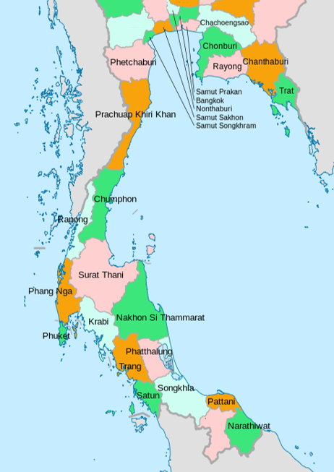

1
2
4
3
Intensity Rank: Represents areas with the highest concentration of risk, where dense populations and critical economic assets face high-impact climate events.
Magnitude Rank: Represents areas with the broadest scale of impact, focusing on extensive geographical exposure, loss of natural resources, and long-term ecosystem degradation across coastal provinces.
High-vulnerability southern pockets: Areas where persistent poverty and sole reliance on natural resources severely limit climate adaptive capacity.
5
5
4
Intensity rank
x
x
Magnitude rank
High-vulnerability southern pockets
1
3
2

Slide 8
How Risks Have Changed Since 2000
From sectoral → interconnected risks
From local → transboundary impacts
From single pressures → cumulative stress

Slide 9
II. How does these areas of risk and vulnerability as assessed in year 2025 differ from the National TDA Report 1.0 (year 2000)?
Risk Category | TDA 2000 | TDA 2025 | Risk Type 2025 | Priority Concern 2025
Climate-related risks | Climate change impacts were not explicitly addressed as a core risk driver. | Climate change now acts as a systemic risk driver, intensifying flooding, erosion, marine heat stress, and extreme events, and interacting with social, ecological, and economic vulnerabilities | Global | Very high
Socioeconomic exposure and vulnerability | Early stages of coastal urbanization and development pressure | Highly concentrated populations and economic assets in coastal megacities and industrial corridors (e.g. Bangkok and EEC) increase vulnerability to high-impact climate events | | National | Very high
Livelihood dependence and poverty | Resource dependence and rural poverty were recognized, but were largely treated separately from broader environmental and climate-related risks. | Persistent poverty and fisheries-dependent livelihoods in southern coastal provinces face compounded climate and ecosystem risks | National | Very high
Land-based pollution (legacy risk) | Pollution from land-based sources was recognized, with emphasis on nutrients, wastewater, and industrial effluents. | Nutrient loading, wastewater discharge, and sedimentation have intensified and now interact with climate stress, resulting in cumulative degradation of nearshore and estuarine ecosystems. | Transboundary | High
Emerging marine pollution | Marine debris and oil spill risks were not explicitly recognized. | Marine debris (plastics, microplastics) and oil spill risks (2016, 2022,2023) have emerged as prominent and increasing transboundary pressures affecting coastal and marine ecosystems | Transboundary | High

Slide 10
Risk Category | TDA 2000 | TDA 2025 | Risk Type 2025 | Priority Concern 2025
Climate change and sea-level rise | Climate change impacts were not explicitly addressed in ecosystem risk assessments | Climate change and sea-level rise now act as systemic drivers that intensify coastal erosion, habitat degradation, and ecosystem vulnerability across mangroves, seagrasses, and coral reefs. | Global | Very high
Coral reef degradation | Coral reef degradation was recognised, largely associated with local pressures and fisheries impacts. | Nearshore coral reefs experience compounded stress from pollution, sedimentation, and marine heatwaves, while offshore reefs function as partial climate refugia. | Transboundary | HIGH
Mangrove degradation and loss | Mangrove loss and conversion were recognised, primarily linked to coastal development and land-use change | Mangroves are increasingly fragmented and degraded by coastal development, altered sediment flows, and climate stress, reducing coastal protection, nursery functions, and ecosystem resilience. | National - | High
Seagrass degradation | Seagrass decline was recognised but received limited policy and management attention | Seagrass meadows are increasingly degraded by coastal development, sedimentation, declining water quality, and climate stress, affecting fisheries productivity and dugong habitats. | National | High
Loss of ecological connectivity (emerging ecosystem risk) | Ecological connectivity was not explicitly recognized in ecosystem assessment | Loss of connectivity between mangroves, seagrasses, and coral reefs undermines larval dispersal, fisheries productivity, and ecosystem resilience, highlighting a transboundary ecosystem risk. | Transboundary | High

Slide 11
II. How does these areas of risk and vulnerability as assessed in year 2025 differ from the National TDA Report 1.0 (year 2000)? ….(Cont.)
Risk Category | TDA 2000 | TDA 2025 | Risk Type 2025 | Priority Concern 2025
Fisheries overexploitation and stock depletion | Overfishing and declining stocks were identified as core problems, primarily framed as national fisheries management issues. | Stock depletion persists and is increasingly compounded by habitat degradation (mangroves, seagrasses, coral reefs) and climate variability, with several fish stocks exhibiting transboundary dynamics requiring regional cooperation. | Transboundary | High
Ecosystem-linked fisheries productivity | Fisheries risks were mainly assessed through catch trends and fishing effort, with limited integration of ecosystem condition. | Degradation of nursery and spawning habitats, declining water quality, and climate stress now directly undermine fisheries productivity and resilience, linking fisheries risks to broader ecosystem and climate dynamics. | National- | High
Governance context (Cross-cutting) | Limited institutional capacity and sectoral management approaches | Governance challenges have shifted from capacity limitations to managing cumulative, cross-sectoral, and transboundary risks across coastal and marine systems | National-transboundary | High

Slide 12
Key Risk Interactions
socio + pollution + ecosystem + fisheries)
Coastal population and asset concentration
Pollution and habitat degradation reinforce each other
Fisheries productivity linked to ecosystem condition and climate variability
Notes:
.”

Slide 13
Existing Governance Capacities
Legal and policy frameworks exist
Sectoral institutions and programmes are in place.

Slide 14
III. How does the current governance capacity address and mitigate the assessed risks?
Risk Category | Governance capacity: addressing and mitigation measures
Climate change and sea-level rise | Climate governance is supported by a multi-level policy framework, including the 20-Year National Strategy, the 13th National Economic and Social Development Plan, and national climate change and adaptation plans. These frameworks promote climate-resilient development, disaster risk reduction, and alignment with international climate commitments.
Socioeconomic exposure and vulnerability | Socioeconomic risks are addressed through national development planning, social protection programmes, and decentralised local governance mechanisms. These include poverty reduction strategies, livelihood support schemes, and local disaster preparedness and response arrangements in coastal and vulnerable communities.
Land-based pollution (legacy risk) | Marine and coastal pollution governance is underpinned by national environmental legislation and regulatory frameworks led by the Pollution Control Department and relevant sectoral agencies. These include water quality standards, wastewater effluent controls, and pollution monitoring systems for rivers, estuaries, and coastal waters.
Emerging marine pollution (marine debris and oil spills) | Governance capacity to address emerging marine pollution risks includes national solid waste management policies, plastic pollution reduction initiatives, and oil spill preparedness and response mechanisms. These are supported by inter-agency coordination arrangements and regional cooperation frameworks for marine pollution incidents.

Slide 15
III. How does the current governance capacity address and mitigate the assessed risks? (Cont.)
Risk Category | Governance capacity: addressing and mitigation measures
Mangrove ecosystems | Mangrove governance capacity is provided through DMCR-led conservation, restoration, and monitoring programmes, supported by legal protection measures, coastal zoning, and community-based mangrove management initiatives aimed at maintaining coastal protection and nursery functions.
Seagrass ecosystems | Seagrass governance capacity includes habitat monitoring, protection, and restoration programmes led by DMCR and partner agencies, as well as integration with marine protected areas, species conservation initiatives, and environmental impact assessment processes for coastal development.
Coral reef ecosystems | Coral reef governance capacity is supported by marine protected areas, reef monitoring and restoration programmes, tourism management measures, and ecosystem-based management approaches aimed at reducing local pressures and enhancing reef resilience.
Ecological connectivity | Governance mechanisms supporting ecological connectivity include integrated coastal management, marine spatial planning initiatives, habitat network planning, and regional collaboration frameworks that promote ecosystem-based and transboundary approaches to coastal and marine conservation.
Fisheries | Fisheries governance capacity is provided through the Fisheries Management Policy and Plan (2023–2027), the Royal Ordinance on Fisheries and its amendments, and the adoption of ecosystem-based fisheries management. These are complemented by monitoring, control, and surveillance systems and regional cooperation mechanisms to address shared and transboundary fish stocks.
Governance (Overall framework) | Overall, coastal and marine governance capacity is anchored in a comprehensive legal and institutional framework, supported by inter-agency coordination mechanisms, stakeholder participation platforms, and alignment with regional and global marine governance commitments.

Slide 16
Governance Gaps
Strategic gaps: limited policy integration
Operational gaps: uneven implementation capacity
Systemic gaps: scale and coordination mismatches

Slide 17
IV. What are the major gaps in governance?
Theme | Strategic gaps | Operational/institutional gaps | Systemic gaps
Climate change and sea-level rise | Climate adaptation and disaster risk reduction policies are not fully integrated into coastal and marine sectoral planning and investment decisions. | Limited translation of national climate and adaptation strategies into locally tailored, ecosystem-specific actions and financing mechanisms. | Fragmented coordination between climate, coastal, marine, and disaster management institutions constrains integrated and anticipatory risk management.
Socioeconomic exposure and vulnerability | Socioeconomic vulnerability is insufficiently integrated into coastal and marine risk assessments and planning frameworks. | Limited capacity of local governments and community institutions to address livelihood vulnerability, poverty, and disaster preparedness in high-risk coastal areas. | Structural inequalities and uneven development across regions exacerbate differential exposure and adaptive capacity.
Land-based pollution (legacy risk) | Pollution control policies are not fully aligned with integrated land–sea management and watershed-to-coast planning approaches. | Insufficient wastewater treatment capacity, uneven enforcement, and limited financial resources for pollution control at subnational levels. | Fragmented governance across land, water, and coastal jurisdictions weakens cumulative pollution management.
Emerging marine pollution (marine debris and oil spills) | Strategic frameworks for marine debris and oil spill risk prevention and preparedness remain fragmented and unevenly prioritised. | Gaps in monitoring, response capacity, and coordination for marine debris management and oil spill preparedness, particularly at local and regional levels. | Transboundary nature of marine debris and oil spills is not matched by sufficiently robust regional governance and financing mechanisms.

Slide 18
IV. What are the major gaps in governance? (Cont.)
Theme | Strategic gaps | Operational/institutional gaps | Systemic gaps
Coastal habitats (mangroves, seagrasses, coral reefs) | Habitat conservation and restoration policies are not consistently integrated across development, fisheries, tourism, and climate agendas. | Limited capacity for large-scale, long-term habitat restoration, monitoring, and enforcement, particularly in nearshore and multi-use areas. | Weak land–sea integration and fragmented institutional mandates undermine ecosystem-based and connectivity-focused management.
Ecological connectivity | Connectivity considerations are not systematically incorporated into marine spatial planning, protected area design, and fisheries management frameworks. | Limited data, tools, and coordination mechanisms to operationalise connectivity across habitats and jurisdictions | Transboundary ecological processes are insufficiently addressed by nationally bounded planning and management systems
Fisheries | Fisheries management strategies remain insufficiently integrated with ecosystem condition, climate variability, and habitat conservation objectives. | Constraints in monitoring, control, and enforcement capacity, particularly for small-scale and transboundary fisheries. | Mismatch between the spatial scale of fish stocks and the jurisdictional scale of fisheries governance limits effective management of shared resources. |
Governance (Overall) | Lack of a coherent, cross-sectoral governance framework to address cumulative and interconnected coastal and marine risks. | Institutional silos, overlapping mandates, and limited coordination mechanisms reduce policy coherence and implementation effectiveness | Governance systems remain poorly aligned with the complex, cross-scale, and transboundary nature of contemporary coastal and marine risks.

Slide 19
From Gaps to Responses
8 Risk Themes → 5 Strategic Response Areas
Integrated response bundles
Focus on alignment and coordination

Slide 20
Strategic Responses
Socioeconomic resilience
Pollution control and land–sea integration
Ecosystem-based and connectivity-focused management
Strategic Responses
Fisheries reform
Cross-cutting governance integration
Climate as a Cross-Cutting Driver
Climate change and sea-level rise affect all sectors
Climate responses are mainstreamed across all strategic areas

Slide 21
V. What are strategic recommendations to improve governance of transboundary environmental problems and closing gaps in Item IV.
Theme | Strategic responses | Operational/institutional responses | System responses
Socioeconomic | Integrate climate adaptation and disaster risk reduction into all stages of national development planning, budgeting, and implementation, including the 13th National Economic and Social Development Plan. | Strengthen applied risk assessment, early warning systems, and regional data-sharing mechanisms through collaboration with ASEAN and international meteorological and disaster-risk platforms | Reorient institutional structures and budget priorities toward proactive risk reduction and prevention, using risk assessment evidence to justify long-term resilience investments.
 | Promote differentiated, area-based adaptation strategies that distinguish between high-intensity economic hubs and large-scale resource-dependent areas, with tailored policy and investment priorities | Enhance inter-ministerial and local government coordination to support area-based adaptation and targeted livelihood resilience programmes. | Mainstream ocean literacy and risk awareness into education, public communication, and stakeholder engagement frameworks.
Pollution | Adopt integrated land–sea and watershed-to-coast pollution management frameworks aligned with national water quality and coastal management strategies. | Prioritise investment in decentralised wastewater treatment and solid waste management systems in high-risk coastal municipalities. | Develop sustainable financing mechanisms for pollution control, including alignment of green and blue finance with national pollution priorities.
 | Establish a national nutrient pollution reduction strategy for coastal waters, supported by clear targets and monitoring protocols. | Strengthen enforcement of plastic reduction measures, including accelerated implementation of Extended Producer Responsibility (EPR) schemes. | Enhance regional and transboundary cooperation mechanisms to address shared pollution pathways and marine pollution risks.

Slide 22
V. What are strategic recommendations to improve governance of transboundary environmental problems and closing gaps in Item IV. (Cont.)
Theme | Strategic responses | Operational/institutional responses | System responses
Ecosystem | Institutionalise ridge-to-reef and ecosystem-based management approaches linking watershed, coastal, and marine planning. | Develop harmonised ecosystem indicators and shared monitoring platforms to support risk assessment, early warning, and adaptive management. | Protect transboundary ecological connectivity through regional networks of MPAs and OECMs, including climate refugia and migratory corridors.
 | Harmonise national ecosystem governance with regional and international frameworks (e.g. SCS SAP, ASEAN, COBSEA, BBNJ). | Scale up community-based co-management and cross-border stakeholder partnerships to strengthen ecosystem stewardship. | Integrate natural capital and blue carbon valuation into national accounts, investment decisions, and regional financing mechanisms.
Fisheries | Strengthen ecosystem-based fisheries management by integrating habitat condition, climate variability, and stock dynamics into fisheries policy and planning. | Enhance fisheries assessment and monitoring systems, including improved stock assessments, effort indicators, and gear efficiency monitoring. | Develop regional cooperation mechanisms for shared fish stocks, including joint assessments, harmonized management measures, and regional fisheries management planning.
 | Promote equitable management frameworks for small-scale and commercial fisheries, aligned with the FAO Voluntary Guidelines for Securing Sustainable Small-Scale Fisheries. | Strengthen monitoring, control, and surveillance capacity for domestic and transboundary fisheries. | Address governance scale mismatches between fish stock dynamics and jurisdictional boundaries.
Governance (Overall) | Prioritise cross-sectoral and multi-level governance integration through strengthened coordination mechanisms, clear mandates, and accountability arrangements. | Establish interoperable risk information, monitoring, and reporting systems to support evidence-based decision-making | Align national governance systems with the cross-scale and transboundary nature of coastal and marine risks through sustained regional cooperation and institutional reform.
 | Embed risk-informed and adaptive governance principles across coastal and marine policy frameworks. | Strengthen operational regional platforms for data-sharing, joint monitoring, and coordinated implementation under SAP-related mechanisms.

Slide 23
Key Takeaways & Way Forward
Risks are cumulative and interconnected
Governance must match the scale and complexity of risks
Integrated responses provide a pathway to SAP development

Slide 24
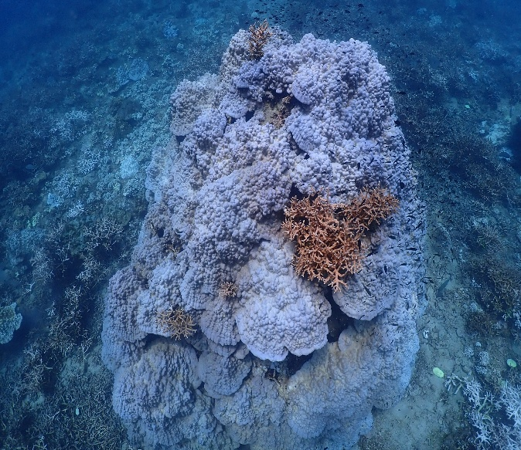
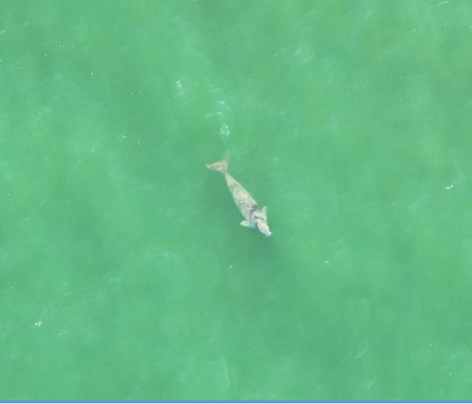

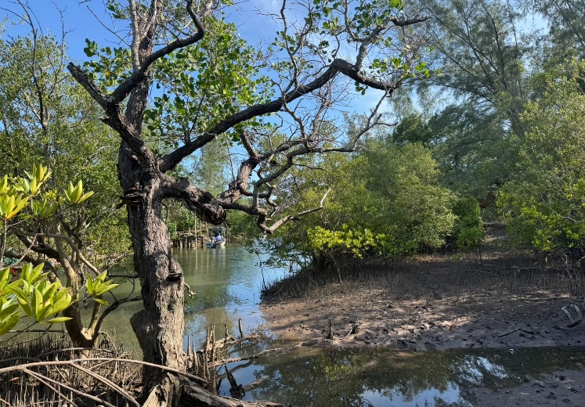
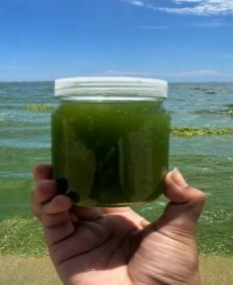
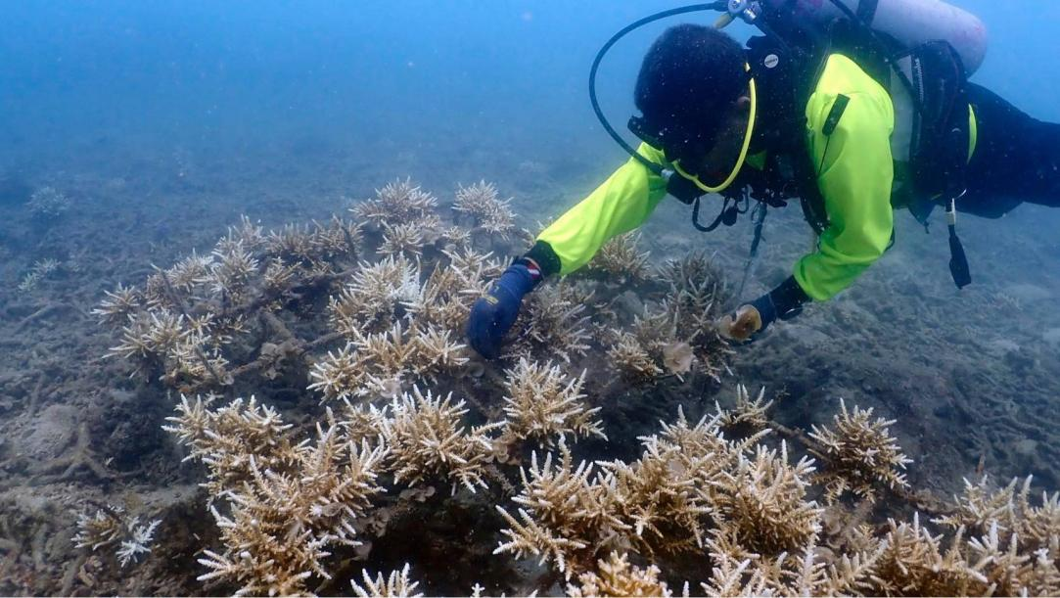
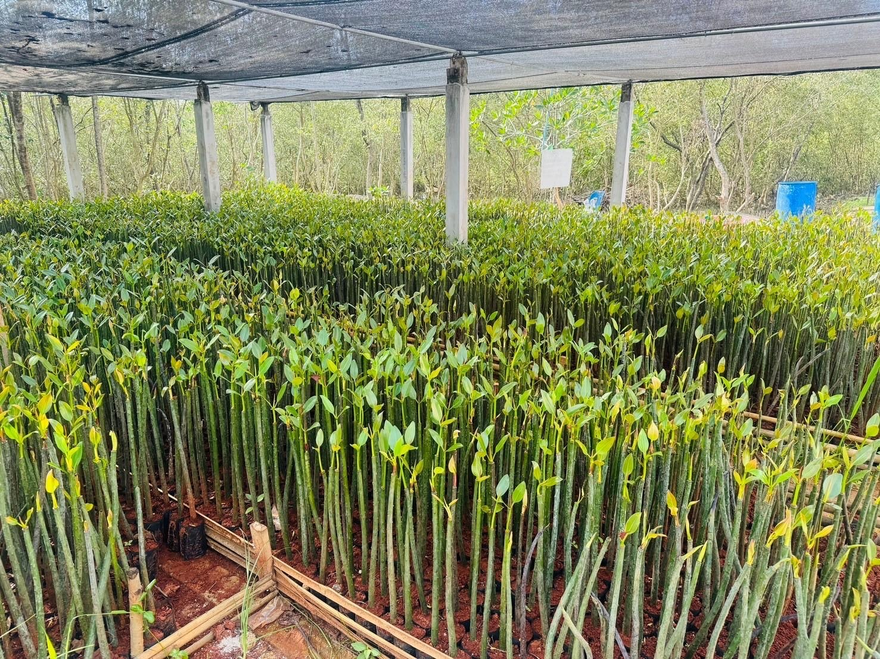
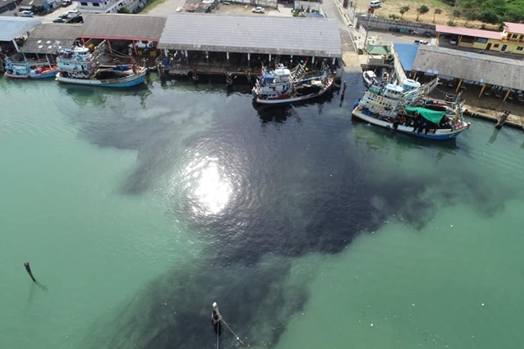
THANK YOU
WWW. DMCR.GO.TH
https://www.facebook.com/DMCRTH

