Slide 1
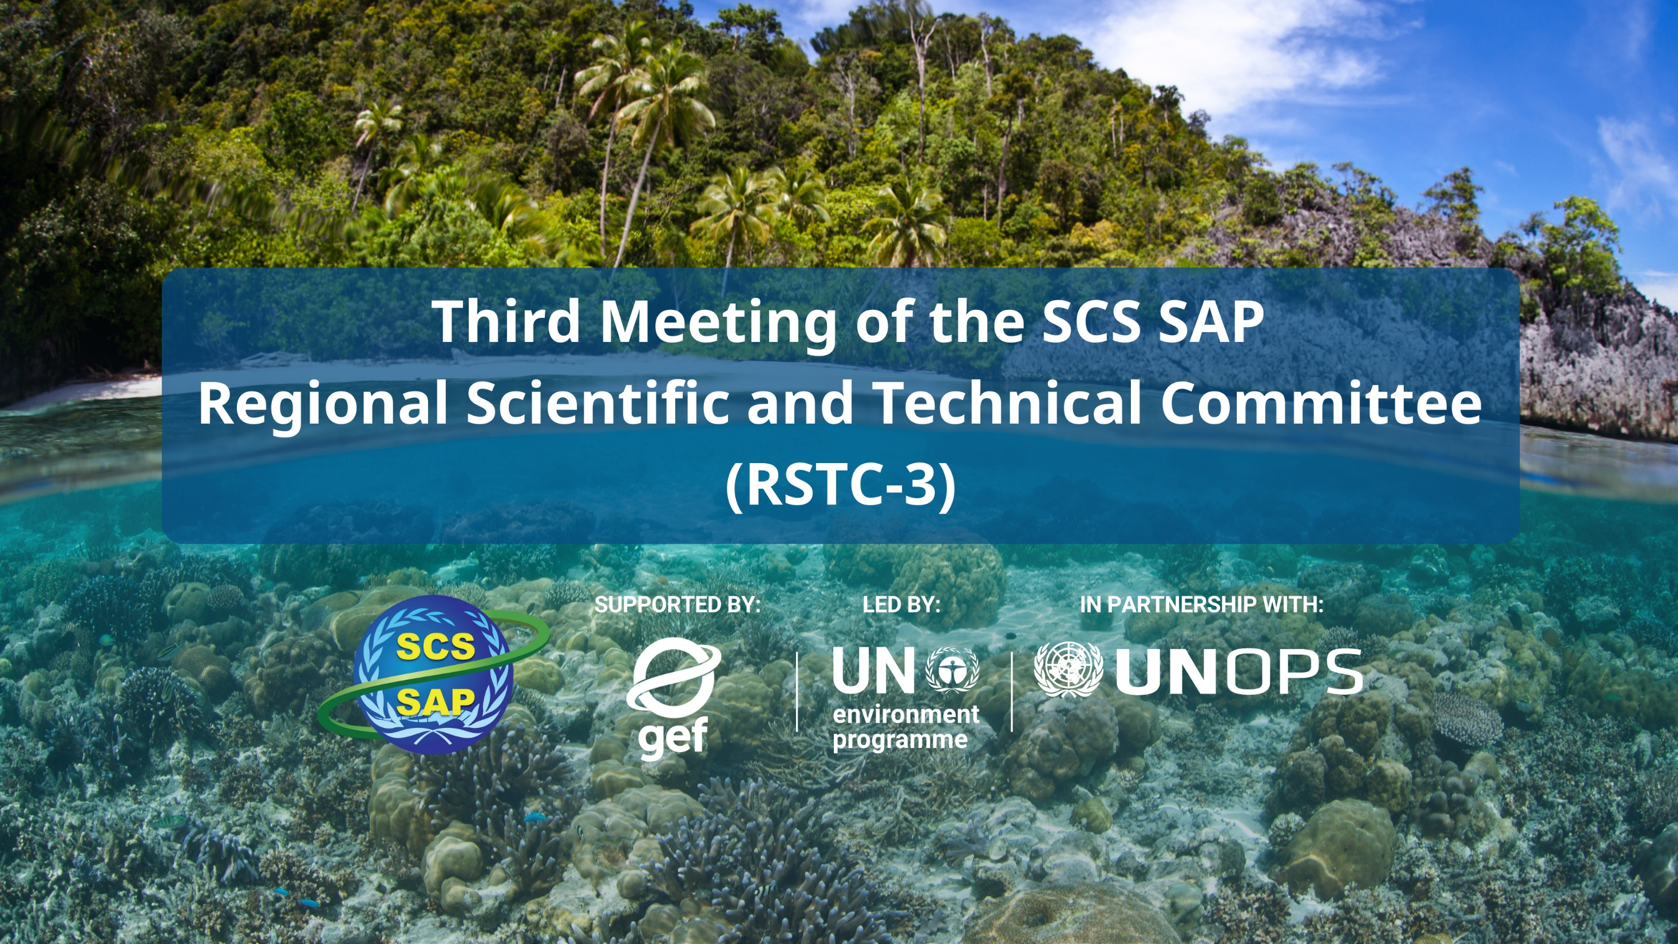




SUPPORTED BY LED BY IN PARTNERSHIP WITH

Slide 2
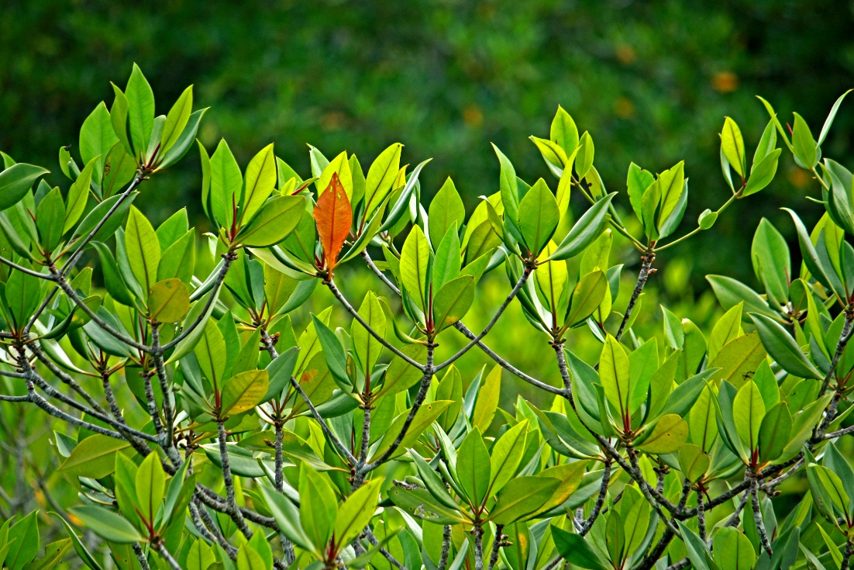
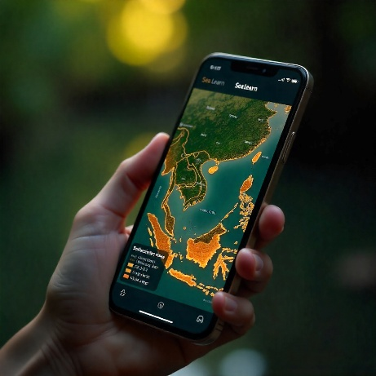
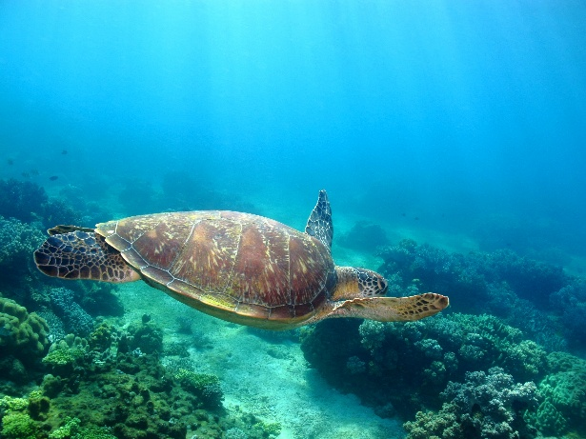
RSTC3 Meeting
26-28 Jan 2026
Phú Quốc
YOUR PRESENTATION’S
TITLE GOES HERE
By: Name of presenter

Slide 3
COUNTRY TDA REPORT PRESENTATION OUTLINE
Presenters are advised to keep to the time limit and to provide ONLY KEY MESSAGES, since the written reports will be circulated four (4) weeks prior to the meeting. Participants are advised to read the documents prior to the meeting.
RSTC3 Meeting
26-28 Jan 2026
Phú Quốc
1. Key thematic/geographic areas of risk and vulnerability because of:
1.1 Exposure to climate change impacts
1.2 Exposure of populations and livelihoods to climate and other environmental impacts
1.3 Ecosystem exposure to climate and exploitation
1.3.1 System state mediated by pollution (e.g. nutrients, plastics, other pollutants)
1.3.2 System states manifested by coastal habitats (coral reefs, seagrasses, mangroves, wetlands)
1.3.3 System states manifested by fisheries and aquaculture
2. How does these areas of risk and vulnerability as assessed in year 2025 differ from the National TDA Report 1.0 (year 2000)?
2.1 Which of these risks are considered transboundary? Which are national? which of these are considered priority concerns?
2.2 Difference/s in perceived importance
2.3 Difference/s in perceived severity
2.4 Difference/s in perceived impacts on people and livelihoods, and ecosystem health
3. How does the current governance capacity address and mitigate the assessed risks?
3.1 Climate risks
3.2 Risks to people and livelihoods
3.3 Risks of pollution
3.4 Risks of coastal habitat deterioration
3.5 Risks of impacted fisheries and aquaculture

Slide 4
COUNTRY TDA REPORT PRESENTATION OUTLINE
Presenters are advised to keep to the time limit and to provide ONLY KEY MESSAGES, since the written reports will be circulated four (4) weeks prior to the meeting. Participants are advised to read the documents prior to the meeting.
RSTC3 Meeting
26-28 Jan 2026
Phú Quốc
3. How does the current governance capacity address and mitigate the assessed risks?
3.1 Climate risks
3.2 Risks to people and livelihoods
3.3 Risks of pollution
3.4 Risks of coastal habitat deterioration
3.5 Risks of impacted fisheries and aquaculture
4. What are the major gaps in governance?
5. What are strategic recommendations to improve governance of transboundary environmental problems and closing gaps in Item 4.

Slide 5
RSTC3 Meeting
26-28 Jan 2026
Phú Quốc

Slide 6
RSTC3 Meeting
26-28 Jan 2026
Phú Quốc

Slide 7
RSTC3 Meeting
26-28 Jan 2026
Phú Quốc

Slide 8

THANK YOU
REPLACE WITH YOUR WEBSITE
REPLACE WITH YOUR SOCIAL MEDIA, IF ANY

