Slide 1
Scale: Large marine ecosystem: South China Sea, Gulf of Thailand
Environmental issues: Transboundary, Shared national issues
Action options: Next slides
Themes | Pollution | Ecosystems | Fisheries
 | Nutrient pollution | Coral reefs | Overharvest
 | Plastics | Mangroves | IUU
 | Pulsed loading because of extreme events | Seagrasses
 |  | Tidal wetlands
Cross-cutting themes
Climate change Adaptation to minimize people’s vulnerability to extreme events Mitigation
Gender equity and social inclusion Promote gender equality in environmental governance Ensure inclusive community participation in decision making
Governance Effective and efficient regional coordination to support SAP implementation Effective financing to support SAP implementation

Slide 2
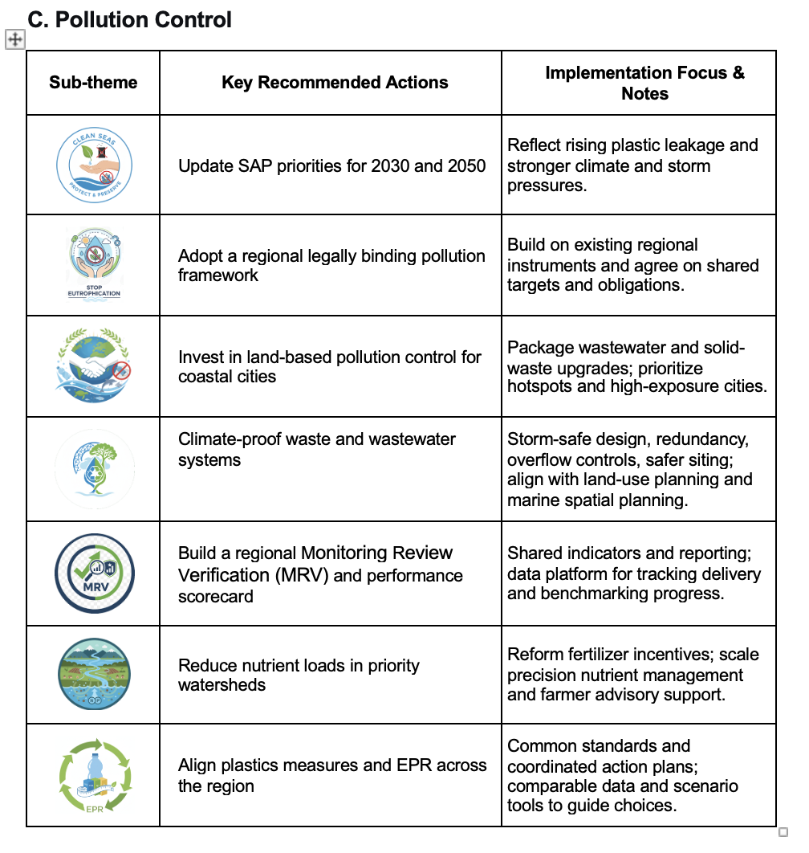

Slide 3
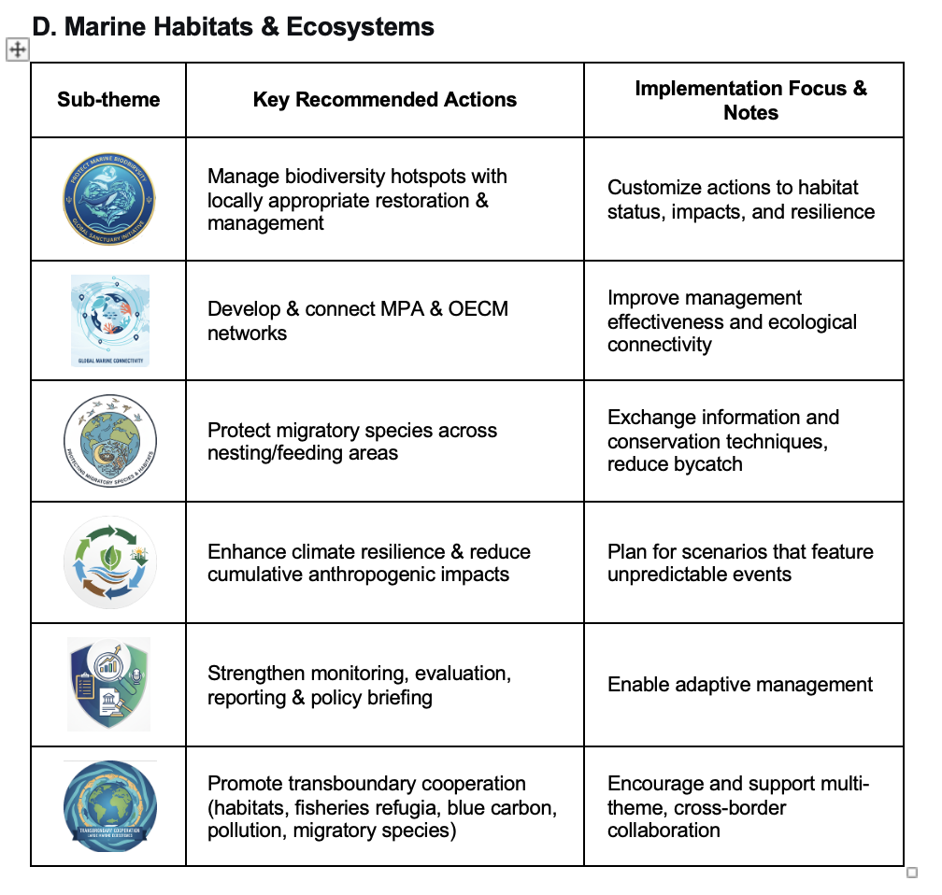

Slide 4
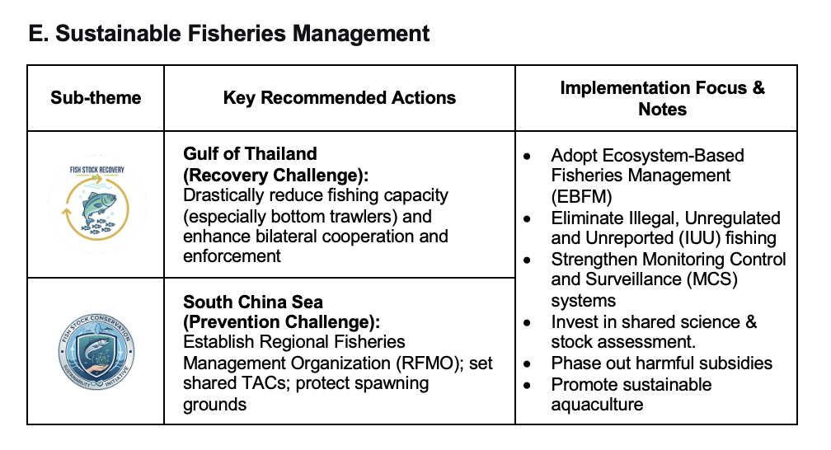

Slide 5
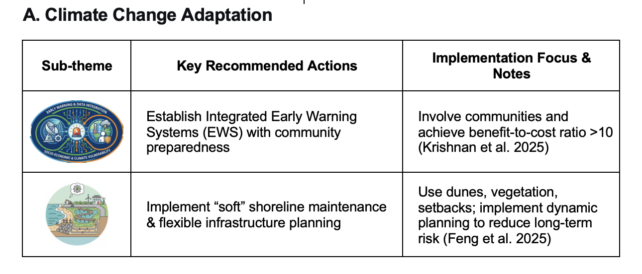

Slide 6
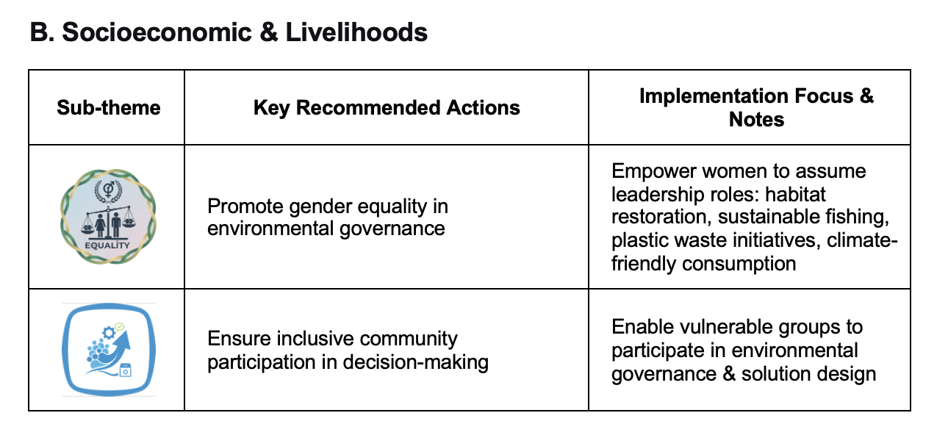

Slide 7
